Slide 1
Fiscal and Economic Issues
Discussion Group
October 2020

Slide 2
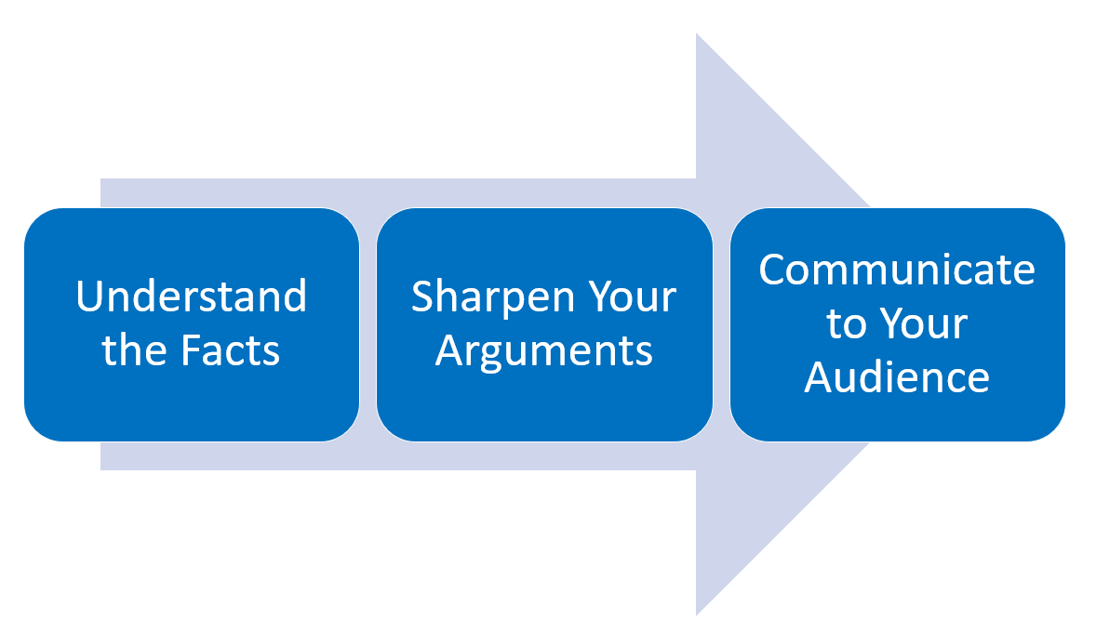
Fiscal Group: What We Ask of You
Slides and Video Available
http://www.nwsofa.org/resources/fiscal/

Slide 3
Topics
Labor Market
Economic Statistics
Budget Deficit & Debt
Illinois Fair Tax
Job Growth by President
Inequality
Biden’s Plans
Take Action

Slide 4
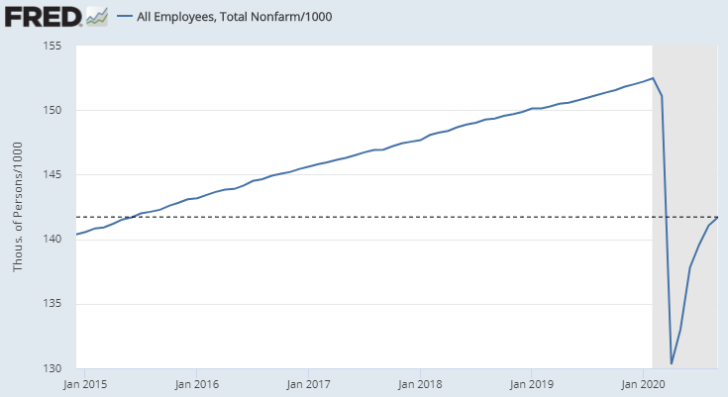
Jobs Are Back to June 2015 Level (Millions)
Current recession has erased 5 years of jobs gains
Down 3.9 million (2.7%) vs. level at inauguration in January 2017 and down 10.7 million (7.0%) vs. Feb 2020 peak
Feb Peak
152.5
# Millions
Jan 2017
145.6
Inauguration
Jun 2015
141.7
Sept 2020: 141.7
Up 661k vs. Aug
About 52% of lost jobs have been recovered vs. peak
Source: FRED
Jobs includes FT and PT, government and private

Slide 5
BLS: Employment Change by Industry in 000s (Feb vs. Sept)
Feb to Sept:
Total -10.7 million
Govt jobs down 942k in Sept, driven by local gov.

Slide 6
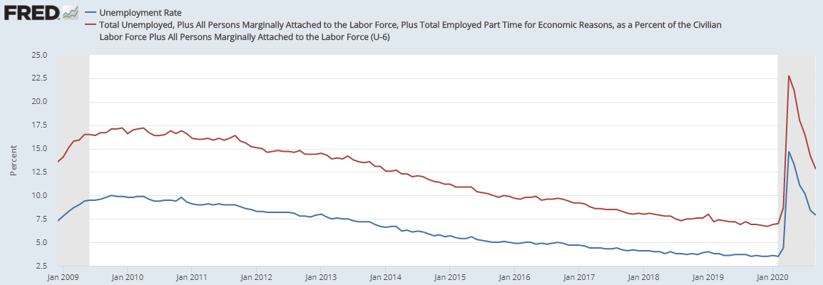
Unemployment Rates
U-6 rate was 9.2% in January 2017; it has increased to 12.8%
U-3 rate was 4.7% in January 2017; it has increased to 7.9%
Obama
Trump
U-6
Sept
12.8%
Down 1.4%
vs. Aug
U-3
9.2%
7.9%
Down 0.5%
4.7%
Previous record 10.2% (Nov 1982) under Reagan, excluding Great Depression (~25%)
FRED: “The BLS defines marginally attached workers as persons who are not in the labor force, want and are available for work, and had looked for a job sometime in the prior 12 months. They are not counted as unemployed [DD: per U-3 rate] because they had not searched for work in the prior 4 weeks, for any reason whatsoever. The marginally attached are a group that includes discouraged workers.”
FRED: “Persons employed part time for economic reasons are those working less than 35 hours per week who want to work full time, are available to do so, and gave an economic reason (their hours had been cut back or they were unable to find a full time job) for working part time. These individuals are sometimes referred to as involuntary part-time workers.”

Slide 7
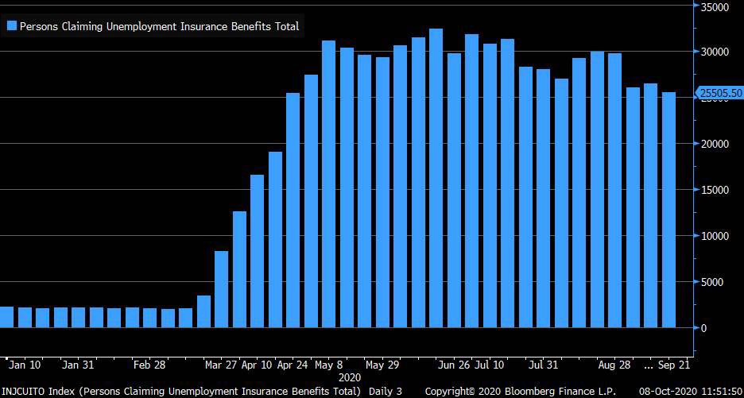
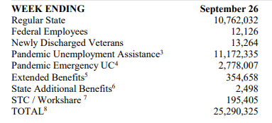
Persons Claiming Unemployment Benefits at 25.3 Million As of 9/26 (Oct 15th Report)
DOL: Unemployment Insurance Weekly Claims 10/15
Source: Liz Ann Sonders (Economist) via Twitter

Slide 8
Topics
Labor Market
Economic Statistics
Budget Deficit & Debt
Illinois Fair Tax
Job Growth by President
Inequality
Biden’s Plans
Take Action

Slide 9
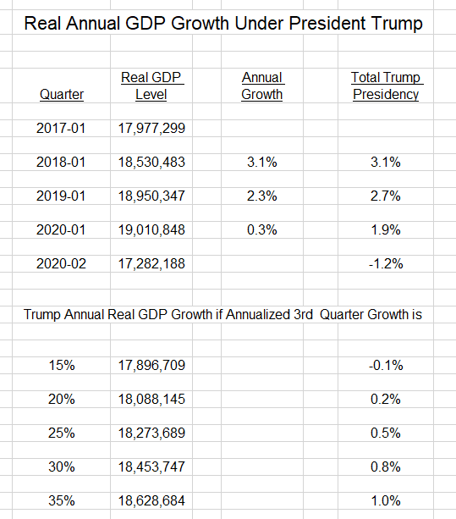
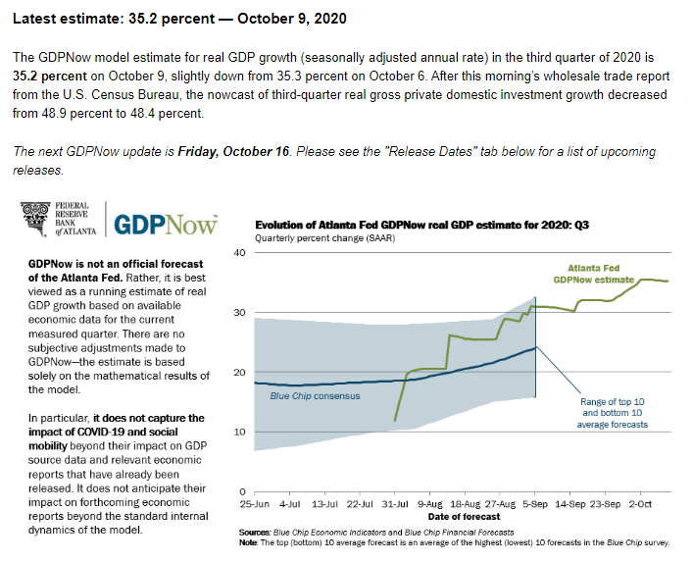
Real GDP Growth Under Different Q3 Scenarios
Trump through 2019-04 = 2.5%

Slide 10
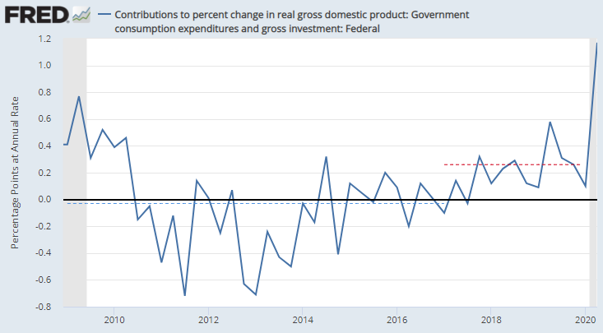
Contribution to % Change in Real GDP: Federal Spending
Trump’s additional spending added 0.26 percentage points to the growth rate 2017-2019.
GDP growth under Trump averaged about 2.5%; theoretically it would have been 2.24% absent this spending.
Obama kept the spending inherited flat through 2015, reducing GDP growth by 0.03 percentage points
GDP growth averaged 2.4%; theoretically it would have been 2.69% if he spent like Trump (2.4 + .03 + .26)
+0.26
-0.03

Slide 11
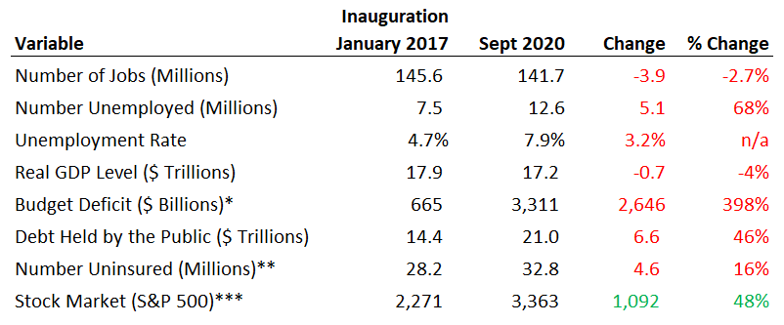
Are We Better Off Than We Were Four Years Ago?
*Budget deficit in fiscal year 2017 versus FY 2020 CBO estimate
**Uninsured level is full-year 2019; the current level is likely higher
***Stock market was up 78% for comparable period in Obama’s first term
Sources: CBO, Federal Reserve Economic Data (FRED), U.S. Treasury Dpt.

Slide 12
Candidate Trump Promises
Real GDP growth of 4-6%.
Didn't happen: 2.5% before Covid; now negative
Job growth of 25 million over 10 years, i.e. 2.5 million per year
Didn't happen: 2.2 million per year in first 3 year; now negative
Eliminate national debt in 8 years
Didn't happen: Deficit INCREASED from $587 billion to $984 billion before Covid
$3.1 trillion with Covid
Reduce/eliminate goods trade deficit
2016 = $735.3262 billion 2019 = $854.3706 billion
Increase manufacturing employment –
Plus 483,000 in Feb; Minus 164,000 now

Slide 13
Topics
Labor Market
Economic Statistics
Budget Deficit & Debt
Illinois Fair Tax
Job Growth by President
Inequality
Biden’s Plans
Take Action

Slide 14
Federal Budget Deficits: Actual vs. CBO Forecast Just Prior to Trump’s Inauguration
$ Billions
Source Data: CBO
Chart shows CBO 10-year forecast for federal budget deficits as of January 2017, versus what actually happened
CBO forecast assumed current law (Obama policies) would continue
Actual results shown for fiscal years 2017-2019; 2020 is preliminary
Budget deficits about 60% above forecast in 2018-2019, due mainly to Tax Cuts and Jobs Act and additional spending in 2018 and after
The 2020 deficit of $3.1 trillion due to coronavirus pandemic economic impact & response
2020 deficit of 15.2% GDP largest since 1945
CBO: “An Update to the Budget Outlook 2020 to 2030” (September 2, 2020)

Slide 15
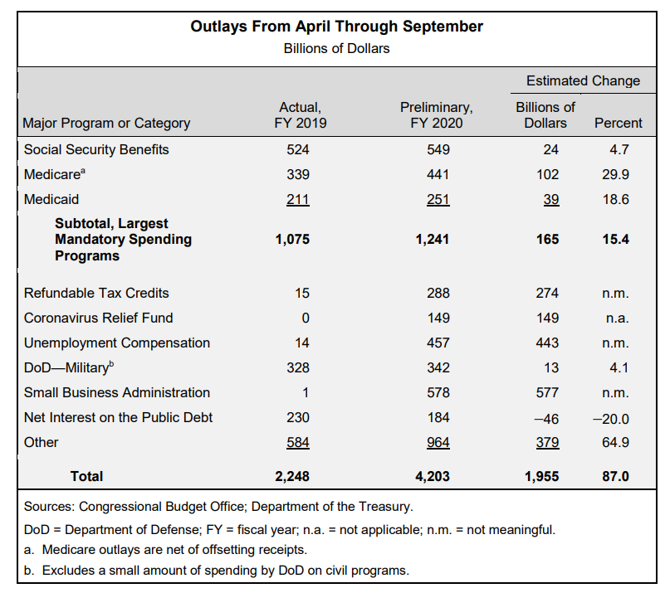
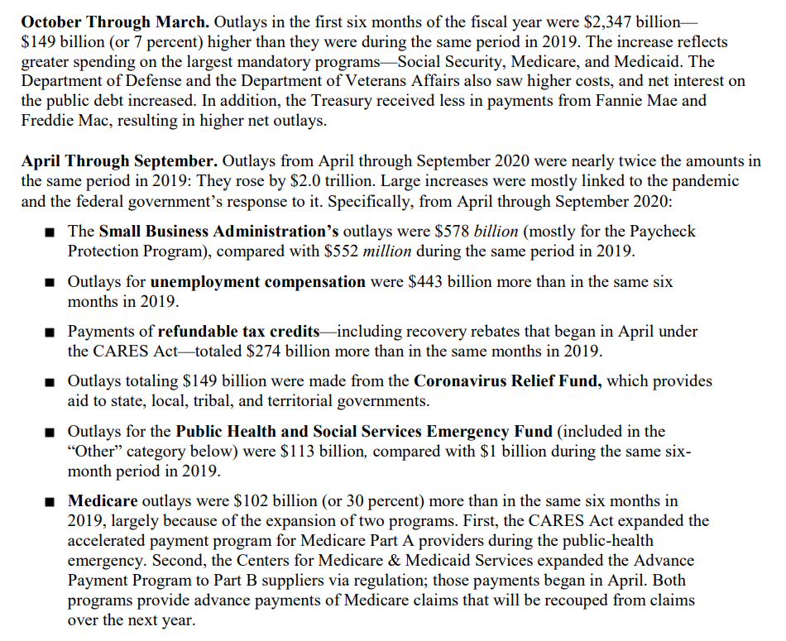
CBO: Outlays - April to September
Source: CBO Monthly Budget Review, September 2020

Slide 16
Topics
Labor Market
Economic Statistics
Budget Deficit & Debt
Illinois Fair Tax and Candidate Introductions
Job Growth by President
Inequality
Biden’s Plans
Take Action

Slide 17
Spending at the state level in Illinois is not high
https://www.kff.org/other/state-indicator/per-capita-state-spending/

Slide 18
Illinois State and Local Taxes are Regressive
https://itep.org/illinois/

Slide 19
Graduated Tax Rate Table
As of 2019, 43 states levied a tax on personal income. Of these 43 states, 11 had a flat income tax rate.
The flat rates ranged from 2.00% in Tennessee to 5.25% in North Carolina.
The remaining 32 states had graduated tax structures, with various numbers of brackets and ranges. New Hampshire and Tennessee taxed personal income derived from interest and dividends but not wages and salaries
https://ballotpedia.org/Illinois_Allow_for_Graduated_Income_Tax_Amendment_(2020)

Slide 20
Use the Fair Tax Calculator to See the Impact on Your Taxes
https://www2.illinois.gov/sites/gov/fairtax/Pages/default.aspx
Some examples:
Single, $50,000 income, $7,000 property taxes = $109 in savings
Married, $200,000 income, $20,000 in property taxes = $265 in savings
Married, $500,000 income, $40,000 in property taxes = $6,410 higher
Married, $1,500,000 income, $50,000 in property taxes = $45,600 higher
Married, $870,000,000 income, $50,000 in property taxes = $26,448,000 higher

Slide 21
Arguments
Argument Against Fair Tax | Response
1. Ransom Demands: “I won’t support the Fair Tax Amendment until IL does X” X = “Fixes its pension system” or “Non-partisan political map making” or “Term limits” or “Reduction in local govt. units.” | Ransom demands can be used for any negotiation and are not specific arguments about the best method of levying taxes. “I don’t want you to tax the rich more until you fix X, Y or Z” is a weak argument for the status quo. CT/Eric Zorn: “Even amending the constitution wouldn’t allow us to clear the many legal and political hurdles that are in the way of significantly trimming benefits now promised to public-sector retirees.”
2. “I want government to cut spending. Fair tax will encourage government to tax and spend more.” | State will require significantly more spending to address impact of COVID-19. CT - Ralph Martire: “State General Fund spending on services for the current fiscal year is $400 million less in non-inflation adjusted dollars than it was in fiscal 2009 at the end of the Great Recession…Illinois has the fifth largest economy and sixth largest population among the states, but ranks in the bottom third in spending on services per capita because of these consistent cuts.” The “starve the beast” idea is a myth at the federal level. Research shows increasing taxes may actually result in lower spending, as people “feel the pain” of higher taxes, in this case rich people. Clinton balanced the budget 1998-2001 after his tax hikes on the rich, and Obama had the deficit below historical average as % GDP in 2014-2015 after his tax hikes on the rich.
3. “Rich people will just leave the state” | Tax flight is minimal; no evidence of flight from graduated tax states People generally don’t leave their friends, family, and jobs behind because of moderate tax hikes Middle- and lower-income persons more likely to leave a state that can’t provide them benefits Why is the bottom 98% worried about moderate tax hikes on the rich, which give those in need more benefits?
4. “If we have graduated rates, legislature can raises taxes on us, one bracket at a time.” | Not happening in 32 other states with graduated systems CT: “ A similar analysis from the Center for Tax and Budget Accountability concluded that “states with graduated income taxes are more than twice as likely to cut taxes on the middle class as to raise them, (and have) cut taxes nearly two-and-a-half times more often than they have raised them on the middle class.”
Chicago Tribune: Eric Zorn “The top four arguments against the ‘fair tax’ and why they fail” (April 24, 2020)

Slide 22
Why a Pension Amendment Wouldn’t Lower Spending Much

Slide 23
Topics
Labor Market
Economic Statistics
Budget Deficit & Debt
Illinois Fair Tax
Job Growth by President
Inequality
Biden’s Plans
Take Action

Slide 24
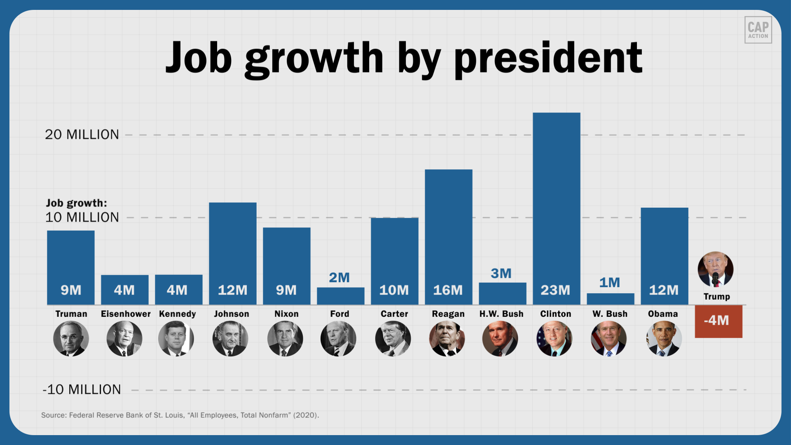
Job Creation by President: Totals
President Obama shared this on Twitter

Slide 25
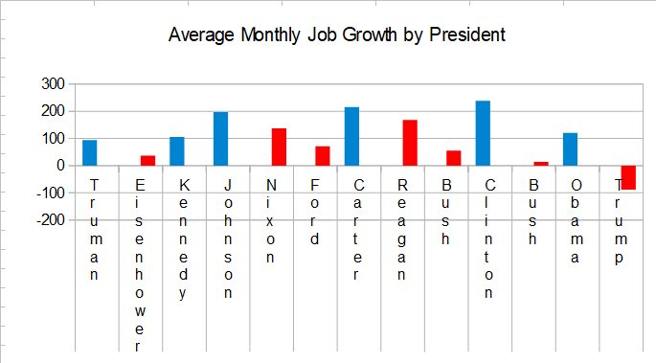
Job Creation by President: Monthly Average

Slide 26
Job Creation is 2.4x Faster Under Democratic Presidents (Truman to Trump)
Total Job Creation (Millions)
Monthly Avg. Job Creation (000’s)
Notes
6 Democrats in office for 429 months
7 Republicans in office for 475 months
Data through September 2020
Source: Washington Post: “Biden’s claim that Trump will be the first president with a negative jobs record” (October 2020)

Slide 27
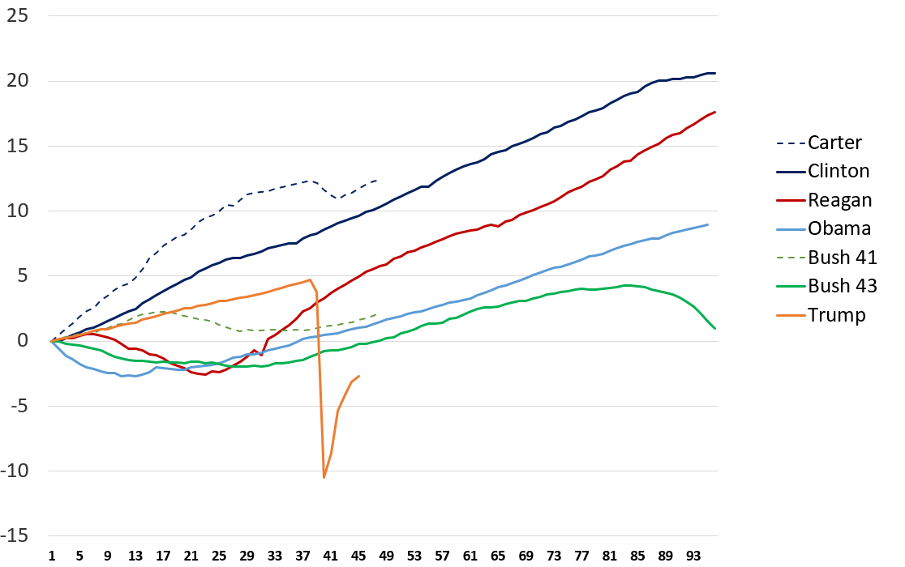
Job Creation by President: Cumulative % Increase
%
As of Sept 2020
3.9 million jobs (2.7%) below January 2017 level
10.7 million jobs (7.0%) below Feb 2020 peak
About 52% of lost jobs peak-trough regained
Months in Office Since Inauguration
Source: Federal Reserve Economic Data (FRED)

Slide 28
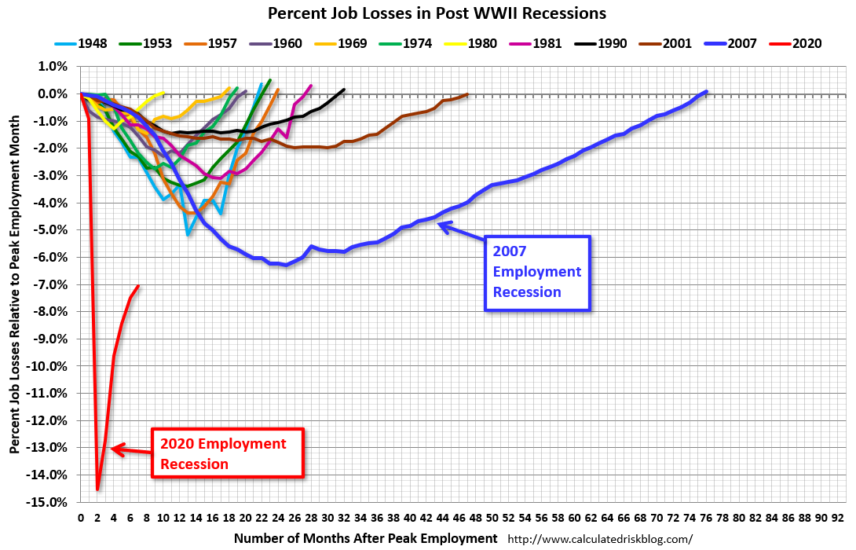
Employment Level: Recession Recoveries

Slide 29
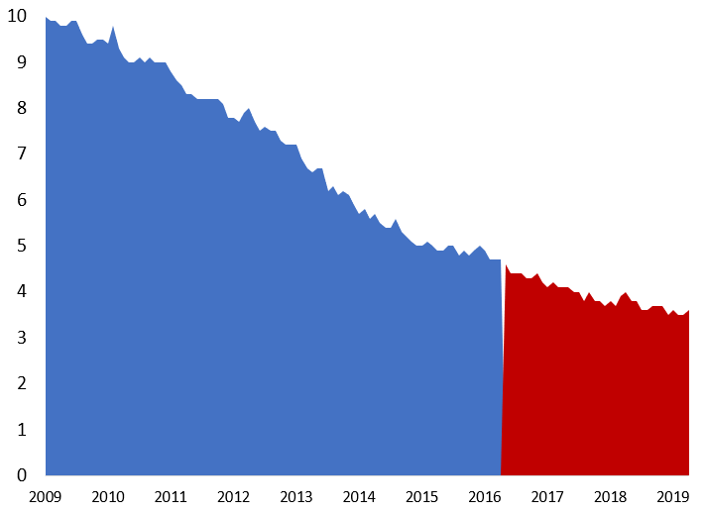
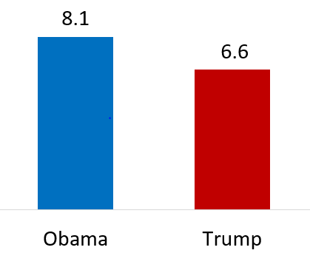
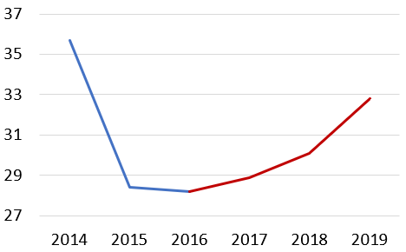
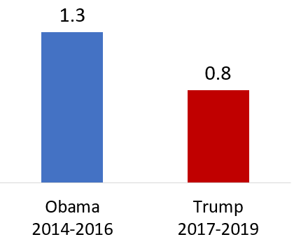
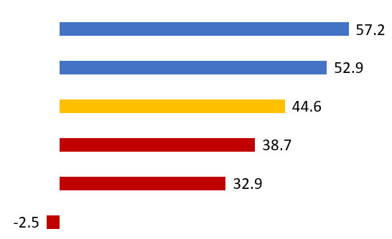
1. Job Creation (Millions)
Obama’s Last 36 Months vs.
Trump’s First 36 (Jan 2020)
2. Unemployment Rate %
3. Federal Budget Deficit
Source: U.S. Bureau of Labor Statistics
Fiscal Year | $ Billion | % GDP
Trump 2019 | $984 | 4.7%
Obama 2016 | $585 | 3.2%
Obama
Trump
Source: Congressional Budget Office
Source: U.S. Bureau of Labor Statistics
4. Number of Uninsured (Millions)
5. Cumulative Stock Market Return % S&P 500 Through Year 3
6. Real Wage Growth (Annual %)
32.8
Clinton
Obama
Trump
28.2
Bush Sr.
Reagan
Bush Jr.
Source: U.S. Centers for Disease Control & Prevention (CDC)
Source: Washington Post
Source: Federal Reserve Economic Data (FRED)

Slide 30
Topics
Labor Market
Economic Statistics
Budget Deficit & Debt
Illinois Fair Tax
Job Growth by President
Inequality
Biden’s Plans
Take Action

Slide 31
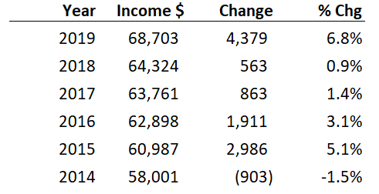
Real Median Household Income: Set Records Annually 2016 to 2019
Real median household income is one of the best measures of middle class prosperity
“Real” means adjusted for inflation, and “median” indicates half of households have income above and below this level
By using the median, we adjust for distortions in average (mean) income caused by very high income persons
Source: Census Bureau “Income and Poverty in the United States: 2019” Table C-1

Slide 32
CBO: Cumulative Growth in Real Average Income, 1979 to 2017 (In 2017 Dollars)
Before Taxes and Transfers
After Taxes and Transfers
Highest Quintile
+108%
+111%
+86%
+49%
+35%
Middle 3 Quintiles
Lowest Quintile
Source: CBO “The Distribution of Household Income, 2017” (Oct 2020)

Slide 33
CBO: Which Income Quintile Are You In? These are the Minimums For Each Group in 2017
Source: CBO “The Distribution of Household Income, 2017” (Oct 2020)

Slide 34
CBO: Share or Percent of Income Going to Top 1%
Inequality improved comparing 2007-2016, but began to worsen in 2017
The Trump Tax cuts should worsen after-tax inequality; effect will be visible in 2018 data
Market Income
Income After Taxes & Transfers
Market income is from labor, business & capital income before any government transfers
After-tax & transfer income is market income plus transfers, less taxes
Transfers include Social Security, Medicare, unemployment insurance, and worker’s comp.
1979 represents the pre-Reagan era of greater equality
2007 is the pre-crisis peak
2016 is last Obama year
2017 is latest CBO data
1979
2007
2016
2017
1979
2007
2016
2017
Source: CBO “The Distribution of Household Income, 2017” (Oct 2020)

Slide 35
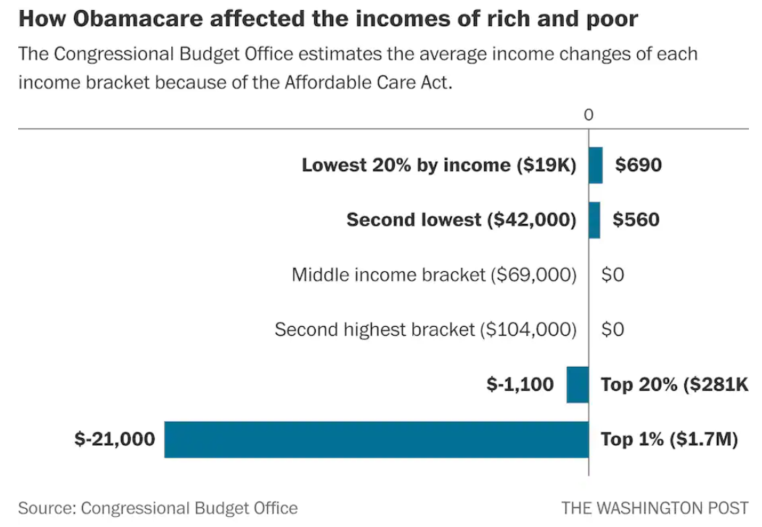
ACA Reduced Inequality
Avg Income = $281k
Mainly 96th to 99th paid more
Avg Income = $1.7M
WaPo: “Obamacare jacked up taxes on the 1 percent, gave $16 billion annually to poor” (March 28, 2018)

Slide 36
CBO: Share or Percent of Income Going to Middle Quintile (40th to 60th Percentile)
Market Income
Income After Taxes & Transfers
How much did the change in equality impact income, other things equal?
In 2017, the middle quintile family earned $61,700 market income, a 12.3% share. At the 1979 share of 15.9%, that would be $79,759, an increase of about $18,000.
After-taxes & transfers, the middle quintile family earned $68,000, a 14.5% share. At 1979 share of 16.4%, that would be an increase of about $8,900.
1979
2007
2016
2017
1979
2007
2016
2017
Source: CBO “The Distribution of Household Income, 2017” (Oct 2020)

Slide 37
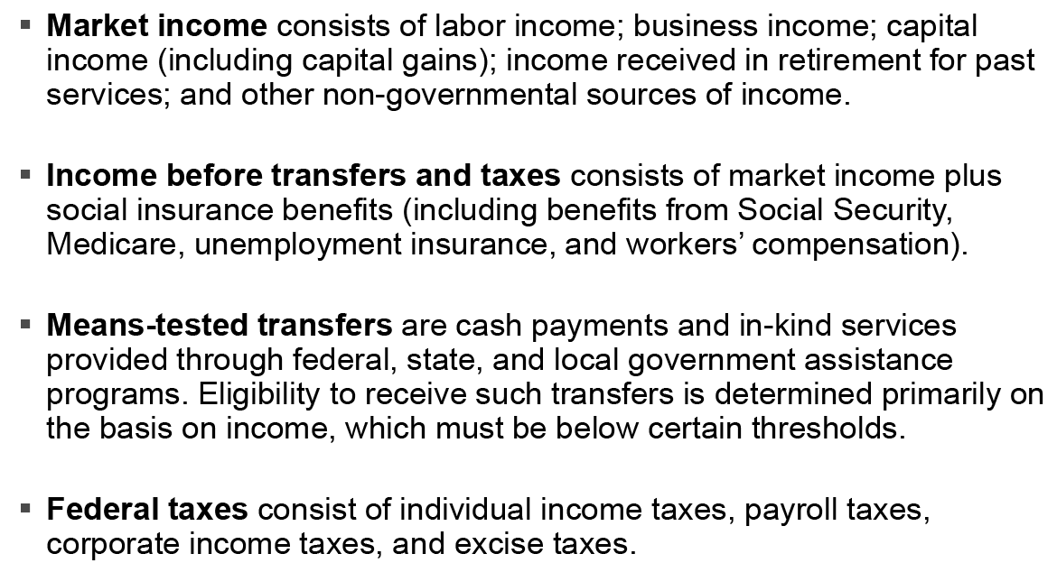
CBO Income Definitions
Source: CBO “The Distribution of Household Income, 2017” (Oct 2020)

Slide 38
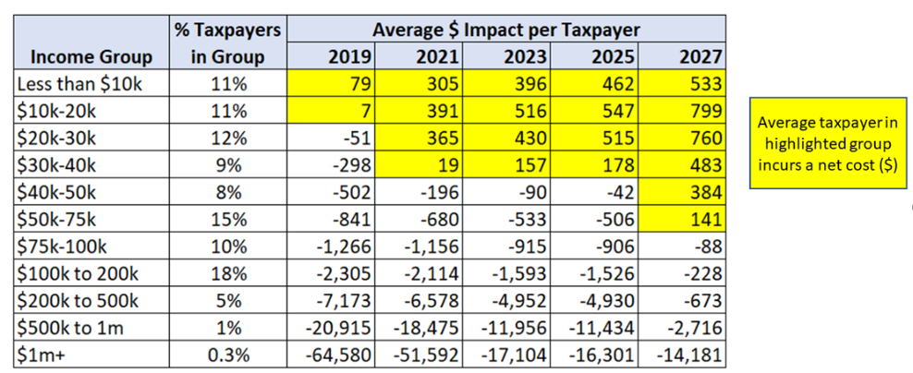
Distributional Impact of Trump Tax Cuts (2018 and Later)
CBO: “Overall, the combined effect of the change in net federal revenues and spending is to decrease deficits (primarily stemming from reductions in spending) allocated to lower-income tax filing units and to increase deficits (primarily stemming from reductions in taxes) allocated to higher-income tax filing units.”
CBO: “A decrease in federal deficits, such as an increase in taxes or a decrease in spending, is shown as a positive value. An increase in federal deficits is shown as a negative value.”
Most everyone got a tax cut, larger % cut for richer tax units
Poorer tax units adversely impacted by fewer insured receiving subsidies, as mandate eliminated
CBO: “Distributional Effects of Changes in Taxes and Spending Under the Conference Agreement for H.R. 1”
https://www.cbo.gov/system/files/115th-congress-2017-2018/reports/53429-distributionhr1.pdf

Slide 39
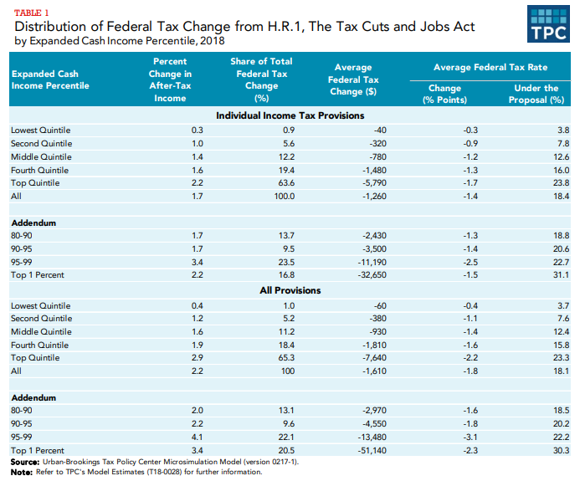
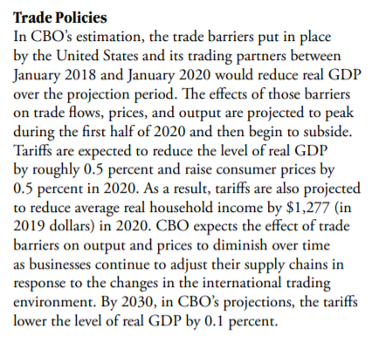
Income Inequality & Trump’s Tax Policies
CBO: Budget & Economic Outlook (Jan 2020)
Tax Policy Center: The Effect of The TCJA Individual Income Tax Provisions Across Income Groups and Across the States (March 2018)

Slide 40
Fed: Real Family Net Worth – Average and Median (2019 Dollars)
Average or Mean in 2019 was $749k
Median in 2019 was $122k
Half of Households Above and Half Below This Level
Source Data: Federal Reserve Survey of Consumer Finances – 2019 (Sep 2020)

Slide 41
Topics
Labor Market
Economic Statistics
Budget Deficit & Debt
Illinois Fair Tax
Job Growth by President
Inequality
Biden’s Plans
Take Action

Slide 42
Summary of Joe Biden’s Domestic Plans
Coronavirus / Covid-19
Pass $3 Trillion HEROES Act, to extend $600 UI benefits and fund state and local government (police, fire, teachers, etc.)
Shut downs where needed, as recommended by healthcare experts
National mask standard for indoor spaces outside of home
Expand testing and contact tracing (hire 100,000 to do so)
Hazard pay for essential workers
Expand Access to Affordable Healthcare
Reduce Medicare eligibility age from 65 to 60
Medicare-like public option, available to all
Expand eligibility for ACA subsidies
Allow Medicare to bargain for lower drug prices
Caregiving
Universal pre-K for 3 & 4 year-olds, via tax credits and subsidies, for families making under $125,000/year
Environment / Clean Energy
Clean energy investments of $2 trillion
Clean energy standard: No carbon production from electricity generation by 2035
Reinstate Obama regulatory baseline, reversing Trump’s damaging executive orders
Manufacturing: “Made in All of America”
$700 billion investment in distressed regions of country, to establish manufacturing facilities to support the clean energy initiative and strategic goods (e.g., healthcare PPE)
$30 billion for Small Business Opportunity Fund, with goal of reaching minority businesses
Education
Public universities free for families with income under $125,000
Also applies to private historically Black colleges & universities
Student loan forgiveness for those earning under $125,000
Empower Labor
$15 minimum wage
Strengthen unions and ban state “right to work” laws
Impose stronger penalties for anti-union behavior by corporations
Taxation and Deficits
Increase income and payroll taxes for incomes above $400,000
Increase corporate tax rate from 21% to 28%
Treat capital gains as ordinary income for millionaires
About $4 trillion in additional revenue over a decade, to reduce budget deficits when economy booming again
Sources: Joebiden.com, Tax Policy Center, Vox: “This is the Future Joe Biden Wants” (August 17, 2020)

Slide 43
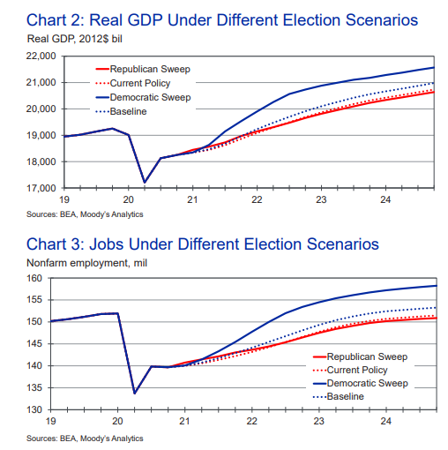
Moody’s Analytics: GDP & Employment Under Different Election Scenarios
Democratic Sweep (Pres, Senate, House)
“The economic outlook is strongest under the scenario in which Biden and the Democrats sweep Congress and fully adopt their economic agenda.
In this scenario, the economy is expected to create 18.6 million jobs during Biden’s term as president, and the economy returns to full employment, with unemployment of just over 4%, by the second half of 2022.
During Biden’s presidency, the average American household’s real after-tax income increases by approximately $4,800, and the homeownership rate and house prices increase modestly.
Stock prices also rise, but the gains are limited. This is because of high current market valuations that limit prospects for near-term gains and the pedestrian growth in corporate profits under Biden’s policies, as more of the benefits from the stronger economy under his policies go to workers.
Near-term economic growth is lifted by Biden’s aggressive government spending plans, which are deficit-financed in significant part. Stronger anticipated global trade and foreign immigration also contribute. His proposal calls for additional spending of $7.3 trillion over the next decade on a static basis on infrastructure, education, and the social safety net including everything from Social Security to housing and healthcare.
The bulk of the spending is slated to happen during his term as president in an effort to generate more jobs to return the economy to full employment as quickly as possible.
While Biden’s spending plans are financed in part by higher taxes on corporations and the well-to-do that come to $4.1 trillion over the decade on a static basis, the net of these crosscurrents is to boost economic activity.”
Moody’s Analytics: “The Macroeconomic Consequences: Trump vs. Biden” (Sept 2020)
NYT / Krugman: “The Very Strong Case for Bidenomics” (Oct 1, 2020)

Slide 44
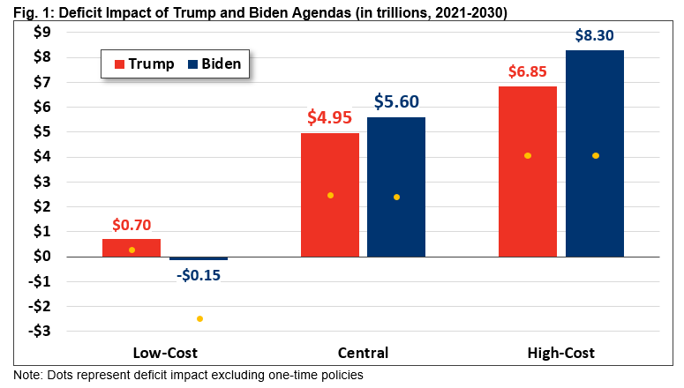
CRFB: Comparing Trump and Biden Campaign Plans
“Under our central estimate, we find President Donald Trump’s campaign plan would increase the debt by $4.95 trillion over ten years and former Vice President Biden’s plan would increase the debt by $5.60 trillion.
Debt would rise from 98 percent of Gross Domestic Product (GDP) today to 125 percent by 2030 under President Trump and 128 percent under Vice President Biden, compared to 109 percent under current law.”
Assumes policies enacted immediately and exclude COVID-19 relief proposals
CRFB: “The cost of the Trump and Biden Campaign Plans” (October 7, 2020)

Slide 45
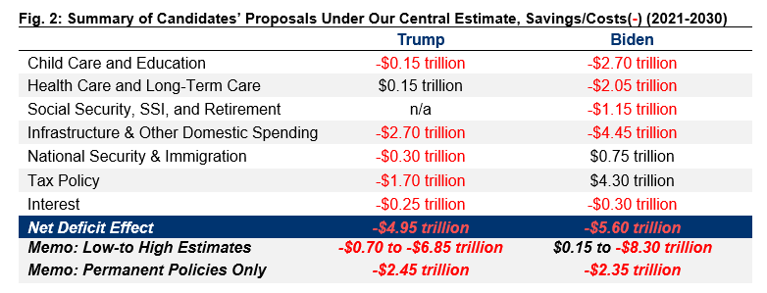
CRFB: Comparing Trump and Biden Campaign Plans
Negative / red text indicates policy increases deficit
CRFB: “The cost of the Trump and Biden Campaign Plans” (October 7, 2020)

Slide 46
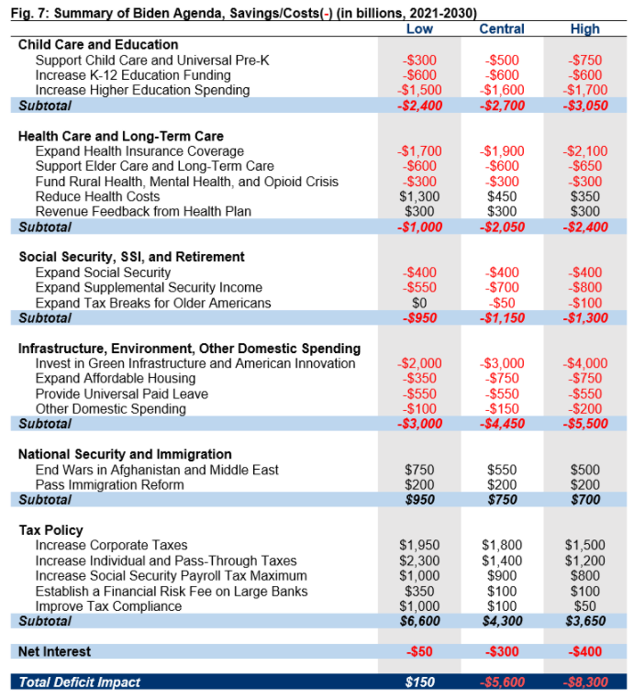
CRFB: Biden Campaign Plans
Child Care
“He would provide access to free pre-kindergarten for all three- and four-year-olds by working with states to provide a mixed delivery system involving public schools, child care centers, family caregivers, and the Head Start program. He would make the existing Child and Dependent Care Tax Credit fully refundable and expand it to cover half of all child care expenses up to $8,000 for one child or $16,000 for multiple children. Finally, borrowing from Representative Bobby Scott’s (D-VA) Child Care for Working Families Act, Biden would implement a sliding-scale subsidy system designed to prevent any family earning under 1.5 times the area median income from spending more than 7 percent of its income on child care.”
Higher Education
“Biden would expand access to and reduce the out-of-pocket cost of education beyond high school in a variety of ways. First, he would make public colleges and universities tuition-free for all families with incomes below $125,000, as proposed in Senator Bernie Sanders’s (I-VT) College for All Act of 2017.²⁷
Biden would also provide up to two years of community college or high-quality training at no cost to students.²⁸
Furthermore, he would invest $75 billion in Historically Black Colleges and Universities (HBCUs), Tribal Colleges and Universities (TCUs), and Minority-Serving Institutions (MSIs), $50 billion to develop better workforce training programs, and $8 billion to help community colleges improve the health and safety of their facilities.
Biden would double the maximum value of a Pell Grant – expanding both the size of Pell Grants and eligibility for them.
Biden would also offer substantial relief to those with student debt. He would forgive all tuition-related student debt accrued at two- and four-year public colleges and universities, as well as private HBCUs, TCUs, and MSIs.”³⁰
CRFB: “The cost of the Trump and Biden Campaign Plans” (October 7, 2020)

Slide 47
CRFB: Biden Campaign Plans
Social Security
“Biden would expand Social Security by establishing a minimum benefit at 125 percent of the Federal Poverty Level (FPL), providing a 5 percent increase for those who have received Social Security benefits for at least 20 years,⁵⁰ and increasing benefits for surviving spouses.⁵¹
Biden also says he will “get rid of the benefit cuts for workers and surviving beneficiaries who happen to be covered by both Social Security and another pension,” which we interpret to mean eliminating the Windfall Elimination Provision (WEP) and Government Pension Offset (GPO).⁵²
With regards to Social Security Disability Insurance (SSDI), Biden would eliminate the current five-month waiting period to collect benefits and two-year waiting period to collect Medicare.
In addition, Biden would increase the earnings limit for SSDI – which currently stands at $1,170 per month – and gradually phase-out this benefit to eliminate the SSDI “benefit cliff.”
In total, we estimate these provisions would cost $400 billion over ten years.⁵³ By themselves, they would also worsen Social Security’s 75-year solvency by about 30 percent.
To offset these costs and improve Social Security solvency, Biden would subject wages above $400,000 per year to the payroll tax, which we discuss in the tax section below.”
CRFB: “The cost of the Trump and Biden Campaign Plans” (October 7, 2020)

Slide 48
CRFB: Biden Campaign Plans
Infrastructure
“Vice President Biden has a number of plans that increase spending on research, infrastructure, procurement, and combatting climate change. However, the extent to which they overlap, and whether or not more recent plans supplement or replace earlier ones, is unclear.”
“Biden’s more recent “Build Back Better” agenda includes a new, and seemingly more ambitious, plan called “The Biden Plan to Build a Modern, Sustainable Infrastructure and an Equitable Clean Energy Future” that calls for 100 percent clean energy by 2035, along with significant new investments. The plan would spend $2.00 trillion over four years.
Meanwhile, “The Biden Plan to Ensure the Future is ‘Made in All of America’ by All of America’s Workers" proposes investing $300 billion over four years to promote research and development of breakthrough technologies – like electric vehicle technology, artificial intelligence systems and next-generation communication networks – as well as $400 billion over four years on federal procurement of products made in the United States by domestic workers.”
CRFB: “The cost of the Trump and Biden Campaign Plans” (October 7, 2020)

Slide 49
Topics
Labor Market
Economic Statistics
Budget Deficit & Debt
Illinois Fair Tax
Job Growth by President
Inequality
Biden’s Plans
Take Action

Slide 50
Twitter Threads: Use Them!
Articles
NYT Steven Rattner: “The Economic Recovery That Isn’t” (August 23, 2020)
https://www.nytimes.com/2020/08/23/opinion/trump-convention-economy.html?
Vox: “This is the future Joe Biden wants” (August 17, 2020)
https://www.vox.com/policy-and-politics/21340746/joe-biden-covid-19-coronavirus-recession-harris
Tweets
How the economy performs better under Democratic Presidents than Republican
https://twitter.com/DavidDo76683013/status/1264619077600972800
Are we better off economically vs. when Trump took office?
https://twitter.com/David_Charts/status/1292684304909250561
Trumps First 3 Years Versus Obama’s Last 3 years
https://twitter.com/David_Charts/status/1295590183342157830
Common Trump Lies (Collection of Fact-checking articles)
https://twitter.com/David_Charts/status/1298079871613259777
Inequality slides from CBO’s latest report
https://twitter.com/David_Charts/status/1312899196828221440

