Slide 2

Agenda
IPCC Special Report Highlights
IPCC Recommendations
CMAP Greenhouse Gas Report
Discussion
  Tying the 2 together
  Local groups & strategies

Slide 3
UN Sustainable Development Goals (SDG)
The UN has 17 Sustainable Development Goals
  Universal Call to Action to end:
    Poverty
    Protect the planet
    Ensure all people enjoy peace and prosperity
Unique in that they call on ALL countries
#13 – Climate Change
IPCC report is framed in the context of the SDGs

Slide 4

Who is the IPCC?
The Intergovernmental Panel on Climate Change is an intergovernmental body of the United Nations, dedicated to providing the world with an objective, scientific view of climate change and its political and economic impacts.

Slide 5
Who is the IPCC?
They author the Climate Change Assessment Reports (5 so far)
These reports are used by all countries and form basis for the Paris Climate Accord
It represents over 30,000 scientific publications

Slide 6
IPCC Special Report – Oct 2018
Report Main Themes
What would be required to limit warming to 1.5° C
The impacts of 1.5° C of warming, compared to 2° C and higher
Strengthening the global response to climate change, mitigation and adaptation options

Slide 7
Key Concepts
At present rates, we are likely to reach +1.5° C between 2030 and 2052 (we are at +1° C already)
2° C impacts worse than 1.5° C in various ways across most natural and human systems
  Mean temperature of land and ocean regions
    High latitudes: 4.5° C @ 1.5° C vs 6° C @ 2° C
  Hot extremes (# of hot days)
  Heavy precipitation (more frequent & more severe cyclones)
  Probability of drought (more frequent & longer)

Slide 8
Key Concepts
2° C impacts worse than 1.5° C in various ways across most natural and human systems
  Ocean level rise .1 metre more at 2° C
    10 million people additionally at more risk
    Faster sea level rise provides less opportunities for adaptation
    Somewhat unsure the level of marine ice sheet instability between 1.5° C vs 2° C (Greenland & Antarctica)
  Specie loss
    16% vs 6% insects
    16% vs 8% plants
    8% vs 4% vertebrates
  Land transformation from one ecosystem type to another
    @1° C – 4%
    @1.5° C – 7%
    @2° C – 13%

Slide 9
Key Concepts
2° C impacts worse than 1.5° C in various ways across most natural and human systems
  High Latitude Tundra/Permafrost loss
    1.5 – 2.5 million km² more
  Ocean Temperature
    Sea ice free arctic once per decade vs once per century
    Coral reef decline >99% vs 70-90%
    Greater ocean acidification
    Decrease in annual fish catch 3 million tonnes vs 1.5 million tonnes

Slide 10
Key Concepts
2° C impacts worse than 1.5° C in various ways across most natural and human systems
  Poverty
    Several hundred million people
  Health
    Heat related morbidity and mortality
    Increase in certain diseases (malaria, dengue fever, etc.)
  Food production
    Smaller yields, loss of livestock, etc.
  Water Stress
    Increase by 50%

Slide 11
Key Concepts
2° C impacts worse than 1.5° C in various ways across most natural and human systems
  Economic Growth
    Less (excluding the costs of mitigation, adaptation as well as the benefits of adaptation)
  Conflict (my addition)
    Over food, water, land, etc.

Slide 12
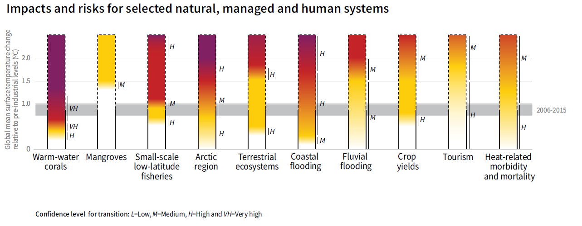
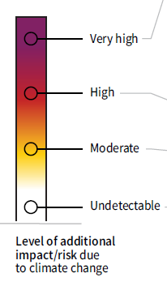
Key Concepts

Slide 13
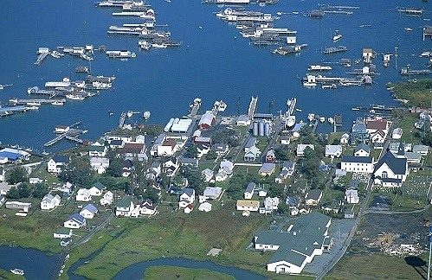
Adaptation

Slide 14
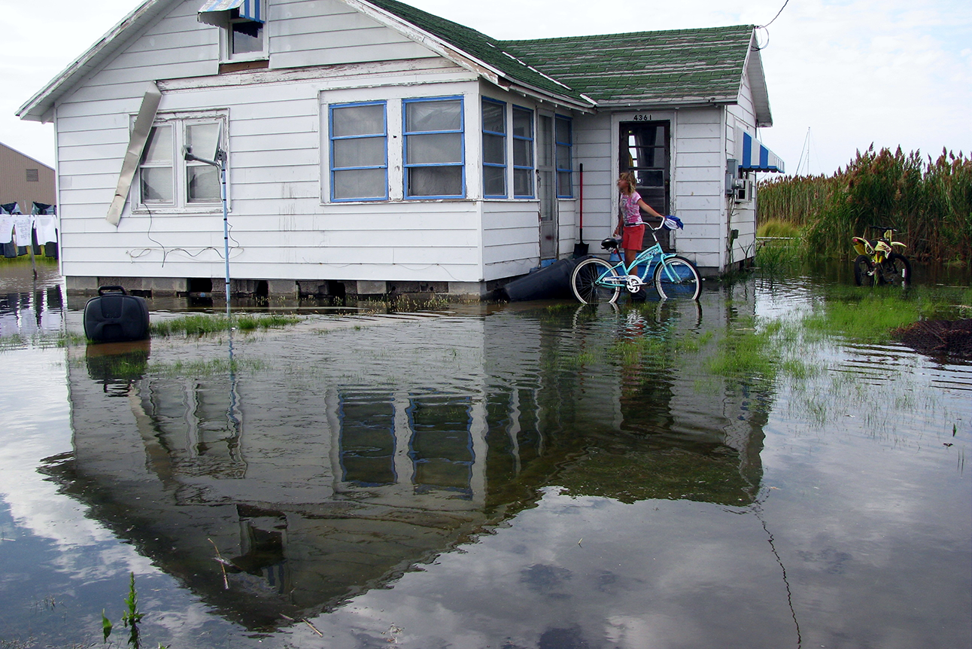
Adaptation

Slide 15
Mitigation Goals & Strategies
For 1.5° C:
Emissions decline of 45% from 2010 levels by 2030 and net zero by 2050
For 2° C:
Emissions decline of 20% from 2010 levels by 2030 and net zero by 2075
Portfolio of measures includes
  Lowering energy intensity
  Decarbonization
  CO2 removal
  Non CO2 emissions reduction of 35% or more

Slide 16
Mitigation Goals & Strategies
Energy (by 2050)
  Lower use through efficiency measures
  Faster electrification of energy end use (e.g. vehicles)
  Greater share of low emission energy sources
    Renewables 70 – 85%
    Increase share of nuclear and fossil fuels with CCS
      With CCS, Gas share could be 8%
    Coal 0%

Slide 17
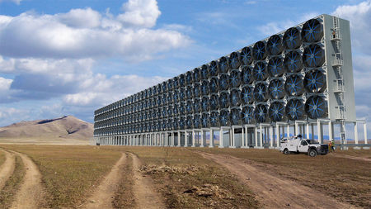
Mitigation Goals & Strategies
Carbon Dioxide Removal (CDR)
  Afforestation & Reforestation
  Land Restoration
  Soil Carbon Sequestration
  New CDR Technology

Slide 18
The Challenge for People’s Hearts and Heads
45% reduction by 2030

Slide 19
The Challenge for People’s Hearts and Heads
45% reduction by 2030
3.5% reduction by 2020

Slide 20
Is it an issue of perception?
45% reduction
from 2010 levels by 2030
3.5% reduction
per year from previous year starting in 2010 until 2030

Slide 21
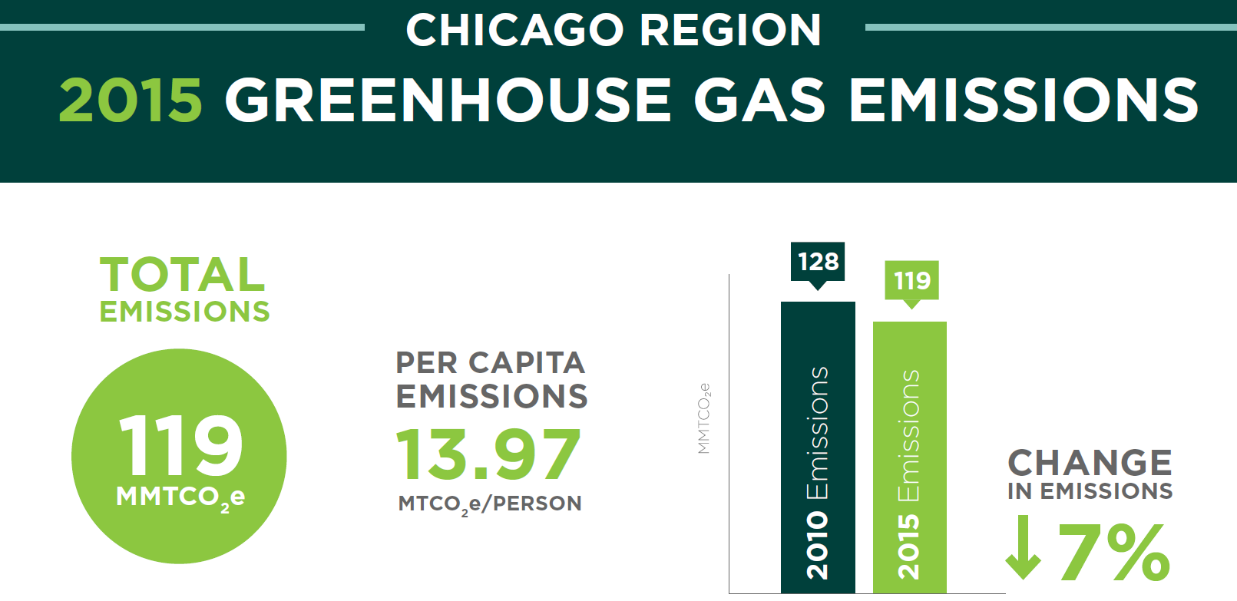
Where are we?
Source: The Chicago Metropolitan Agency for Planning (CMAP)

Slide 22
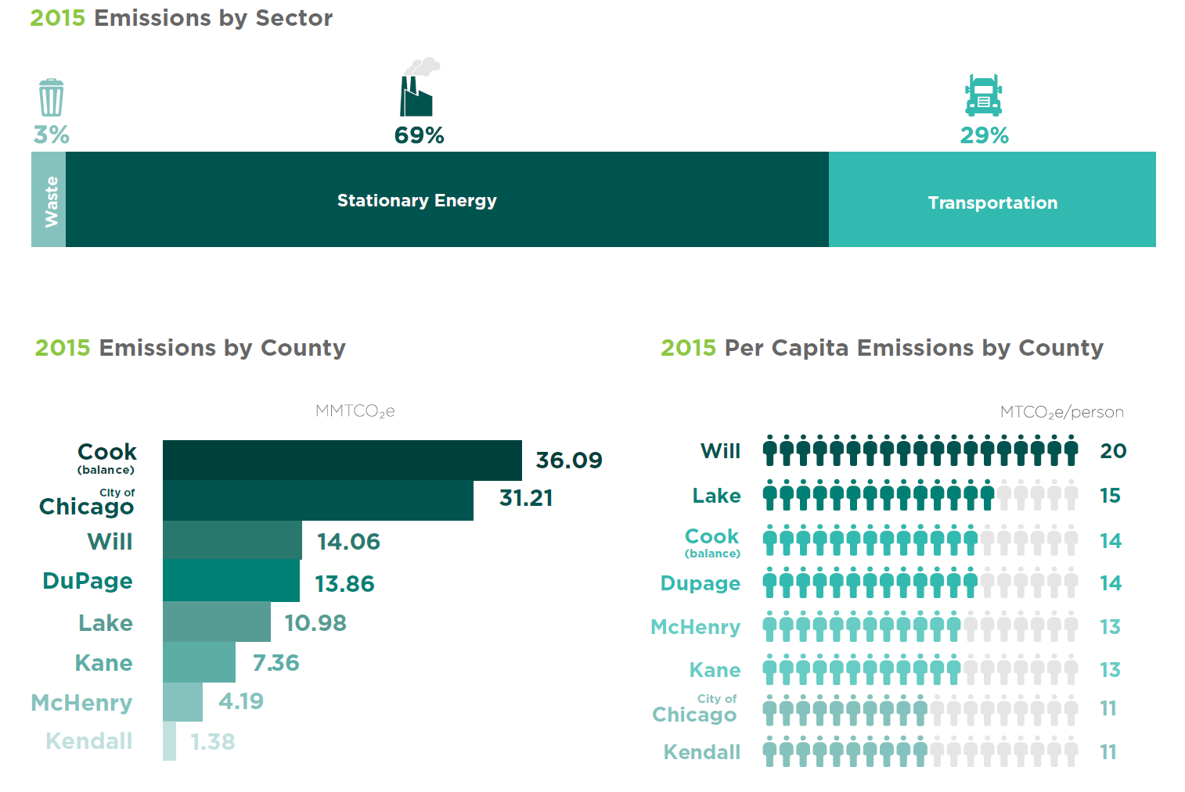

Slide 23
If We Adopt IPCC Goal as Our Goal
Averaged 1.4% reduction 2010 – 2015
Need average 5.5% reduction per year from previous year (assuming 2016 – 2018 same rate as 2015)
  Energy Efficiency
  Move to Clean Energy
  Electrify Transportation
  Plant Trees

Slide 24
How do we move the needle?
Communications
Education
Legislation
  Federal
  State
  Local
Political Engagement
  Elections
  Lobbying
Energy & Transportation Focus
Other Campaigns
  e.g. Reduce non-CO2 emissions
Collaborate/Cooperate
  NWSOFA
  Sierra Club
  Faith in Place
  Citizens Climate Lobby
  League of Woman Voters
  Community Green Teams
    Arlington Heights*
    Barrington Area**
    Buffalo Grove*
    Hoffman Estates**
    Palatine
    Park Ridge**
    Rolling Meadows*
    Schaumburg**
    Wheeling*
    * Signed Greenest Region Compact (GRC)
    ** plus Solsmart

Slide 25
Communications
Continue with our Group communications
  Expand reach
Establish more robust external communication tactics
  Letters to Editor
  Success Stories (PR)
  Space in Town’s newsletters
  Effective use of social media platforms
Establish a Group Communication Network
  Schedule a Summit/Workshop
“It’s not too late to act”

Slide 26
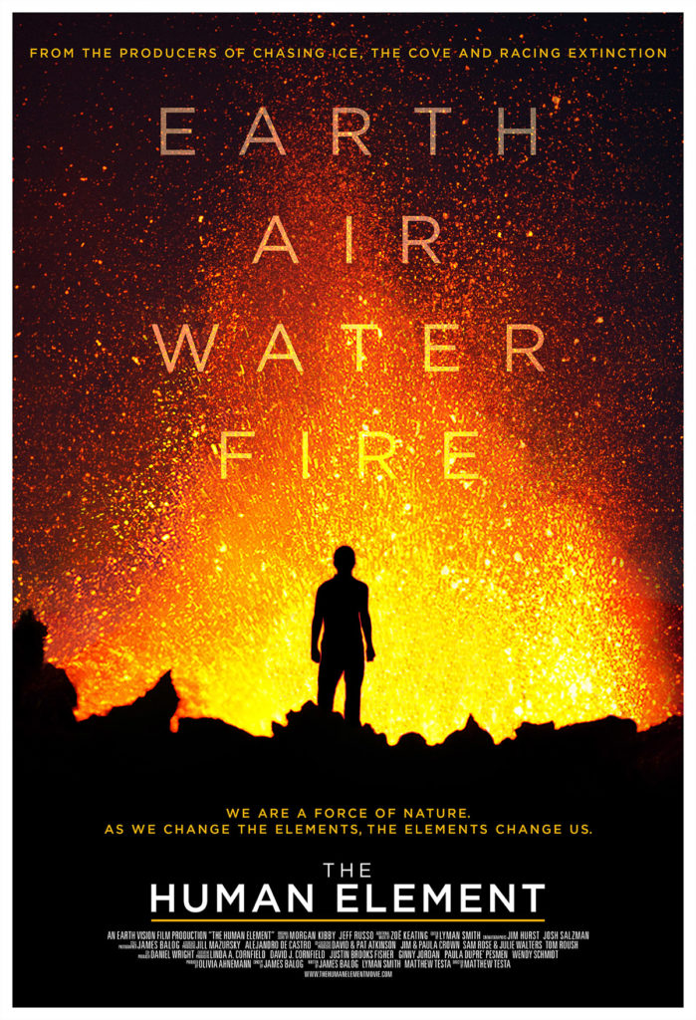
Education/Events
Continue/Expand programs and events
  Share speakers
More focus to this subject/from different angles
  Adjust perceptions
Reach new audiences
  Research organizations outside of “Green” community

Slide 27
Legislative/Political
Federal
  Hold new elected officials accountable
  Seek opportunities to interact
State
  Follow IEC lead (FEJA 2.0)
  Support new legislation/Lobby
Local
  Municipal Elections
  Leverage GRC
  Hold Summit/Workshop on GRC

Slide 28
Clean Energy/Transportation
Leverage GRC
Leverage Solsmart
Offer Solarize Program (Solar Group Buy)
Educate
Campaigns related to Transportation

Slide 29
Green Groups Collaboration
Communication
Events
Best Practices
Strategy
  GRC
  Solsmart

Slide 30
Next Steps?
Communications Summit/Workshop – Lead?
GRC Summit/Workshop – Lead?
  Palatine: - Get GRC approved
  Others: - Review GRC and refine appropriately
  Others w/ Solsmart: - Drive solar installation demand
    ISEA Solar Ambassador Presentation
    Develop a Solarize (Group Buy) program
What is your 2019 Plan?
Interest in “The Human Element” screening?

Slide 31
Contact Info
Peter Gorr
pagorr@comcast.net
847-767-0993
Sierra Club
Illinois Solar Energy Association
Go Green Barrington
Deer Grove Natural Areas Volunteers

