Slide 1
Fiscal and Economic Issues
Discussion Group
November 2018

Slide 2
What We Ask of You
Understand the Facts
Sharpen Your Arguments
Communicate to Your Audience
http://www.nwsofa.org/resources/fiscal/

Slide 3
Economic Summary
Job creation in Trump’s first 21 months through October 2018 was 4.05 million (193,000/month), vs. 4.48 million (213,000/month) in Obama’s last 21 months. Job creation has been positive each month starting October 2010 (97 months). Private sector job growth has been positive since March 2010; government was negative due to Census workers peaking in May 2010. The total number of jobs regained its January 2008 peak in May 2014 and has set records monthly since.
The unemployment rate remained at 3.7% in October 2018, the lowest since the late 1960’s and below the April 2000 rate of 3.8%. The unemployment rate has fallen consistently since its peak of 10.0% in October 2010.
Real median household income rose from the record level of $60,309 in 2016 to $61,372 in 2017, an increase of $1,063 or 1.8%. This figure grew by 3.1% in 2016 and 5.1% in 2015.
Real wage growth has averaged 0.3% per month (measured vs. year-ago level) during the Trump Administration, vs. 0.8% per month during the Obama Administration. Higher inflation (due mainly to energy prices) has offset rising nominal wages.
Inflation (CPI-All items) was 2.3% in September 2018. It averaged 2.3% from January 2017 to August 2018 (20 months), vs. 0.9% in the preceding 20 months.

Slide 4
Economic Summary
30-year fixed mortgage rates have risen from 3.95% (Jan 4, 2018) to 4.94% (Nov 8, 2018). The rate averaged 4.2% for 2017 and 2018 (92 weeks) during the Trump Administration, vs. 3.8% during the last 92 weeks of the Obama Administration.
CBO reported the budget deficit for FY2018 at $782 billion, up $116 billion (18%) vs. 2017 but up $295 billion (61%) vs. the January 2017 baseline estimate for FY2018. The deficit was 3.9% GDP in 2018 vs. 3.5% GDP in 2017. The debt addition trajectory for 2018-2027 has increased from $9.4 trillion (January 2017 baseline) to $13.7 trillion (April 2018 current policy baseline), an increase of $4.3 trillion or 46%. These increases are driven by tax cuts and spending increases and consider economic feedback.
The Census Bureau reported that the number of persons without health insurance rose from 27.3 million in 2016 to 28.0 million in 2017. The uninsured rate rose from 8.6% in 2016 to 8.7% in 2017. This was the first increase in the number and rate of uninsured since 2010.
Real GDP growth was 3.5% in Q3 2018. Net imports were a sizable drag, inventory building was a significant boost, and business investment was a small negative contributor.
The IMF lowered its global growth estimate for 2018 from 3.9% to 3.7%, citing trade wars. The U.S. estimate for 2018 was unchanged at 2.9%, while the 2019 estimate was lowered by 0.2% to 2.5%.

Slide 5
Topics
Key Economic Indicators
Budget Deficits & Debt
Other Topics

Slide 6
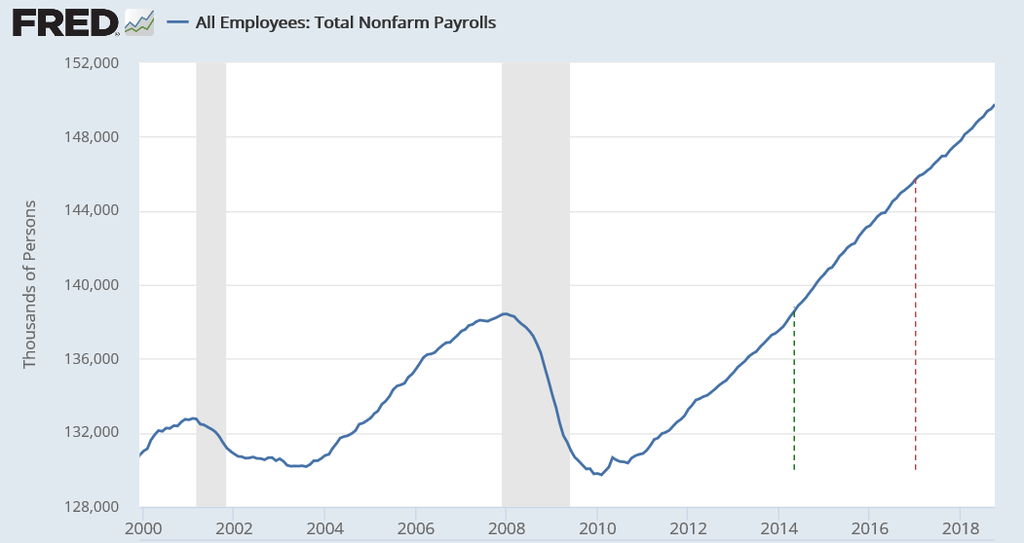
Jobs: Total Non-Farm Payrolls (Private and Govt / FT & PT)
Oct 2018
149.8 million total
+250,000 vs. Sept
Total number of jobs in record territory since May 2014
Private is 128m; Govt is 22m
May ‘14
Jan ‘17

Slide 7
Monthly Average Job Creation 2014 – 2018
Average monthly job creation higher in 2018 (through Oct) than 2016 and 2017 (Full Year)
Source Data: Federal Reserve Economic Data (FRED)

Slide 8
Job Creation Faster in Obama’s Last 21 Months than Trump’s First 21
Job creation in Obama’s last 21 months was 4.48 million, vs. 4.05 million for Trump’s first 21
Obama’s job creation averaged 213,000 per month during that time, vs. 193,000 for Trump
Source Data: Federal Reserve Economic Data (FRED)

Slide 9
Quality of Jobs: Manufacturing Job Creation (Annual in 000’s)
Source Data: Federal Reserve Economic Data (FRED)
Computation: December of Y2 – December of Y1

Slide 10
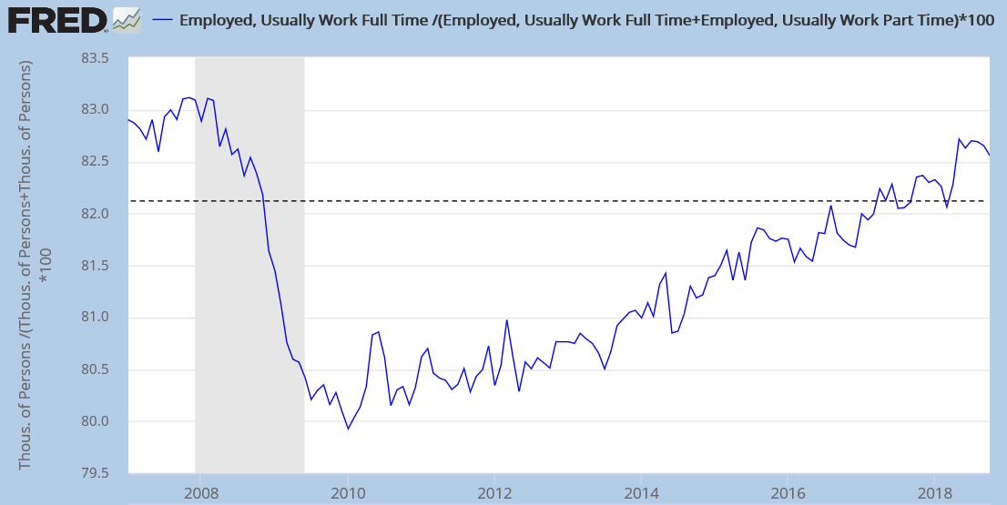
Quality of Jobs: Share of Full-Time Employed (> 35 hours)
The share of employed persons that work full time has increased consistently since 2010
This ratio gets at the “quality of jobs” in the economy
However, share remains slightly below pre-crisis level
%
83.1%
82.6%
Historical Average 82.1% (1980-2017)
79.9%

Slide 11
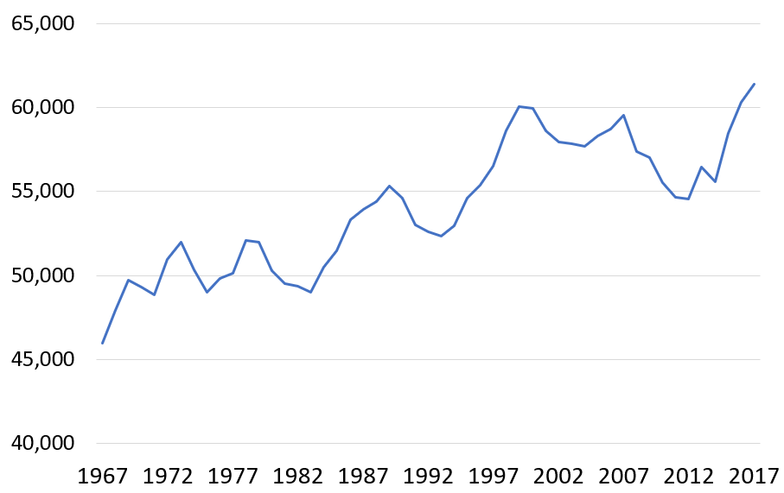
Quality of Jobs: Record Real Median Household Income in 2016 and 2017
2017
$61,372
+1,063 or 1.8%
Year | Income | Change | Pct Chg
2017 | 61,372 | 1,063 | 1.8%
2016 | 60,309 | 1,833 | 3.1%
2015 | 58,476 | 2,863 | 5.1%
Source: Census Bureau

Slide 12
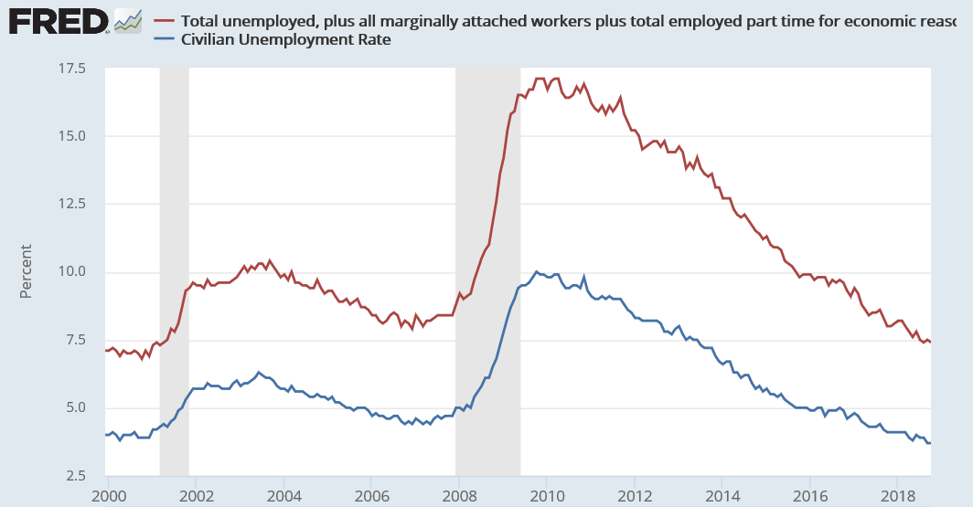
Unemployment Measures Below Pre-Crisis Levels / Are We At Full Employment?
U-6
October ‘18
U-3
7.4%
3.7%
Pre-crisis rates (Nov ‘07) were 8.4% (U6) and 4.7% (U3). U3 recovered in May 2016; U6 in May 2017
U-3 rate stayed the same as September; U-6 declined by 0.1%

Slide 13
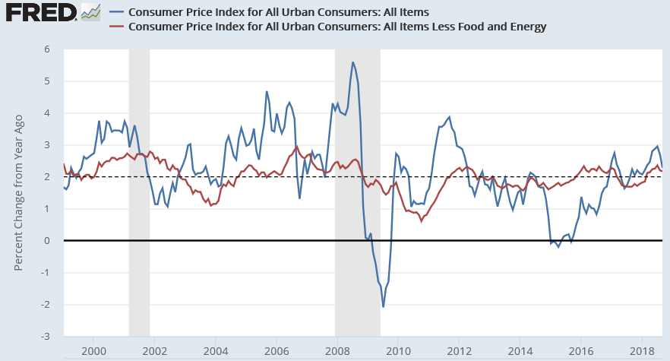
Inflation
Year | All Items | Excl. Food & Energy
2015 | 0.1 | 1.8
2016 | 1.3 | 2.2
2017 | 2.1 | 1.8
2018 | 2.5 | 2.1
All Items
Sept ’18
2.27%
2.17%
Excluding
Food & Energy
All Items: Food and energy prices tend to be volatile, so the blue line has more variation. Energy price declines in 2015 reduced inflation to nearly zero.

Slide 14
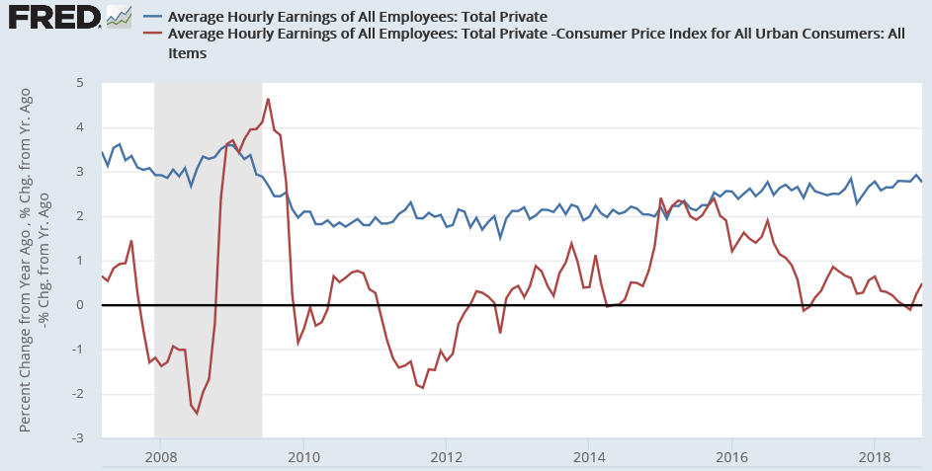
Hourly Earnings Growth Rate (%)
Sept ’18
2.75%
Nominal
Real
0.48%
Higher energy prices are driving higher inflation, offsetting gains in nominal wages
Real Earnings Growth Rate
Obama: 0.8% average 2009 – 2017
Trump: 0.3% average 2017 – 2018
Source: NYT “For Wages, a Trump Slump” (August 2018)

Slide 15
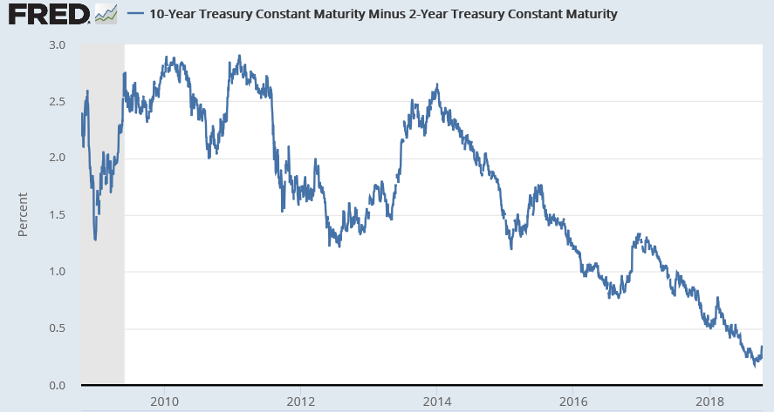
Interest Rates: Yield Curve
NYT: “For much of the last couple of years, short-term interest rates, which the Fed controls directly, have risen much faster than longer-term rates, which are set based on global supply and demand for bonds. The Fed was plowing ahead with rate increases, while investors were evidently skeptical that growth would be persistent enough to justify higher long-term rates.
In late August, the rate on 10-year government bonds was only 0.18 percent higher than for two-year government bonds, a phenomenon known as a flat yield curve. (When that number turns negative, it’s considered an “inverted yield curve” and is often a measure of looming recession.)
Since then, longer-term rates have risen faster than shorter-term ones. While the yield curve remains flat by historical standards (the gap between 10-year and two-year bonds was up to only 0.33 percent in recent days), it has moved in a direction consistent with a more optimistic outlook.
The long end of the yield curve has finally moved to the view that this could be a more persistent recovery,” said Michelle Meyer, head of U.S. economics at Bank of America-Merrill Lynch. “It’s reflecting the possibility that this recovery has further legs.”
Oct 10, 2018
0.34%
NYT: Neil Irwin - Interest Rates Are Rising for All the Right Reasons (Oct 11, 2018)

Slide 16
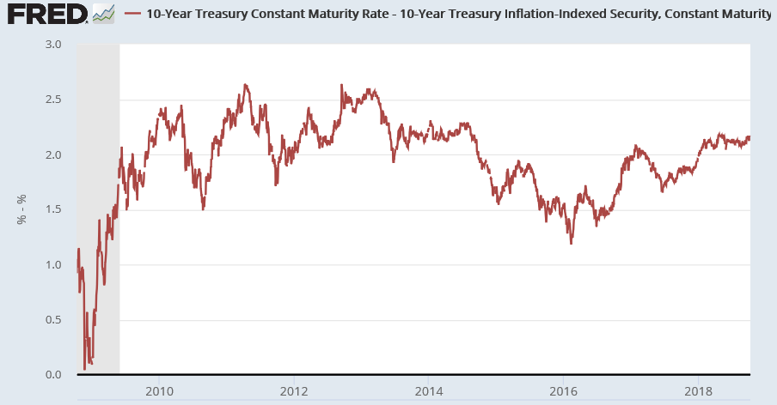
Interest Rates and Inflation Expectations
NYT: “The yields of inflation-protected bonds have moved mostly in lock step with traditional bonds in recent weeks, suggesting that traders haven’t become more worried about inflation.
For example, inflation of 2.16% a year over the coming decade is implied by the current price gap between the two types of bonds, up only a smidgen since August and below its level in May.
The rise in longer-term interest rates is driven mainly not by a rise in inflation expectations, but rather by a rise in investors’ expectations for what the Fed will do and for how much compensation bond investors are demanding in lending over long time horizons.”
Oct 10, 2018
2.16%
NYT: Neil Irwin - Interest Rates Are Rising for All the Right Reasons (Oct 11, 2018)

Slide 17
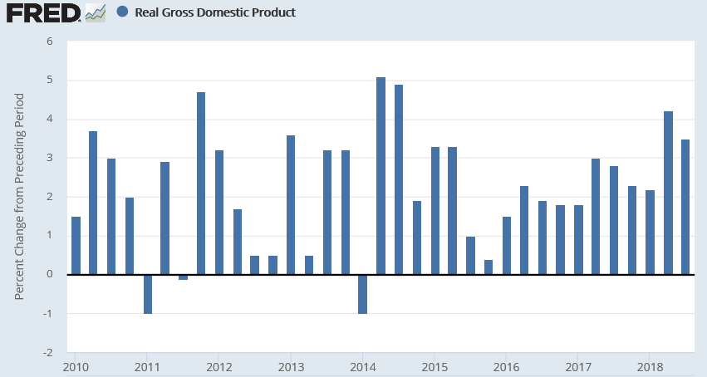
Quarterly Real GDP Growth % 2010-2018
Real GDP growth was 3.5% in Q3 2018, down from 4.2% in Q2 2018
From 2010 to 2016, there were 11 quarters of 3.0% growth or better, including 3 quarters of 4.0% growth or better
The GDP figure is the % change vs. the prior quarter, annualized
Obama
Trump
4.2
3.5

Slide 18
Q3 2018: Contribution to % Change in GDP
Personal consumption was an above average contributor in Q3
A sizable boost from net exports brought forward to avoid tariffs in Q2 reversed in Q3
Non-residential (business) investment was a below average contributor
Government (federal, state, local) continues to be an above-average contributor
Residential investment (housing) remains a drag on the economy
Inventory building was an unusually large positive contributor

Slide 19
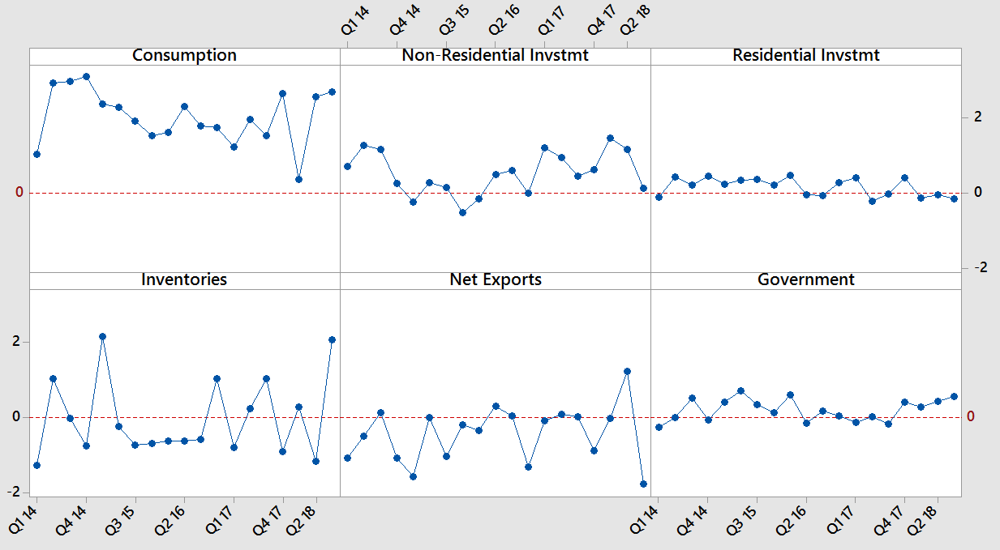
Contribution to % Change in GDP Q1 2014 – Q3 2018
Sizable fluctuations in inventories and net exports in last two quarters

Slide 20
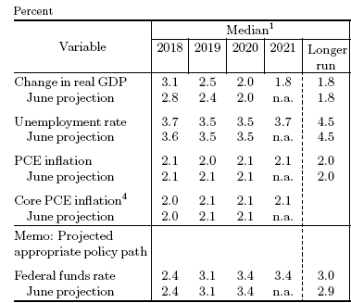
Federal Reserve Economic Projections (September)

Slide 21
Topics
Key Economic Indicators
Budget Deficits & Debt
Other Topics

Slide 22
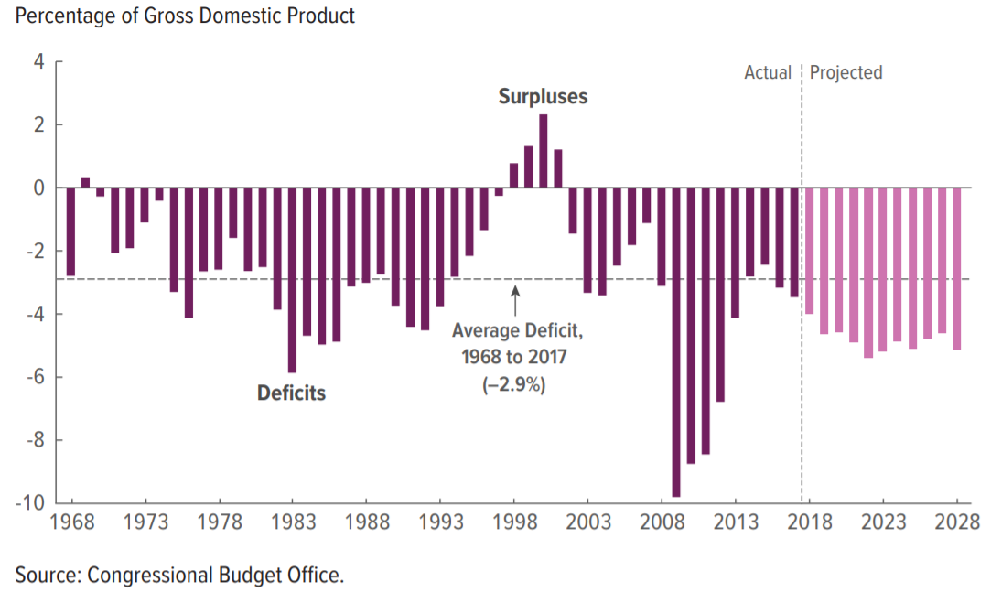
Federal Budget Deficit % GDP (1968-2028)
Deficits average about 5% GDP 2018-2028, or $1.2 trillion per year
1% GDP is about $200 billion
CBO “Budget & Economic Outlook 2018-2028” (April 2018)

Slide 23
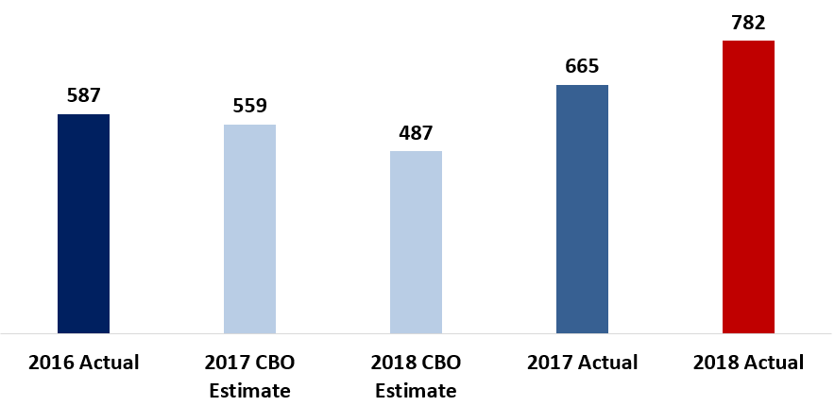
Federal Budget Deficit for Fiscal Years 2016 – 2018 ($ Billions)
FY2018 deficit is an increase of $117 billion (18%) vs. FY2017 deficit and $295 billion (61%) vs. CBO January 2017 baseline estimate for 2018. Differences mainly due to Tax Act and spending increases.
Note: Fiscal year 2018 ran from October 1, 2017 to September 30, 2018 and was the first year budgeted by President Trump.
January 2017 Current Law Baseline

Slide 24
Federal Budget Deficit FY 2018 (Oct 1 2017 to Sept 30 2018)
CRFB: “CBO Shows $782 billion deficit for FY2018” (October 9, 2018)

Slide 25
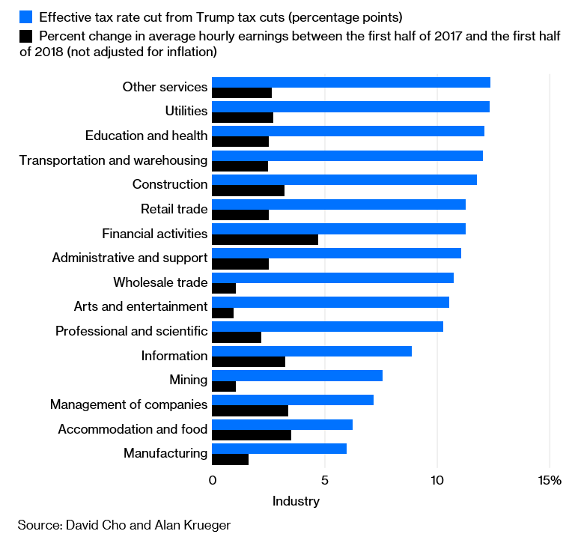
Size of Corporate Tax Cut for Industry Not Correlated with Wage Gains
“Different industries pay different rates of corporate tax, so the tax cut was effectively a different size for each one.
Economists David Cho and Alan Krueger compared the size of the effective tax cuts received by various industries with the change in their wages between the first half of 2017 and the first half of 2018.
Some industries got bigger tax cuts but had only small wage changes; others, the reverse. Overall, the researchers found no correlation between the two.”
Bloomberg: “Trump Puts Supply-side Economics to its Final Test” (October 10, 2018)

Slide 26
Federal Budget Deficit Forecasts for 2018-2027 ($ Billions)
CBO January 2017 Baseline (Obama) vs. April 2018 Alternate (Trump)
$13.7 trillion total additions
$4.3 trillion additions due to Trump’s tax cuts and spending increases, if current policy extended
+45% vs. January 2017 baseline (+$34,000 per household)
5x Obama 2009 Stimulus Plan (ARRA)
$9.4 trillion total
CBO January 2017 Baseline
Source: CBO “Budget & Economic Outlook” (January 2017 and April 2018)

Slide 27
Topics
Key Economic Indicators
Budget Deficits & Debt
Other Topics

Slide 28
Number of Uninsured 2008-2017 (000’s)
Number of uninsured fell by nearly 20 million from 2010 to 2016
Major ACA provisions went into effect for 2014
In 2017, number and rate of uninsured increased for first time since 2010
Census Bureau: “Health Insurance Coverage in the United States: 2017” Historical Tables for ACS survey
Percent:
15.5%
15.1%
14.8%
14.5%
11.7%
9.4%
8.6%
8.7%

Slide 29
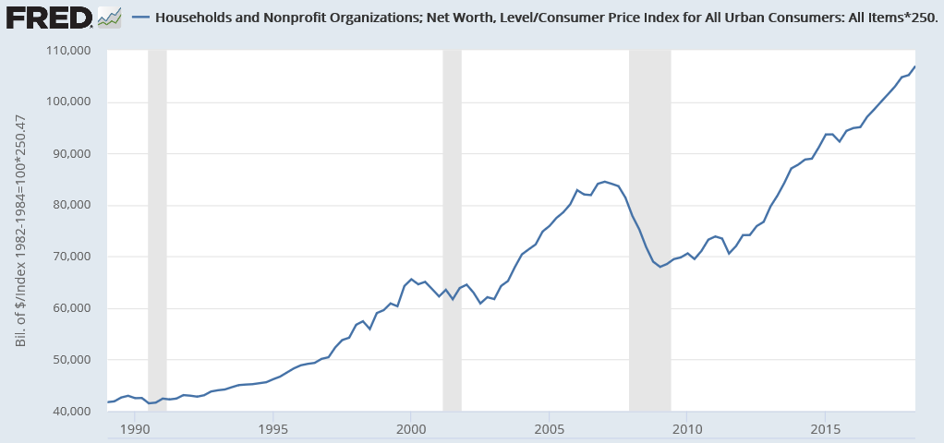
Real U.S. Household Net Worth Hit $106 Trillion in Q2 2018
Q2 2018
$106.9
trillion
Real Net Worth
(2018 $)
Regained pre-crisis peak in Q4 2013
Net worth reflects stock market (financial assets) and home equity
The globalized free trade system has been a massive wealth generator, but the gains were unequally distributed
Real (inflation-adjusted) household net worth has increased 2.5x since 1990
$100 trillion is about $800,000 per family if split evenly
Median (50th percentile family) had $97,300 net worth in 2016
The top 1% owns about 40% of this wealth, vs. 25% in the pre-Reagan era

Slide 30
Legacy of the Financial Crisis
Median Family Net Worth 1989 - 2016
Net worth remained about $42,400 (30%) below the pre-crisis (2007) peak as of 2016
$139.7
$97.3
Thousands of
2016 Dollars
$83.7
Source Data: Federal Reserve Survey of Consumer Finances (2017)
Statistic for “All Families”

Slide 31
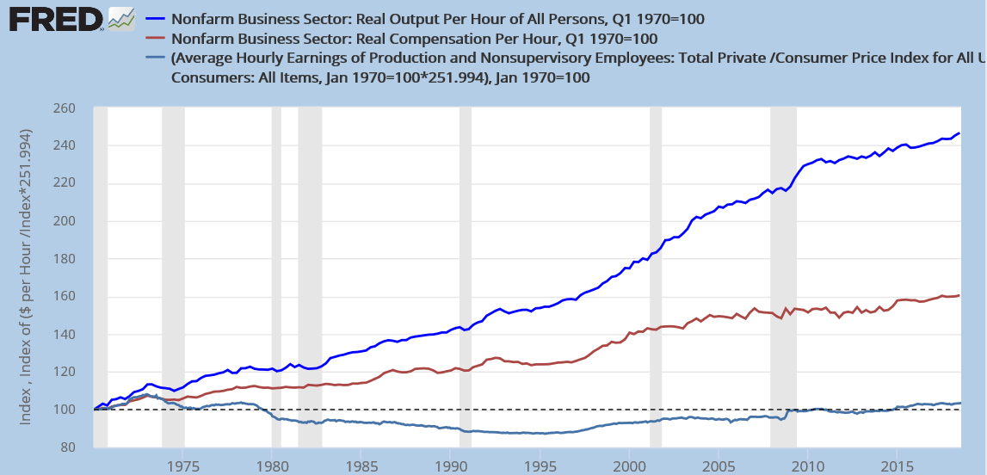
Q&A – Wages & Benefits (Compensation) vs. Productivity (1970 Q1 – 2018 Q3)
Productivity measured by output per hour is also a fairness measure for how much a worker should be paid
Compensation includes salaries/wages and benefits
Compensation has grown faster than wages due to healthcare benefits replacing wage growth
Labor power relative to capital is an important factor (e.g., lower union participation, deregulation) in gap between compensation and productivity
Productivity + 147%
Compensation +61%
Wages +3%
Index = 100 is the starting point in January 1970
Index number (vertical scale) – 100 = % increase in variable
Source: BLS “Beyond the Numbers: Understanding the labor productivity and compensation gap” (June 2017)

Slide 32
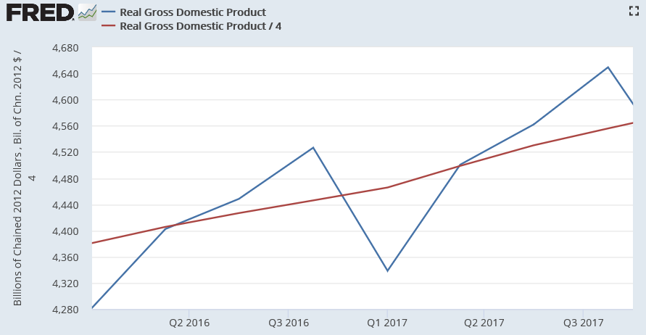
Q&A – Seasonality in GDP Numbers ($ Billions)
Main impact of seasonal adjustment is Q1 increased and Q4 reduced
Changes in other quarters less significant
2016 Q1 increased by $100B and Q4 reduced $80B
2017 Q1 increased $127B and Q4 reduced $93B
Q4 ‘17
Q4 ‘16
Unadjusted
Seasonally
Adjusted
Q1 ‘17
Q1 ‘16

Slide 33
Election Results

