Slide 1
Fiscal and Economic Issues
Discussion Group
September 2018

Slide 2
What We Ask of You
Understand the Facts
Sharpen Your Arguments
Communicate to Your Audience
http://www.nwsofa.org/resources/fiscal/

Slide 3
Topics
Key Economic Indicators
Budget Deficits & Debt
Stock Market

Slide 4
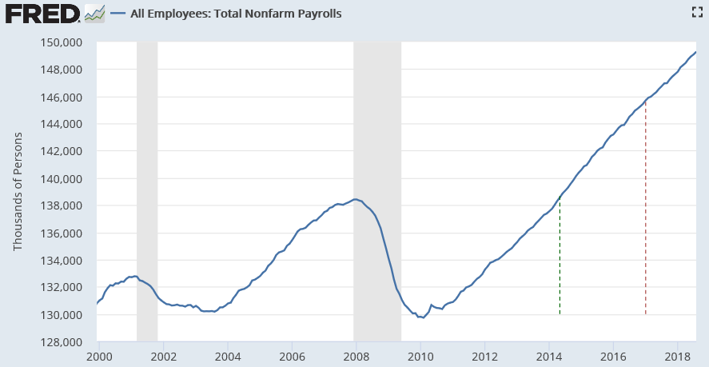
Jobs: Total Non-Farm Payrolls (Private and Govt / FT & PT)
August 2018
149.3 million total
+201,000 vs. July
Total number of jobs in record territory since May 2014
Private is 127m; Govt is 22m
May ‘14
Jan ‘17

Slide 5
Monthly Average Job Creation 2014 – 2018 (Through August)
Average monthly job creation higher in 2018 (through Aug) than 2016 and 2017 (Full Year)
Source Data: Federal Reserve Economic Data (FRED)

Slide 6
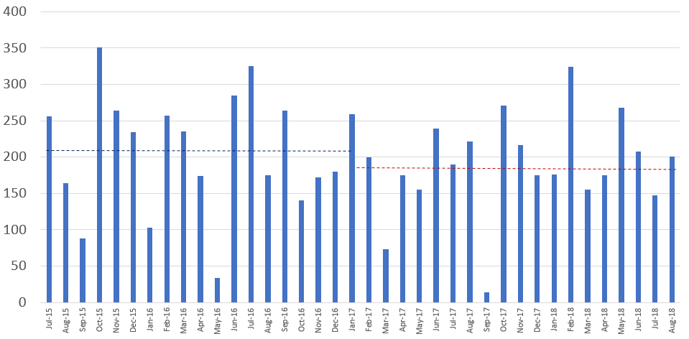
Monthly Job Creation Faster in Obama’s Last 19 months than Trump’s First 19 Months
Job creation in Obama’s last 19 months was 3.96 million, vs. 3.58 million for Trump’s first 19 months
Obama’s job creation averaged 208,000 per month during that time, vs. 189,000 for Trump
Source Data: Federal Reserve Economic Data (FRED)

Slide 7
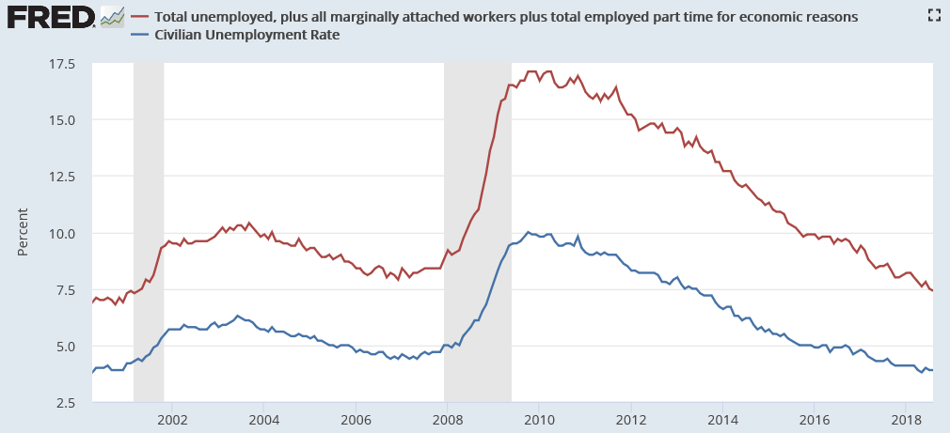
Unemployment Measures Below Pre-Crisis Levels / Are We At Full Employment?
U-6
Aug ‘18
U-3
7.4%
3.9%
Pre-crisis rates (Nov ‘07) were 8.4% (U6) and 4.7% (U3). U3 recovered in May 2016; U6 in May 2017
No change in U-3 rate vs. prior month; U-6 improved by 0.1%

Slide 8
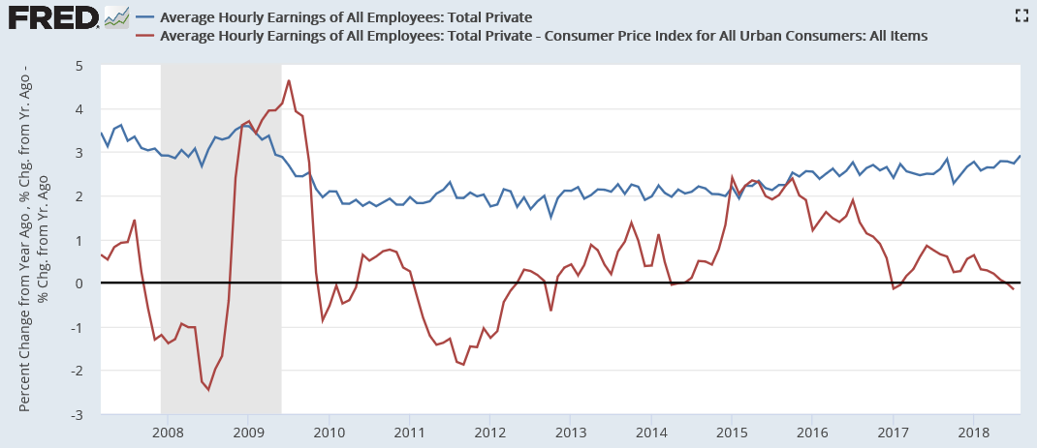
Hourly Earnings Growth Rate (%)
Aug ‘18
Nominal
2.92%
Real
Jul ‘18
(0.19%)
Obama: 0.8% average 2009-2017
Trump: 0.3% average 2017-2018
Source: NYT “For Wages, a Trump Slump” (August 2018)

Slide 9
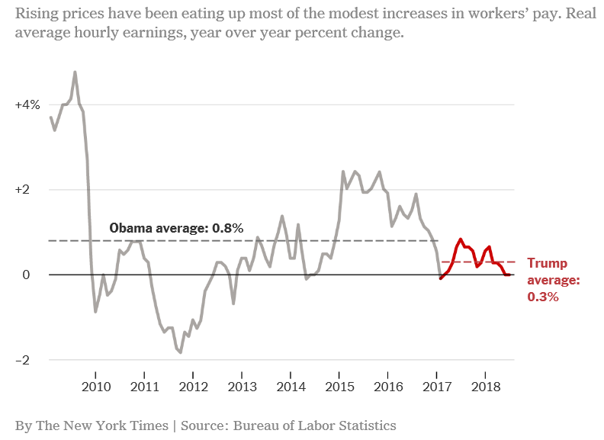
Real (Inflation-Adjusted) Hourly Earnings Growth Rate (%)
Real wage growth averaged 0.8% under Obama (2009-2016) vs. 0.3% for Trump (2017-Jul 2018)
Real wage growth turned negative in June and July 2018, as gas prices drove inflation faster than wage growth
Source: NYT “Trump’s Economic Claims Are Overblown” (August 3, 2018)

Slide 10
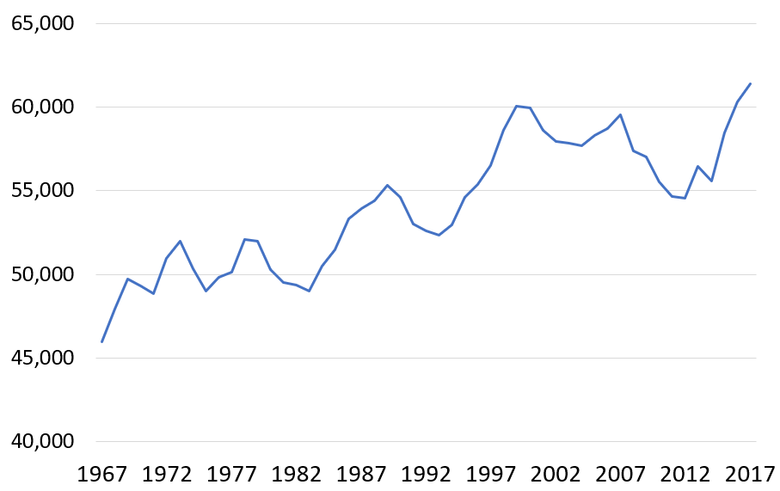
Real Median Household Income 1967 - 2017 (2017 Dollars)
2017
$61,372
+1,063 or 1.8%
Year | Income | Change | Pct Chg
2017 | 61,372 | 1,063 | 1.8%
2016 | 60,309 | 1,833 | 3.1%
2015 | 58,476 | 2,863 | 5.1%

Slide 11
Real GDP Growth (Annual)
Real GDP growth measured for full year was faster in 2014 and 2015 than in 2017
2.9%
2.5%
2.2%
2.2%
1.8%
1.6%

Slide 12
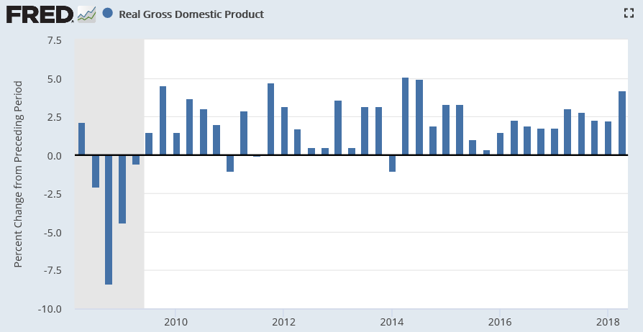
Real GDP Growth % (Quarterly)
Note: There were four Obama quarters of 4.2% GDP growth or higher
4.7
5.1
4.9
4.5
4.2
2.2

Slide 13
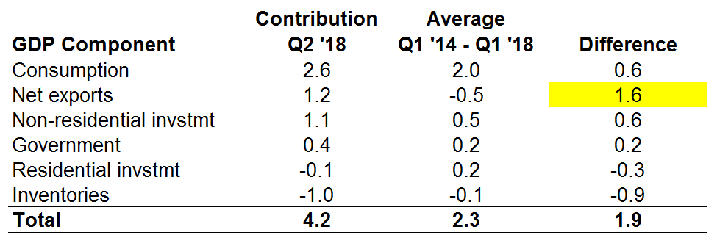
Real GDP Contribution by Component in Q2 2018 vs. Average (Percentage Points)
With the average -0.5% contribution from Net exports, GDP growth would have been 2.6%
Calculations from CBO data indicate GDP growth would be about 0.1% higher per quarter due to the Tax Act. The impact would appear mainly in the Consumption category.
Additional federal spending of about 0.2% above average is in the Government category.
Source: BEA Table 1.1.2 Contributions to Percent Change in Real GDP

Slide 14
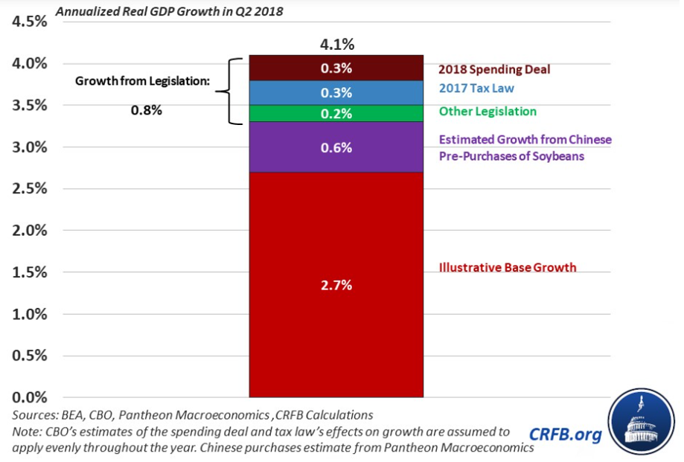
Real GDP Contribution in Q2 2018: Legislation and Trade Pre-Purchases
Note: This analysis was done for the initially reported 4.1% Q2 2018 GDP growth
CRFB: “Growth just hit 4.1% - Don’t Expect it to Last” (July 27, 2018)

Slide 15
Topics
Key Economic Indicators
Budget Deficits & Debt
Stock Market

Slide 16
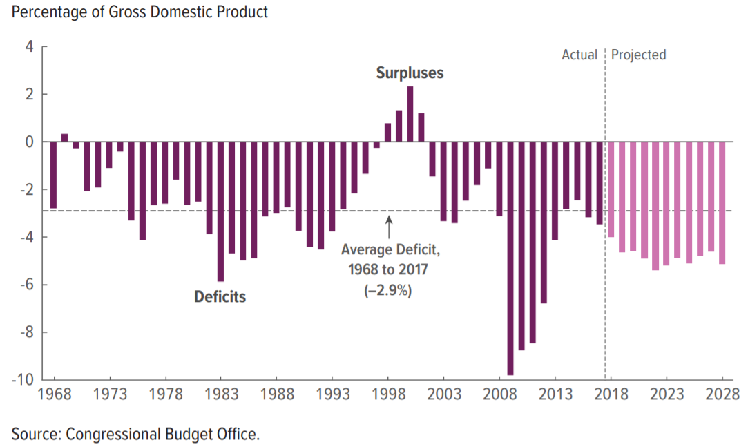
Federal Budget Deficit % GDP (1968-2028)
Deficits average about 5% GDP 2018-2028, or $1.2 trillion per year
1% GDP is about $200 billion
CBO “Budget & Economic Outlook 2018-2028” (April 2018)

Slide 17
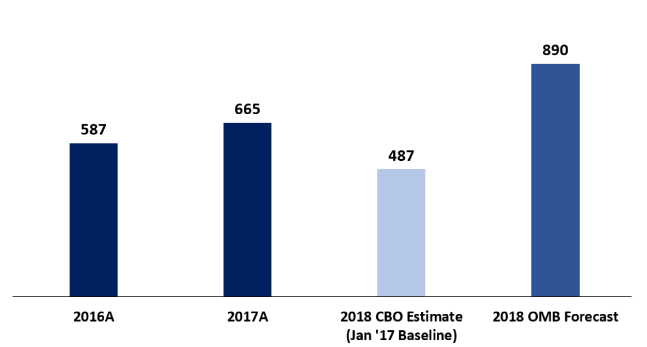
Federal Budget Deficit FY 2018 (Oct 1 2017 to Sept 30 2018)
OMB forecast is an increase of $225 billion (34%) vs. FY2017 deficit and $403 billion (83%) vs. CBO January 2017 baseline. Differences mainly due to Tax Act and spending increases.

Slide 18
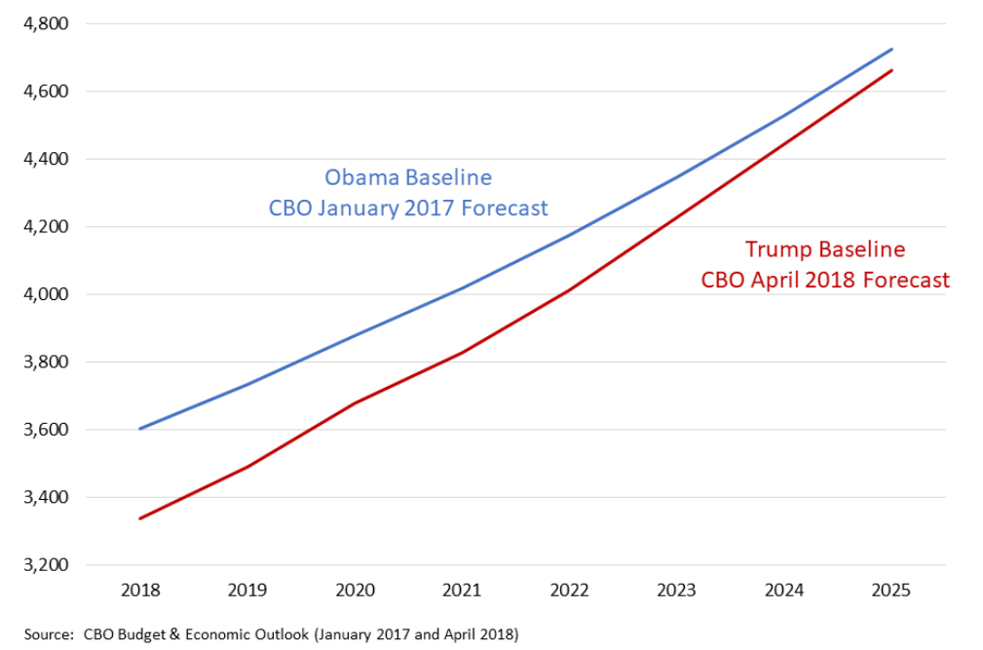
Federal Revenue Collection Forecast 2018-2025 ($ Billions)
Tax cuts reduce revenues relative to a baseline without them
Revenues tend to rise with the economy, but less after a tax cut
The tax cuts are front-loaded, as the gap narrows over time

Slide 19
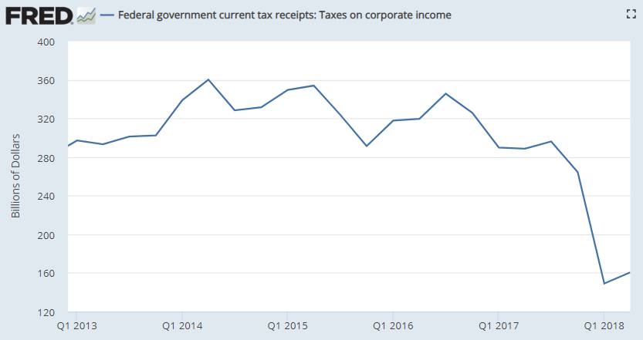
Federal Corporate Income Tax Receipts Q1 2013 - Q2 2018 ($ Billion)
Krugman: “Corporations have gotten a really big tax cut: The tax take on corporate profits has fallen off a cliff since the tax cut was enacted. But they’re using the extra money for stock buybacks and higher dividends, not investment.”
Q2 2018
$161B
-50% vs.
2013-2016 Avg
NYT: Paul Krugman “Trump, Tariffs, Tofu and Tax Cuts” (July 9, 2018)

Slide 20
Federal Budget Deficit Forecasts for 2018-2027 ($ Billions)
CBO January 2017 Baseline (Obama) vs. April 2018 Alternate (Trump)
$13.7 trillion total additions
$4.3 trillion additions due to Trump’s tax cuts and spending increases, if current policy extended
+45% vs. January 2017 baseline (+$34,000 per household)
5x Obama 2009 Stimulus Plan (ARRA)
$9.4 trillion total
CBO January 2017 Baseline
Source: CBO “Budget & Economic Outlook” (January 2017 and April 2018)

Slide 21
Topics
Key Economic Indicators
Budget Deficits & Debt
Stock Market

Slide 22
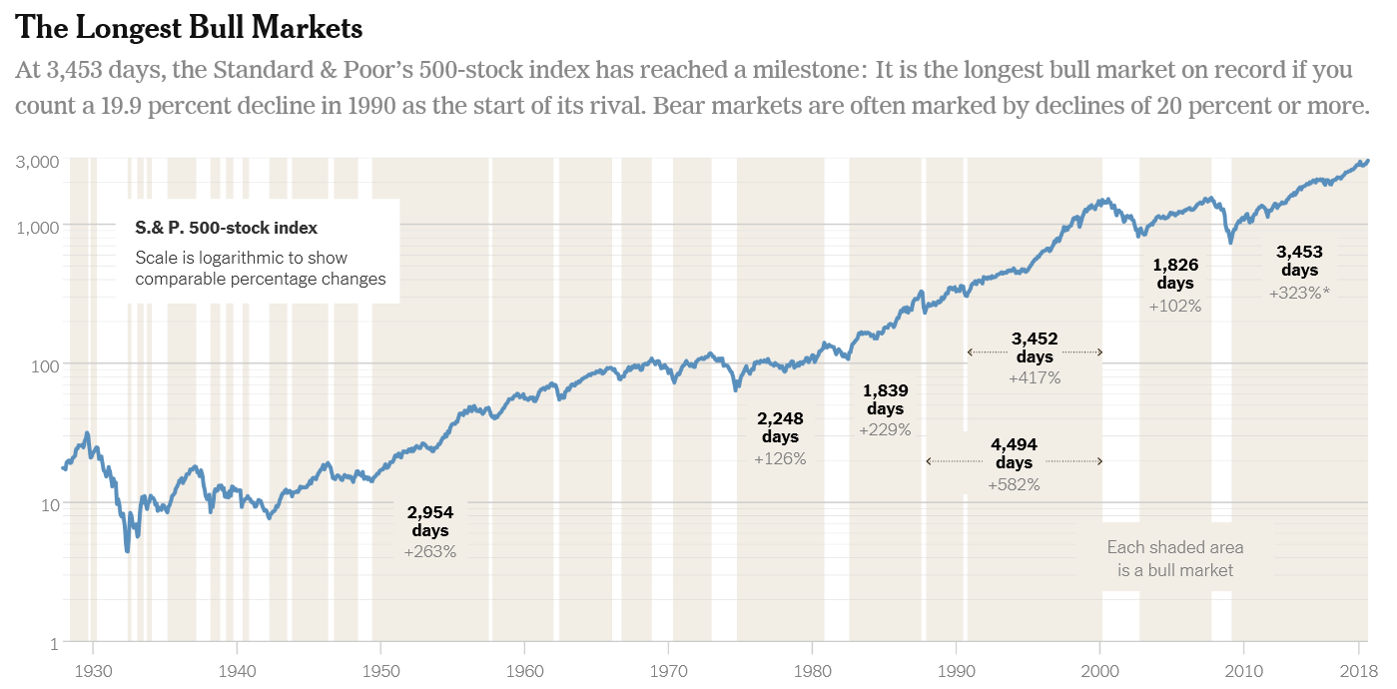
Stocks: Bull Market Since 2009
The stock market has been increasing since March 2009 without a 20% decline
The top 1% wealthiest own about 40% of stock market value
The top 10% wealthiest own about 81%
The bottom 80% own 8%
The bottom 50% have no direct or indirect stock ownership (i.e., no 401k)
NYT: “Bull Market Hits a Milestone: 3,453 Days. Most Americans Aren’t at the Party.” (August 22, 2018)
NPR: “While Trump Touts Stock Market, Many Americans Are Left Out Of The Conversation” (March 1, 2017)

Slide 23
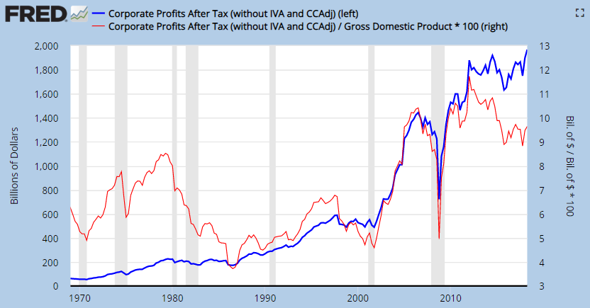
Corporate Profits Hit Record $ Level in Q2 2018 (Annualized)
$1.97 trillion
$ (Left Axis)
9.7% GDP
% GDP (Right Axis)

Slide 24
S&P 500: Is the Stock Market Doing Better Under Trump?
S&P
500
Trump
11/1/16 to 9/5/18
17.4% Annual
Growth Rate
Obama
Trough 3/9/09 to 11/1/16
15.1% Annual Growth Rate
Number of Trading Days
Source Data: FRED SP 500

Slide 25
S&P 500 Sector Performance (Year-to-Date 9/7/2018)
Consumer discretionary: Apparel, restaurants, leisure, general retail
Consumer staples: Food products, beverages, soap/toiletries, tobacco
Source Data: Raymond James

Slide 26
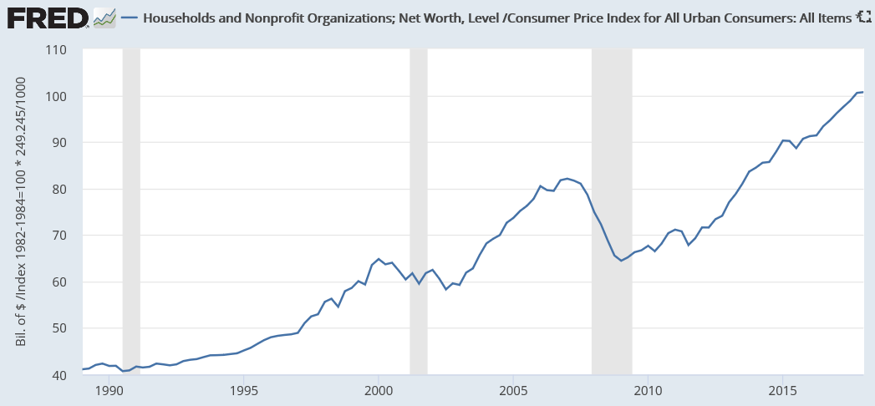
Real U.S. Household Net Worth Hit $100 Trillion in Q1 2018
Q1 2018
$100.8
trillion
Real Net Worth
(2018 $)
Net worth reflects stock market (financial assets) and home equity
The globalized free trade system has been a massive wealth generator, but the gains were unequally distributed
Real (inflation-adjusted) household net worth has increased 2.5x since 1990
$100 trillion is about $800,000 per family if split evenly
Median (50th percentile family) had $97,300 net worth in 2016
The top 1% owns about 40% of this wealth, vs. 25% in the pre-Reagan era

Slide 27
Legacy of the Financial Crisis
Median Family Net Worth 1989 - 2016
Net worth remained about $42,400 (30%) below the pre-crisis (2007) peak as of 2016
$139.7
$97.3
Thousands of
2016 Dollars
$83.7
Source Data: Federal Reserve Survey of Consumer Finances (2017)
Statistic for “All Families”

