Slide 1
Trade
Fiscal and Economic Issues
Discussion Group
July 2018

Slide 2
Topics
Trade Theory
Trade Figures
The China Price
Trade War So Far

Slide 3
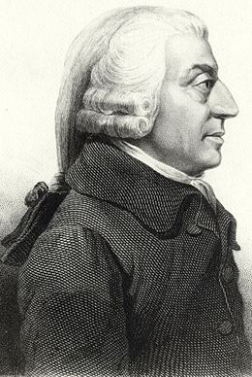
The Wealth of Nations: Adam Smith (1776)
“In every country it always is and must be the interest of the great body of the people to buy whatever they want of those who sell it cheapest.”
“It is the maxim of every prudent master of a family, never to make at home what it will cost him more to make than to buy.”
Source: Henry Hazlitt: Economics in One Lesson (1979 Edition)

Slide 4
How Trade Increases GDP (Output and Incomes)
Comparative advantage allows countries to specialize in those goods they are relatively more efficient at producing
Economies of scale occur when firms spread fixed cost by producing for a larger market
Technological spillovers accelerate the spread of technology around the world
Import competition reduces pricing power of domestic firms
Employment in import and export industries
Peterson Institute for International Economics: Bradford, Grieco, and Hufbauer- “The Payoff to America from Global Integration” (2005)
Business Round Table: “How the U.S. Economy Benefits from International Trade and Investment” (2015)

Slide 5
Theoretical Impact of Import Tariffs
Import tariff imposed
Protected industry (PI)
Demand Rises for Domestic Product
Final product prices rise
Unprotected industries (UI)
Consumers have less to spend
Jobs and incomes reduced in UI
Jobs and incomes increase in PI
Overall productivity
More labor in less efficient industries
Reduced overall output & income
Consumers spend more for same product
Reduced output per hour
Source: Henry Hazlitt: Economics in One Lesson (1979 Edition)

Slide 6
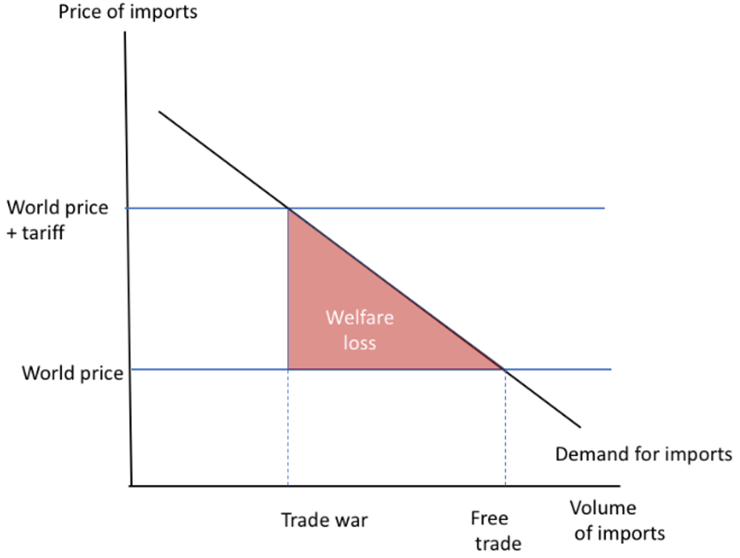
Krugman: Effect of Higher Trade Barriers
“So when a tariff drives up the price of imports to consumers, leading them to buy fewer imported goods, the welfare loss will be roughly:
Loss = fall in imports * ½ tariff rate”
Krugman estimates 2-3% GDP loss with a major trade war, if we had tariffs of 40% and a 70% decline in trade
Significant employment disruption (11 million employed in export industries)
NYT: Paul Krugman “Thinking About a Trade War” (June 2018)

Slide 7
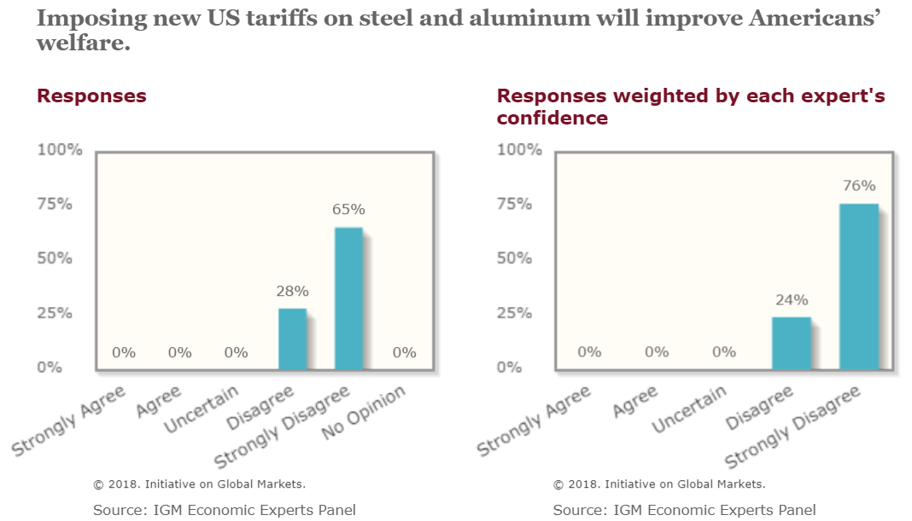
IGM Economic Experts Panel: Tariffs Help Some, Hurt Others, Overall A Bad Idea (March ‘18)

Slide 8
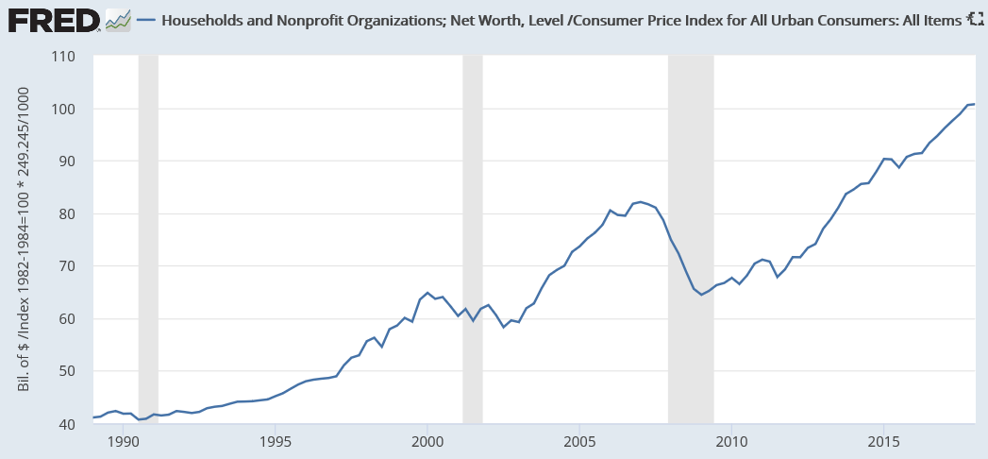
U.S. Household Net Worth Hit $100 Trillion in Q1 2018
$100.7
trillion
Real HH Net Worth
(2018 $)
The globalized free trade system has been a massive wealth generator, but the gains were unequally distributed
Real (inflation-adjusted) household net worth has increased 2.5x since 1990
$100 trillion is about $800,000 per family if split evenly
Median (50th percentile family) had $100,000 net worth in 2016

Slide 9
Topics
Trade Theory
Trade Figures
The China Price
Trade War So Far

Slide 10
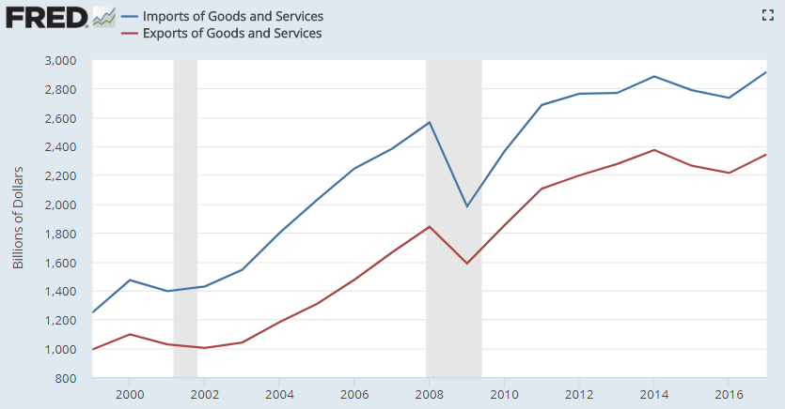
Imports and Exports of Goods and Services ($ Billions)
2017
$2.90 trillion
15% GDP
Imports
Exports
$2.35 trillion
12% GDP
Exports add to GDP
Imports subtract from GDP
GDP = C + I + G + Net Exports
U.S. GDP is about $20,000 billion or $20 trillion.
The trade deficit of $550 billion is a net reduction to GDP.

Slide 11
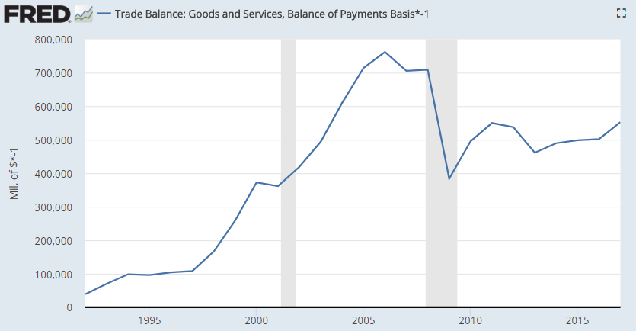
Trade Deficit ($ Billions)
2017
$552 B
Trade deficit around 2.8% GDP since 2013
2016 | 2017 | Change | % Chg.
502 | 552 | 50 | 10%

Slide 12
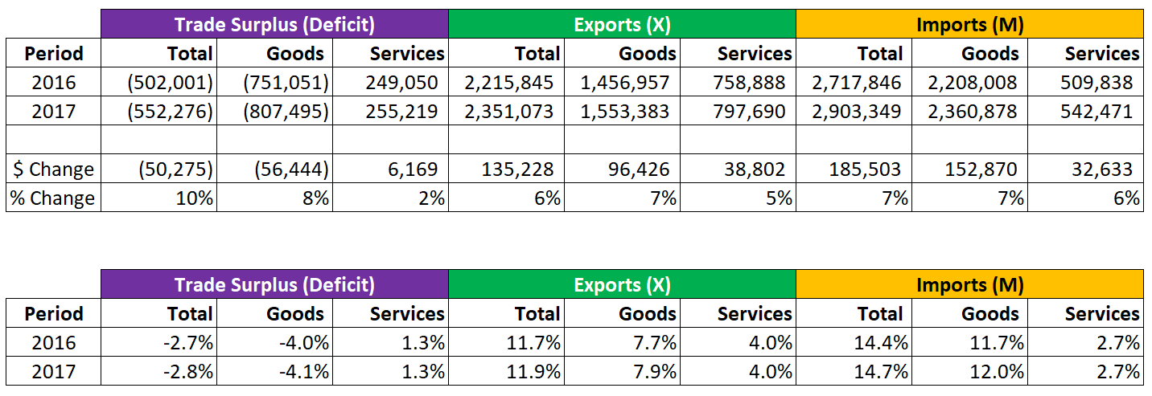
Imports and Exports of Goods and Services ($ Billions)
The U.S. has a goods trade deficit and services trade surplus, for a net deficit overall.
Trade Surplus (Deficit) = Exports – Imports = X – M = Net Exports
Net Exports are negative, which reduces GDP, other things equal
$
% GDP
Source: U.S. Census Bureau – Foreign Trade Data

Slide 13
Top Goods Imports and Exports (May 2018 YTD)
# | Commodity Imports | May YTD ($ Billions)
1 | Passenger cars, new and used | 73
2 | Crude oil | 65
3 | Pharmaceutical preparations | 55
4 | Vehicles parts and accessories | 46
5 | Cell phones and other household goods | 46
6 | Computers | 33
7 | Telecommunications equipment | 31
8 | Computer accessories | 27
9 | Industrial machines, other | 25
10 | Electric apparatus | 23
11 | Semiconductors | 22
12 | Apparel, textiles, nonwool or cotton | 21
13 | Apparel, household goods - cotton | 18
14 | Medicinal equipment | 17
15 | Furniture, household goods, etc. | 16
# | Commodity Exports | May YTD ($ Billions)
1 | Vehicle parts and accessories | 26
2 | Petroleum products, other | 26
3 | Industrial machines, other | 26
4 | Passenger cars, new and used | 24
5 | Civilian aircraft | 23
6 | Pharmaceutical preparations | 22
7 | Semiconductors | 20
8 | Engines-civilian aircraft | 20
9 | Electric apparatus | 19
10 | Fuel oil | 16
11 | Crude oil | 16
12 | Medicinal equipment | 16
13 | Plastic materials | 15
14 | Telecommunications equipment | 15
15 | Computer accessories | 14
Source: U.S. Census Bureau / FT900 Report / Exhibit 8
Source: U.S. Census Bureau / FT900 Report / Exhibit 7

Slide 14
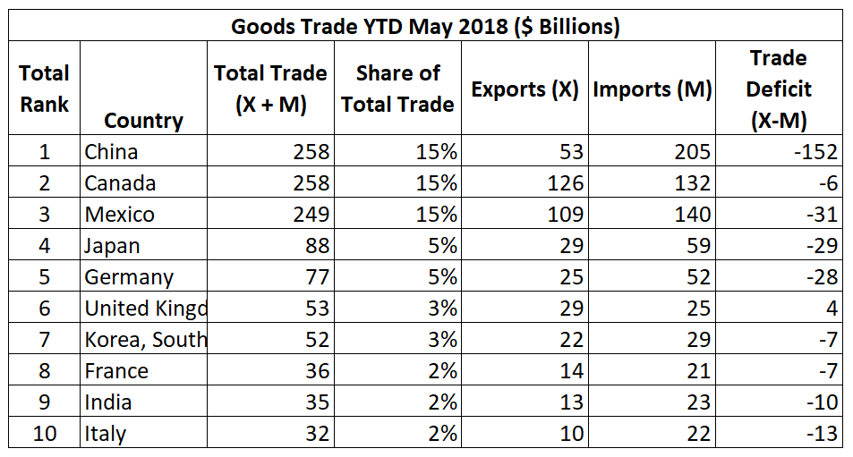
Main Trading Partners: Goods Only (May 2018 YTD)
Source: U.S. Census Bureau – Top Trading Partners
https://www.census.gov/foreign-trade/statistics/highlights/toppartners.html

Slide 15
Topics
Trade Theory
Trade Figures
The China Price
Trade War So Far

Slide 16
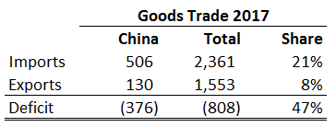
Goods Trade with China ($ Billions)
$376B of the $807B goods trade deficit (47%) is with China.
Source: U.S. Census Bureau – Trade in Goods with China

Slide 17
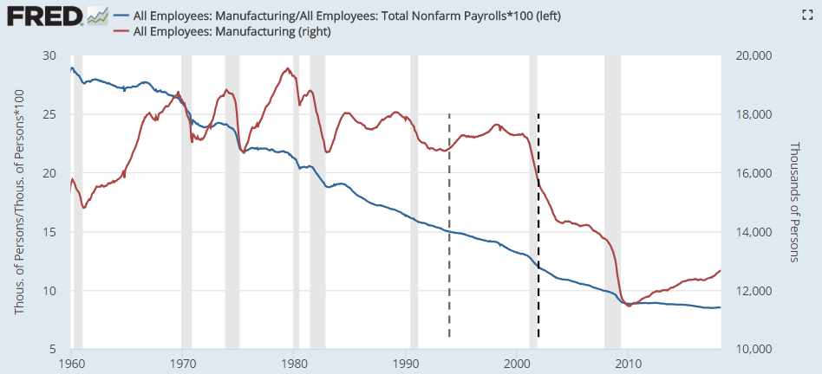
Manufacturing Employment: Number and Share of Total Employment
%
(000s)
28%
Feb ‘98
17.6 million
May ‘18
12.7 million
NAFTA Signed December 8, 1993
8.5%
China Joined WTO
December 11, 2001

Slide 18
NYT Paul Krugman on Manufacturing Trends (December 2016)
Trend in Share of Manufacturing Jobs to Total
Q: “How much of a role did trade play in the long-term decline in the manufacturing share of total employment, which fell from around a quarter of the work force in 1970 to 9% in 2015?
A: “The answer is, something, not much.”
Trend in Number Employed
Q: “How much of a role did trade play in the absolute decline in manufacturing employment, down about 5 million since 2000?”
A: “Here the role is bigger…even so, trade is less than half the story, but by no means trivial.”
About 1 million manufacturing jobs lost 1999-2011 (Autor / Dorn “The China Shock” August 2016)
“Absent the trade deficit, manufacturing [employment] would be maybe a fifth bigger than it is.”
Krugman’s estimate: 1/5 x 12.3m = 2.5 million
EPI: “Specifically, between 2000 and 2007, growing trade deficits in manufactured goods led to the loss of 3.6 million manufacturing jobs in that period.”
Conclusion: “Less than a fifth of the absolute loss of manufacturing jobs over that period, and a quite small share of the long-term manufacturing decline.”
Source: Paul Krugman “Trade and Manufacturing Employment: No Real Disagreement” (December 4, 2016)

Slide 19
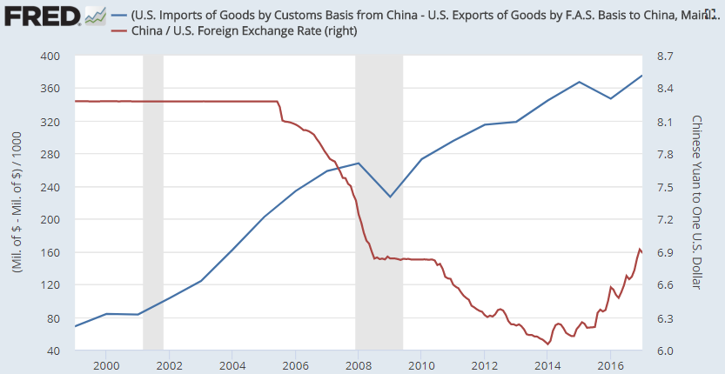
Goods Trade Deficit with China ($ Billion) and Exchange Rate (Yuan per $1)
2005 to 2014: U.S. trade deficit with China increased consistently despite weaker dollar
In theory, currency of country with deficit should weaken, making exports more attractive, reducing trade deficit
$ Billion
Stronger Dollar
Weaker Yuan
U.S. Trade Deficit with China
(Left Axis)
Yuan per Dollar
(Right Axis)
Weaker Dollar
Stronger Yuan

Slide 20
Topics
Trade Theory
Trade Figures
The China Price
Trade War So Far

Slide 21
U.S. Import Tariffs & Response
Tariffs
Solar panels (30% rate) and washing machines (20%)
Steel (25%) and Aluminum (10%) from Russia, China, Turkey, EU, Canada and Mexico
South Korea, Australia, Brazil, and Argentina exempted
Since these are “intermediate products” (inputs to other products), they could have widespread negative impact
Tariffs cover an estimated 4.1% of U.S. imports (as of March)
25% tariffs applied to $34 billion of imports from China; another $16B pending
10% tariff list for another $200 billion of Chinese imports under consideration
Trump threatened import tariffs for all Chinese imports (~$500B)
Responses
China and EU have filed WTO complaints
China retaliated with $34B import tariffs on soybeans, pork, fish, orange juice, and whiskey
Canadian retaliatory tariffs went into effect in July on $13B of U.S. exports
Japan and EU signed a trade pact
NPR: “Trump Slaps Tariffs on Imported Solar Panels and Washing Machines” (January 22, 2018)
Washington Post: “Trump has officially put more tariffs on U.S. allies than China” (May 31, 2018)
Bloomberg: “Trump Says He’s Ready to Go with $500 billion in tariffs on all China imports” (July 20, 2018)

Slide 22
U.S. Rationale for Tariffs
General
Loss of manufacturing jobs
National security (steel, aluminum)
Reduced wages
Political motives: Protect potential swing voters
Bargaining ploy: Take radical position to obtain a more favorable outcome
China
Market barriers to prevent export to China
U.S. Trade Representative (USTR) concluded that China forces US tech companies to enter into joint ventures with Chinese businesses and share their technology
Chinese firms allegedly steal patents and software from the American firms
Chinese manipulation of regulations to protect its own high-tech industries
U.S. Trade Representative: “Findings of the Investigation into China’s Acts…” (March 22, 2018)
Robert Lighthizer, “Evaluating China’s role in the WTO over the past decade” Congressional Testimony (2010)

Slide 23
It’s About Identify Politics, Not Economics
“The Peterson Institute for International Economics estimates that the U.S. economy benefits to the tune of $2.1 trillion every year from trade expansion.”
“Neither the Trump administration nor its supporters have any valid economic or national security reason for these tariffs, and even tariff supporters admit it. Still, actual trade policy will get worse in the short run. The current schism on the issue has little to do with economics and everything to do with identity, and the metamorphosis of this debate spells trouble for defenders of the open global economy.”
“For trade to be Pareto-improving, the winners have to compensate the losers out of their windfalls. This did not happen during the China shock. American corporations gained access to a new market and less expensive labor and materials, even as regular citizens were seeing factories shut down and jobs dry up. So you can understand why Rust Belt steelworkers have been pissed off for more than a decade. Economist Dani Rodrik has mused that for every dollar of extra output that trade liberalization produces, it redistributes $4–$5 from the losers of globalization to the winners. That is a surefire recipe for contentious politics.”
“Consistent with longstanding economic theory, China's liberalization benefitted capital and hurt labor in the developed world, as Chinese workers suddenly became available as substitutes for union workers in, say, Scranton. Labor economist David Autor and others have found that local labor markets more exposed to Chinese imports experienced "increased unemployment, decreased labor-force participation, and increased use of disability and other transfer benefits, as well as lower wages.“
Source: Reason.com “The Economic Case for Free Trade is Stronger than Ever” (June 2018)

