Slide 1
Fiscal and Economic Issues
Discussion Group
August 2018

Slide 2
What We Ask of You
Understand the Facts
Sharpen Your Arguments
Communicate to Your Audience
http://www.nwsofa.org/resources/fiscal/

Slide 3
Topics
Key Economic Indicators
Budget Deficits & Debt

Slide 4
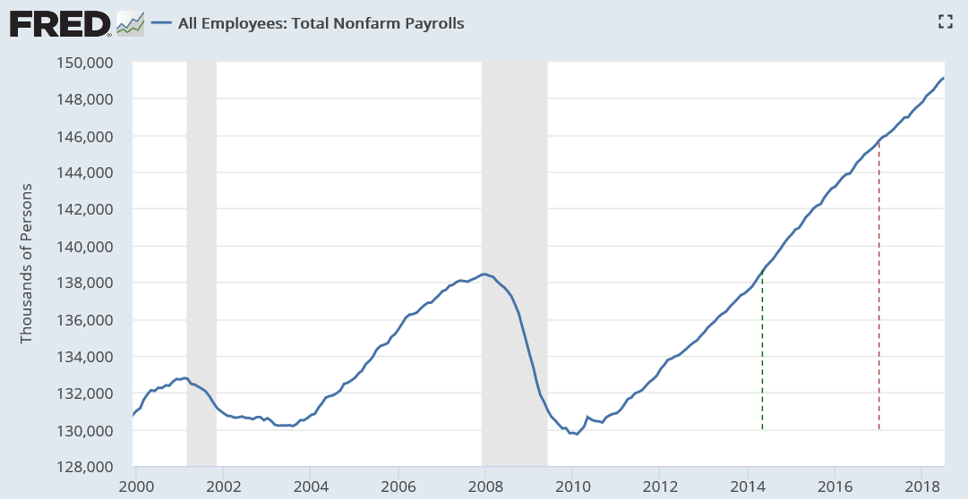
Jobs: Total Non-Farm Payrolls (Private and Govt / FT & PT)
July 2018
149.1 million total
+2,400,000 for 12 mos.
+157,000 vs. June
Recent Trend
First 18 mos. Trump = 3.43 mil jobs
Last 18 mos. Obama = 3.70 mil jobs
Monthly: 215k in 2018 vs.
182k in 2017
Private is 127m; Govt is 22m
May ‘14
Jan ‘17

Slide 5
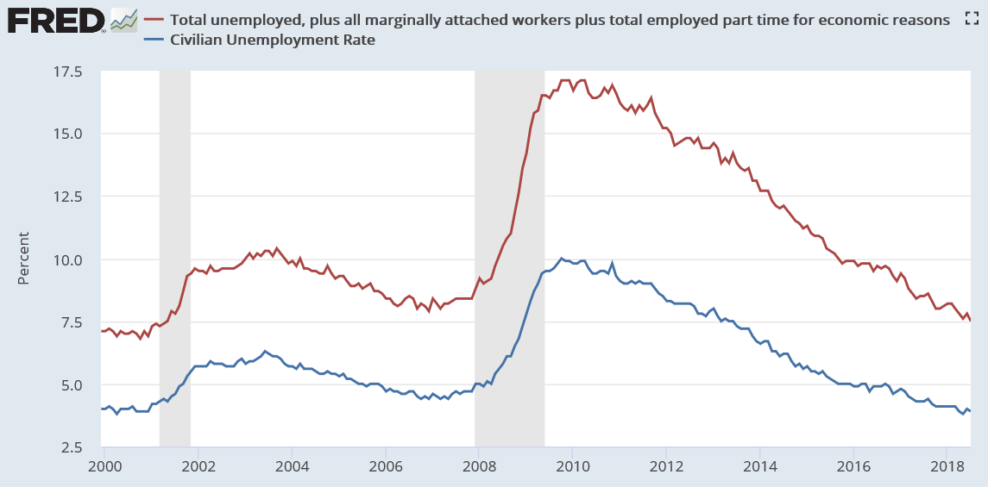
Unemployment Measures Below Pre-Crisis Levels / Are We At Full Employment?
U-6
July ‘18
U-3
7.5%
3.9%
Pre-crisis rates (Nov ‘07) were 8.4% (U6) and 4.7% (U3). U3 recovered in May 2016; U6 in May 2017

Slide 6
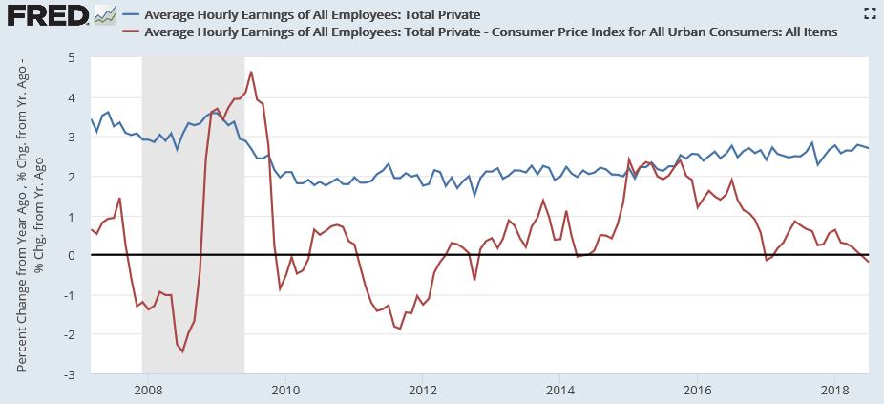
Hourly Earnings Growth Rate (%)
July ‘18
Nominal
2.70%
Real
(0.19%)
Obama: 0.8% average 2009-2017
Trump: 0.3% average 2017-2018
Source: NYT “For Wages, a Trump Slump” (August 2018)

Slide 7
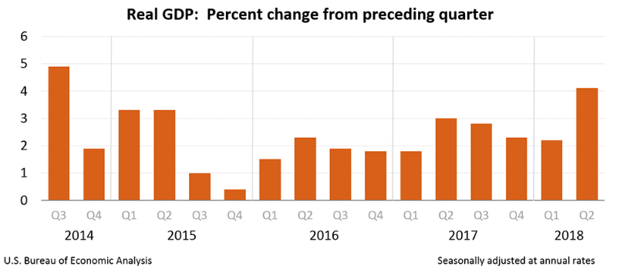
Real GDP Grew 4.1% in Q2 ’18; Best Since Q3 2014
%
4.9
4.1
Note: There were four Obama quarters of 4.1% GDP growth or higher

Slide 8
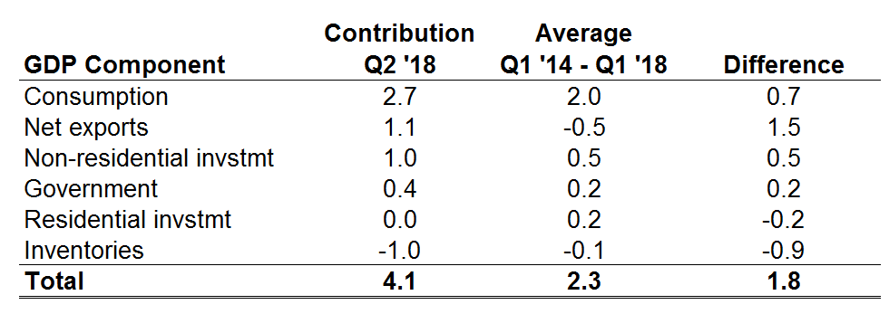
Real GDP Contribution by Component in Q2 2018 vs. Average (Percentage Points)
With the average -0.5% contribution from Net exports, GDP growth would have been 2.6%
Calculations from CBO data indicate GDP growth would be about 0.1% higher per quarter due to the Tax Act. The impact would appear mainly in the Consumption category.
Additional federal spending is in the Government category.
Source: BEA Table 1.1.2 Contributions to Percent Change in Real GDP

Slide 9
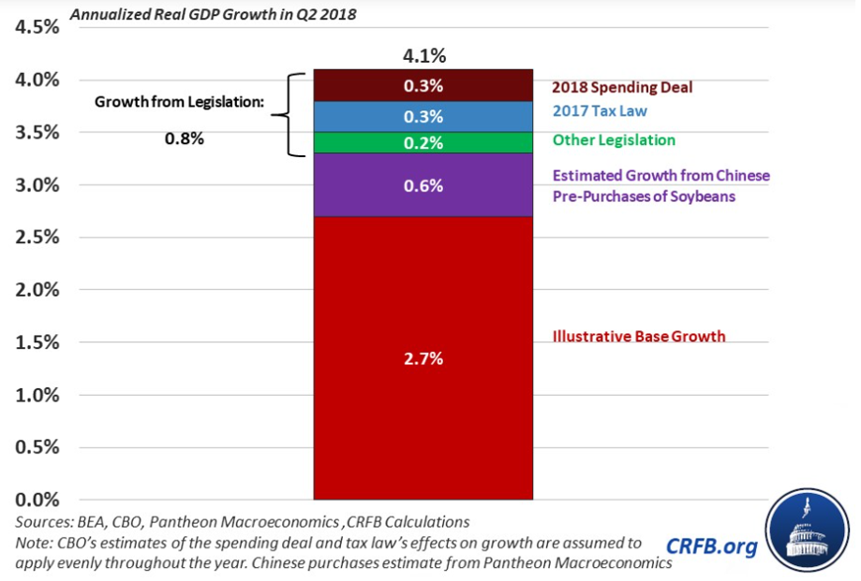
Real GDP Contribution in Q2 2018: Legislation and Trade Pre-Purchases
CRFB: “Growth just hit 4.1% - Don’t Expect it to Last” (July 27, 2018)

Slide 10
Real Potential GDP (% Change from Year Ago)
Krugman: “There’s no reason to believe that the U.S. economy’s potential growth — the rate of growth it can achieve on a sustained basis — will rise from the 2 percent or less expected by most analysts.”
1.64%
Q2 2018
FCST
2%
1955
2000
2025
NYT: Paul Krugman “Trump, Tariffs, Tofu and Tax Cuts” (July 9, 2018)

Slide 11
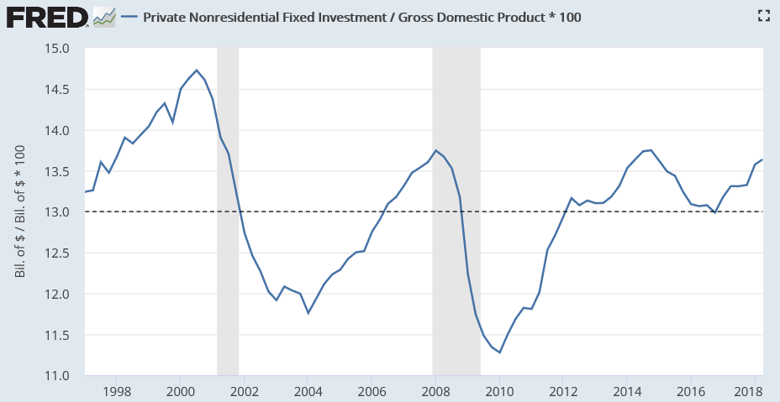
Business Investment % GDP (1997-2018)
Krugman: “Leading indicators of business investment, like orders of capital goods, show no sign of an investment boom ahead.”
13.7%
Average
13.0%
NYT: Paul Krugman “Trump, Tariffs, Tofu and Tax Cuts” (July 9, 2018)

Slide 12
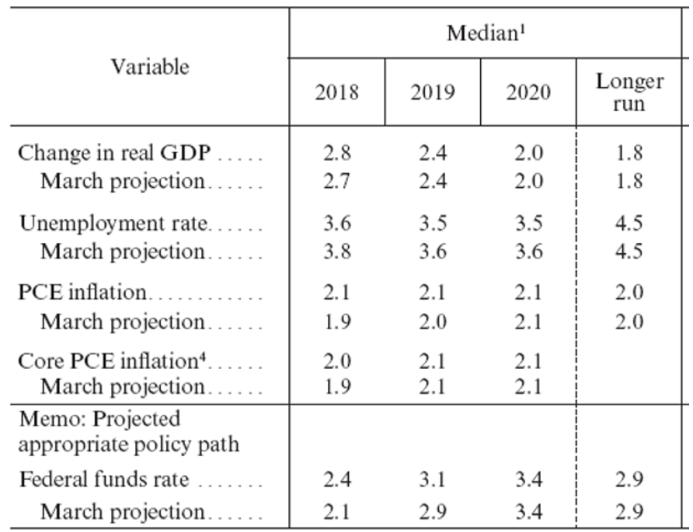
Federal Reserve Forecast for U.S. Economy (%)
Federal Reserve: Monetary Policy Report July 2018

Slide 13
Real GDP Growth Rate by President
Source: https://www.bloomberg.com/view/articles/2018-08-01/ranking-presidents-economic-records-by-gdp-growth

Slide 14
Real GDP per Capita Growth Rate by President
Source Data: FRED

Slide 15
Topics
Key Economic Indicators
Budget Deficits & Debt

Slide 16
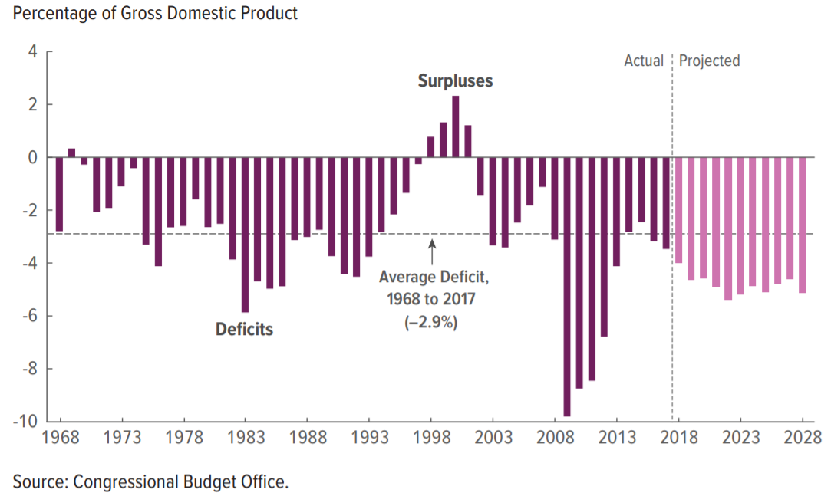
Federal Budget Deficit % GDP (1968-2028)
Deficits average about 5% GDP 2018-2028, or $1.2 trillion per year
1% GDP is about $200 billion
CBO “Budget & Economic Outlook 2018-2028” (April 2018)

Slide 17
Federal Corporate Income Tax Receipts ($ Billion)
Krugman: “Corporations have gotten a really big tax cut: The tax take on corporate profits has fallen off a cliff since the tax cut was enacted. But they’re using the extra money for stock buybacks and higher dividends, not investment.”
2013
2018
NYT: Paul Krugman “Trump, Tariffs, Tofu and Tax Cuts” (July 9, 2018)

Slide 18
Federal Budget Deficit Forecasts for 2018-2027 ($ Billions)
CBO January 2017 Baseline (Obama) vs. April 2018 Alternate (Trump)
$13.7 trillion total additions
$4.3 trillion additions due to Trump’s tax cuts and spending increases, if current policy extended
+45% vs. January 2017 baseline (+$34,000 per household)
5x Obama 2009 Stimulus Plan (ARRA)
$9.4 trillion total
CBO January 2017 Baseline
Source: CBO “Budget & Economic Outlook” (January 2017 and April 2018)

Slide 19
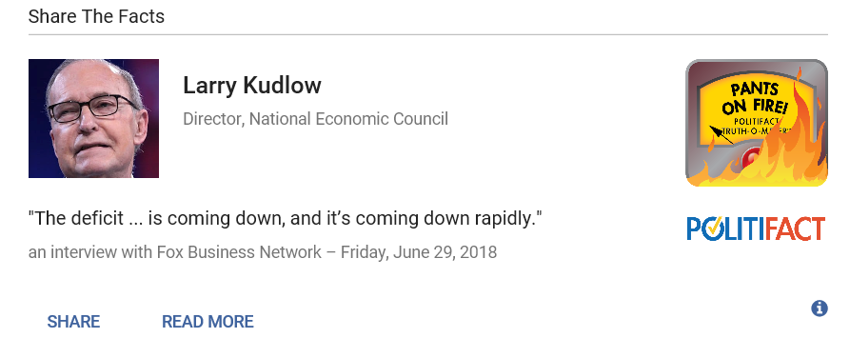
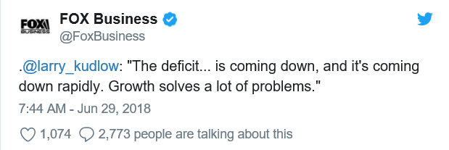
Meanwhile, From the Credible Sources Department…
Politifact: “Larry Kudlow wrong about deficits falling rapidly under Donald Trump” (July 2018)

