Slide 1
Fiscal and Economic Issues
Discussion Group
July 2018

Slide 2
U.S. Import Tariffs & Response
Tariffs
Solar panels and washing machines
Steel (25% rate) and Aluminum (10%) from Russia, China, Turkey, EU, Canada and Mexico
South Korea, Australia, Brazil, and Argentina exempted
Since these are “intermediate products” (inputs to other products), they could have widespread negative impact
Tariffs cover an estimated 4.1% of U.S. imports (as of March)
About $35-50 billion of imports from China affected
Responses
China and EU have filed WTO complaints
China stated it would retaliate (e.g., Soybeans)
Canadian retaliatory tariffs went into effect in July on $13B of U.S. exports
¹NPR: “Trump Slaps Tariffs on Imported Solar Panels and Washing Machines” (January 22, 2018)
²Washington Post: “Trump has officially put more tariffs on U.S. allies than China” (May 31, 2018)

Slide 3
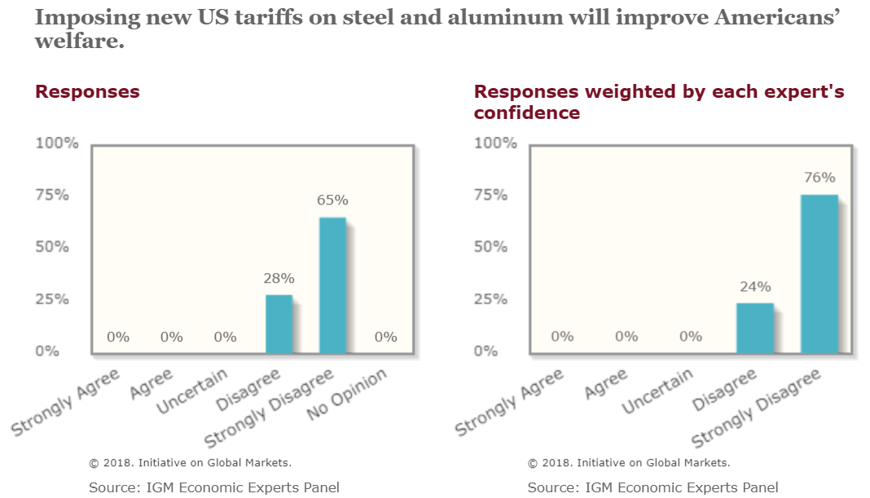
IGM Economic Experts Panel: Tariffs Help Some, Hurt Others, Overall A Bad Idea

Slide 4
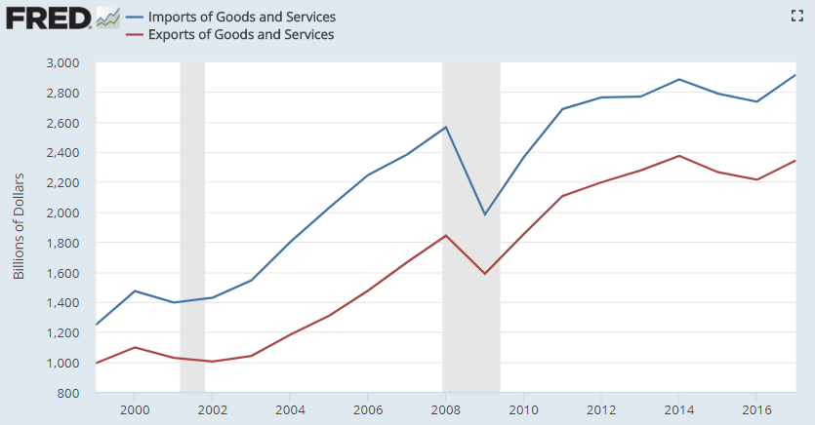
Imports and Exports of Goods and Services ($ Billions)
2017
$2.90 trillion
15% GDP
Imports
Exports
$2.35 trillion
12% GDP

Slide 5
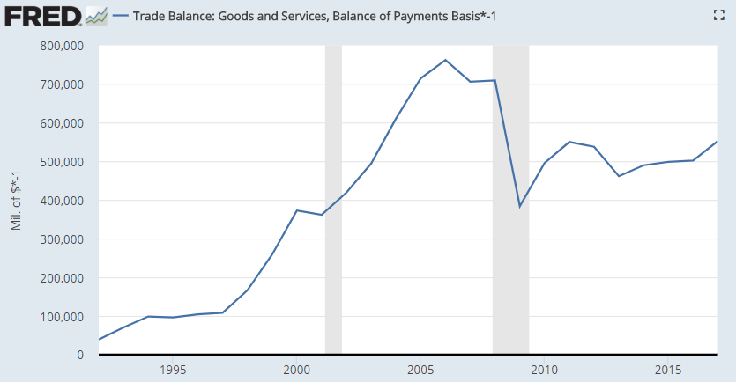
Trade Deficit ($ Billions)
2017
$552 B
2016 | 2017 | Change | % Chg.
502 | 552 | 50 | 10%

Slide 6
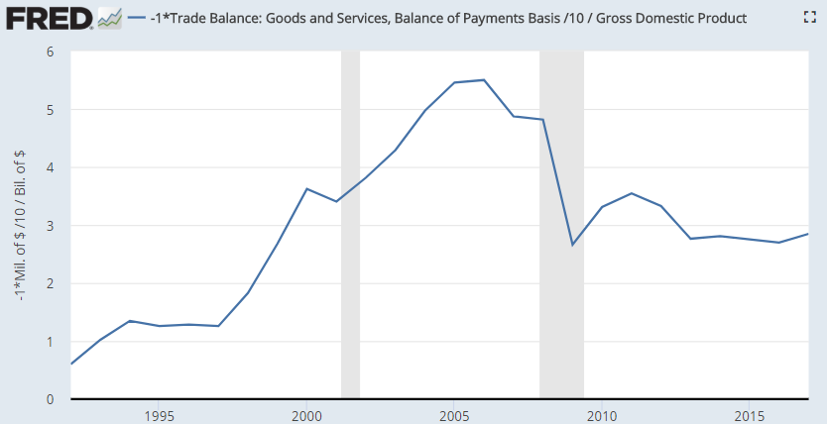
Trade Deficit (% GDP)
2017
2.85% GDP
Trade deficit ~2.8% GDP since 2013

Slide 7
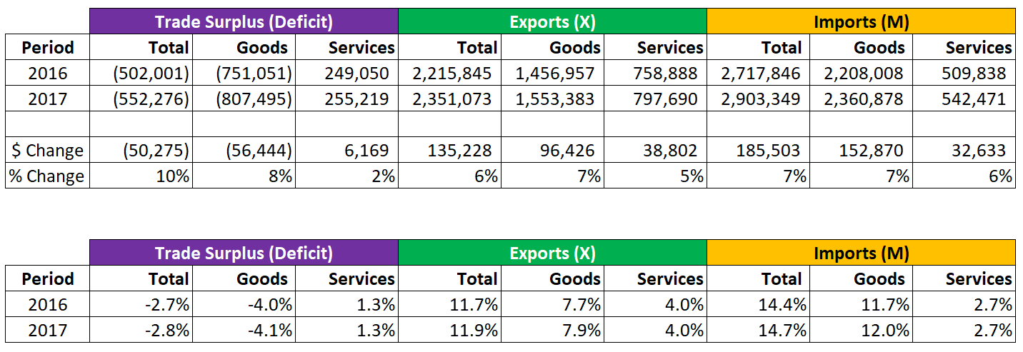
Imports and Exports of Goods and Services ($ Billions)
Trade Surplus (Deficit) = Exports – Imports = X – M = Net Exports
GDP = Consumption + Investment + Government + Net Exports
Note: Since net exports are negative, they reduce GDP, other things equal
$
% GDP
Source: U.S. Census Bureau – Foreign Trade Data

Slide 8
The Wealth of Nations: Adam Smith (1776)
“In every country it always is and must be the interest of the great body of the people to buy whatever they want of those who sell it cheapest.”
“It is the maxim of every prudent master of a family, never to make at home what it will cost him more to make than to buy.”
Source: Henry Hazlitt: Economics in One Lesson (1979 Edition)

Slide 9
Effect of Import Tariff
Import tariff imposed
Protected industry
Input costs rise
Final product prices rise
Unprotected industries
Consumers have less to spend
Jobs and incomes reduced
Jobs and incomes increase
Overall productivity
More labor in less efficient industries
Reduced overall output & income
Consumers spend more for same product
Reduced output per hour
Source: Henry Hazlitt: Economics in One Lesson (1979 Edition)

Slide 10
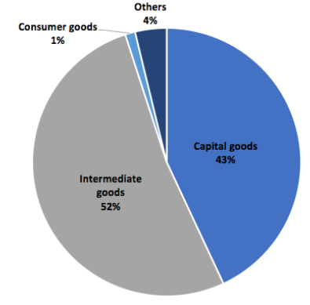
Krugman: Applying Tariffs to Intermediate and Capital Goods a Bad Idea
Krugman NYT: “Put a tariff on car parts, and even the first-round effect on jobs is uncertain: maybe domestic parts producers will add workers, but you’ve raised costs and reduced competitiveness for downstream producers, who will shrink their operations.
So in today’s world, smart trade warriors – if such people exist – would focus their tariffs on final goods, so as to avoid raising costs for downstream producers of domestic goods.”
NYT: Paul Krugman “How to Lose a Trade War” (July 2018)

Slide 11
Fed Minutes: June 12-13, 2018
“[M]any District contacts expressed concern about the possible adverse effects of tariffs and other proposed trade restrictions, both domestically and abroad, on future investment activity; contacts in some Districts indicated that plans for capital spending had been scaled back or postponed as a result of uncertainty over trade policy.
Contacts in the steel and aluminum industries expected higher prices as a result of the tariffs on these products but had not planned any new investments to increase capacity.”
NYT: Paul Krugman “How to Lose a Trade War” (July 2018)

Slide 12
Views on Tariff Effects
“The Aluminum Association, which represents the bulk of the American industry, says that 97 percent of American jobs in aluminum are at what are called “downstream” businesses that shape the metal into things like auto parts or other goods. Those companies are hurt by Mr. Trump’s tariffs, because they must now pay higher prices for their raw materials.”
“I would like to tell the president, ‘Man, you are messing up our market,’” said Kevin Scott, a soybean farmer in South Dakota and the secretary of the American Soybean Association. The idea of changing NAFTA, he said, “gives us a lot of heartburn in farm country.”
GM: “If import tariffs on automobiles are not tailored to specifically advance the objectives of the economic and national security goals of the United States, increased import tariffs could lead to a smaller GM, a reduced presence at home and abroad for this iconic American company, and risk less—not more—U.S. jobs… In a highly intertwined, global car industry, a trade war can play out in unexpected and costly ways.”
“Harley-Davidson said it would move some of its production outside of the United States to avoid retaliatory measures by the European Union. The company said it was the only “sustainable option” to “maintain a viable business in Europe.”
NYT: “How Trump’s Policy Decisions Undermine the Industries He Pledged to Help” (July 4, 2018)
NYT: “G.M. Says New Wave of Trump Tariffs Could Force U.S. Job Cuts” (June 29, 2018)

Slide 13
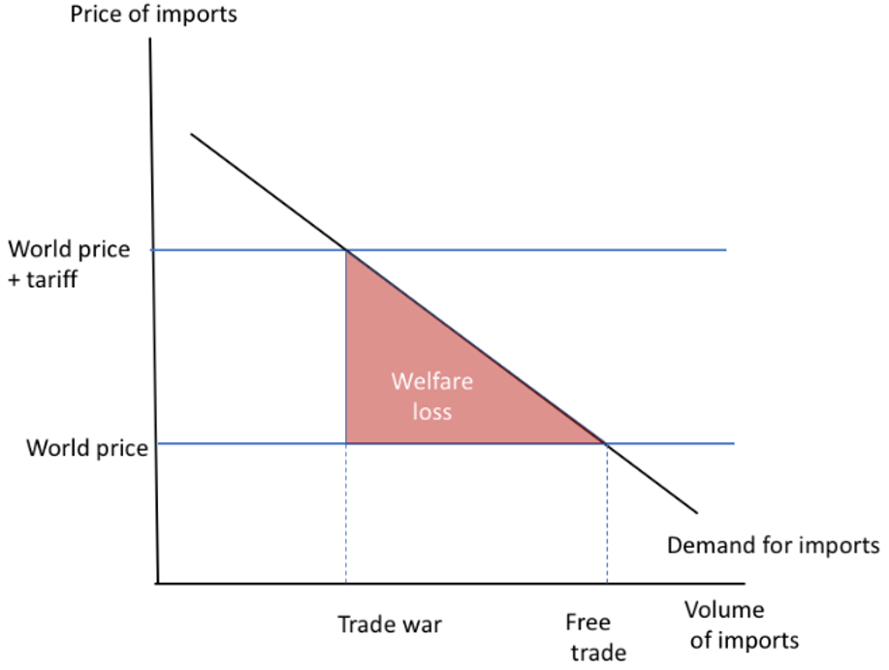
Krugman: Effect of Higher Trade Barriers
“So when a tariff drives up the price of imports to consumers, leading them to buy fewer imported goods, the welfare loss will be roughly
Loss = fall in imports * ½ tariff rate”

Slide 14
Krugman: Effect of Higher Trade Barriers
Imports
Now, the U.S. currently spends 15% GDP on imports. Suppose we end up with a trade-war tariff of 40 percent, and (as I’ve been suggesting) a 70% decline in trade.
Then the welfare loss is ½ (40%) * 0.7 * 15% GDP, or 2.1% of GDP.
2.1% GDP = $420 Billion
How much per household? $3,327
Exports
“The U.S. currently exports about 12 percent of GDP. Not all of that is domestic value added, because some components are imported. But there’s still a lot of the economy, maybe 9 or 10 percent, engaged in production for foreign markets.
And if we have the kind of trade war I’ve been envisaging, something like 70 percent of that part of the economy – say, 9 or 10 million workers – will have to start doing something else.
And there would be a multiplier effect on many communities now built around export industries, which would lose service jobs too.”

Slide 15
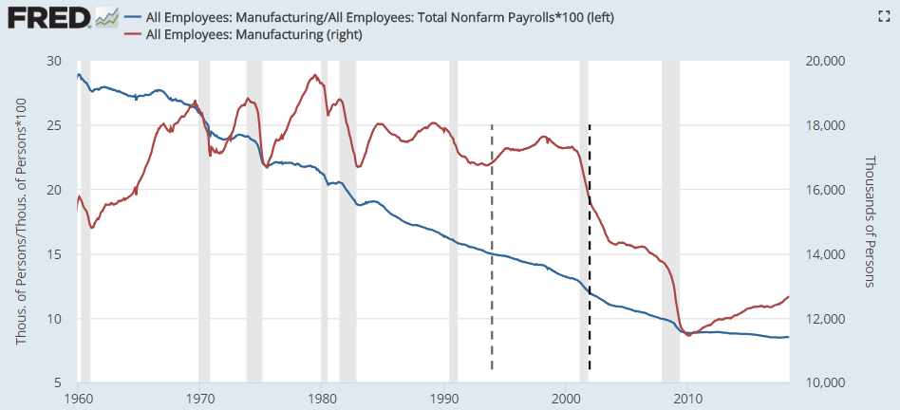
Manufacturing Employment: # and Share of Total Employment
%
(000s)
28%
Feb ‘98
17,627
May ‘18
12,673
NAFTA Signed December 8, 1993
8.5%
China Joined WTO
December 11, 2001

Slide 16
NYT Paul Krugman on Manufacturing Trends (December 2016)
Trend in Share of Manufacturing Jobs to Total
Q: “How much of a role did trade play in the long-term decline in the manufacturing share of total employment, which fell from around a quarter of the work force in 1970 to 9% in 2015?
A: “The answer is, something, not much.”
Trend in Number Employed
Q: “How much of a role did trade play in the absolute decline in manufacturing employment, down about 5 million since 2000?”
A: “Here the role is bigger…even so, trade is less than half the story, but by no means trivial.”
About 1 million manufacturing jobs lost 1999-2011 (Autor / Dorn “The China Shock” August 2016)
“Absent the trade deficit, manufacturing [employment] would be maybe a fifth bigger than it is.”
Krugman’s estimate: 1/5 x 12.3m = 2.5 million
EPI: “Specifically, between 2000 and 2007, growing trade deficits in manufactured goods led to the loss of 3.6 million manufacturing jobs in that period.”
Conclusion: “Less than a fifth of the absolute loss of manufacturing jobs over that period, and a quite small share of the long-term manufacturing decline.”
Source: Paul Krugman “Trade and Manufacturing Employment: No Real Disagreement” (December 4, 2016)

Slide 17
It’s About Identify Politics, Not Economics
“The Peterson Institute for International Economics estimates that the U.S. economy benefits to the tune of $2.1 trillion every year from trade expansion.” [Note: Some combination of net worth and GDP]
“Neither the Trump administration nor its supporters have any valid economic or national security reason for these tariffs, and even tariff supporters admit it. Still, actual trade policy will get worse in the short run. The current schism on the issue has little to do with economics and everything to do with identity, and the metamorphosis of this debate spells trouble for defenders of the open global economy.”
“For trade to be Pareto-improving, the winners have to compensate the losers out of their windfalls. This did not happen during the China shock. American corporations gained access to a new market and less expensive labor and materials, even as regular citizens were seeing factories shut down and jobs dry up. So you can understand why Rust Belt steelworkers have been pissed off for more than a decade. Economist Dani Rodrik has mused that for every dollar of extra output that trade liberalization produces, it redistributes $4–$5 from the losers of globalization to the winners. That is a surefire recipe for contentious politics.”
“Consistent with longstanding economic theory, China's liberalization benefitted capital and hurt labor in the developed world, as Chinese workers suddenly became available as substitutes for union workers in, say, Scranton. Labor economist David Autor and others have found that local labor markets more exposed to Chinese imports experienced "increased unemployment, decreased labor-force participation, and increased use of disability and other transfer benefits, as well as lower wages.“
Source: “The Economic Case for Free Trade is Stronger than Ever” (June 2018)

Slide 18
U.S. Sectoral Balances 1990 - 2017 (% GDP)
Relationship of Trade and Budget Deficits
Private + Foreign + Govt = 0
(S-I) + (M-X) + (T-G) = 0
Private (S-I)
Foreign (M-X)
2.3
1.2
-3.5
Govt (T-G)
Source Data: BEA Integrated Macroeconomic Accounts - Table S.2.a

Slide 19
Understanding U.S. Sectoral Balances
Private sector: A surplus balance means U.S. households and businesses together are net savers, building their financial asset position. In other words, savings by households exceed the amount borrowed and invested by businesses. The private sector had a roughly 1.2% GDP surplus in 2017. A deficit would mean households and businesses together are net borrowers, reducing their financial asset position.
Foreign sector or "rest of the world": A surplus balance means those outside the U.S. are net savers. This is consistent with a U.S. trade deficit, in which U.S. residents borrow savings from foreign residents to finance import purchases. Foreigners are building their net financial asset position by lending to the U.S. so it can purchase their imports. The U.S. had a trade deficit of roughly 2.3% GDP in 2017. A foreign sector deficit balance would mean foreign residents are net spenders and are borrowing from the U.S. private sector, which would be consistent with a U.S. trade surplus.
Government balance (all levels, e.g., federal, state and local in the U.S.): A surplus balance represents a government collecting more tax revenue than it pays in outlays, building its net financial asset position. This would mean the government is a net saver, removing funds from the private sector. A deficit balance means government outlays are greater than tax revenue and it is reducing its net financial asset position (i.e., increasing its debt position), providing funds to the private sector. Another interpretation is that a government surplus reduces private sector financial assets, while a government deficit increases private sector financial assets. The U.S. government at all levels ran a 3.5% GDP deficit in 2017.
Source: Wikipedia “Sectoral Balances”

Slide 20
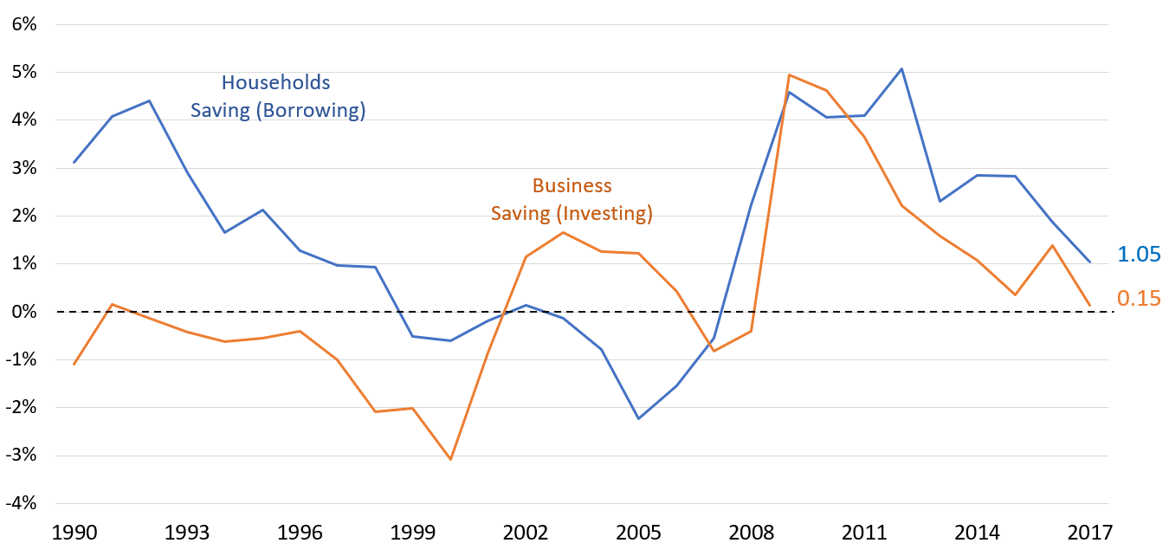
U.S. Sectoral Balances: Private Sector Components 1990-2017 (% GDP)
“In a healthy economy, businesses invest using money borrowed from households who are saving for future consumption.
In the ideal world, this business sector deficit and household sector surplus are accompanied by net exports (a deficit for the rest of the world) and a small government deficit (to fund its own investment).”
Household Surplus (Deficit) = Net Saving (Net Borrowing)
Business Surplus (Deficit) = Net Saving (Net Borrowing or Investment)
Source: New Policy Institute “United States Sector Balances over Five Decades” (July 2011)

