Slide 1
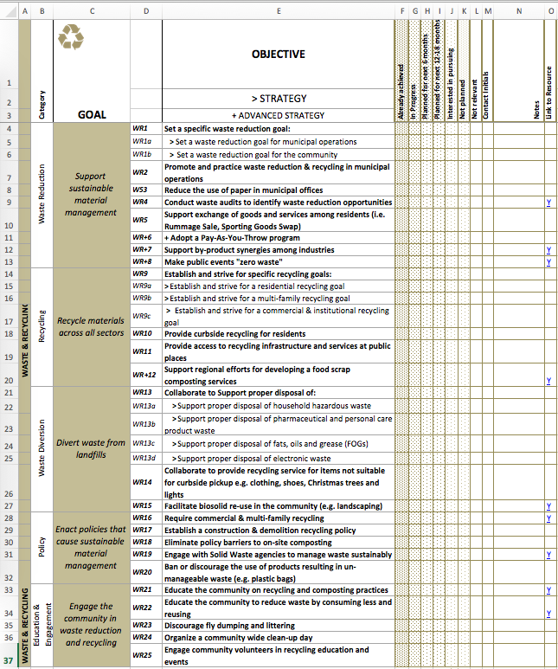
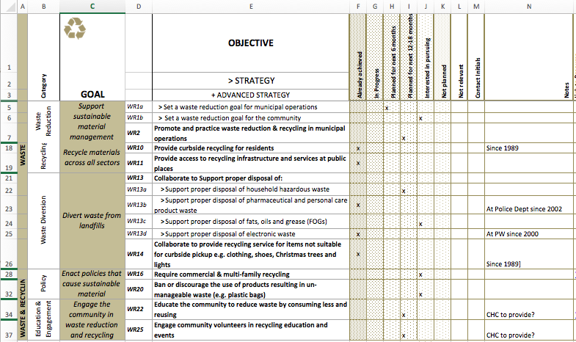
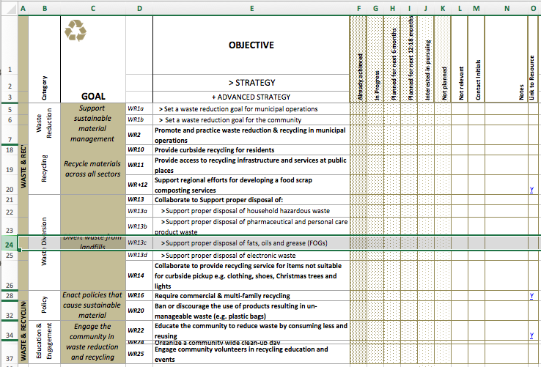
Example use of GRC2: Waste & Recycling
34 Candidate Actions
Select 15 Areas to Consider
Develop Initial Plan

Slide 2
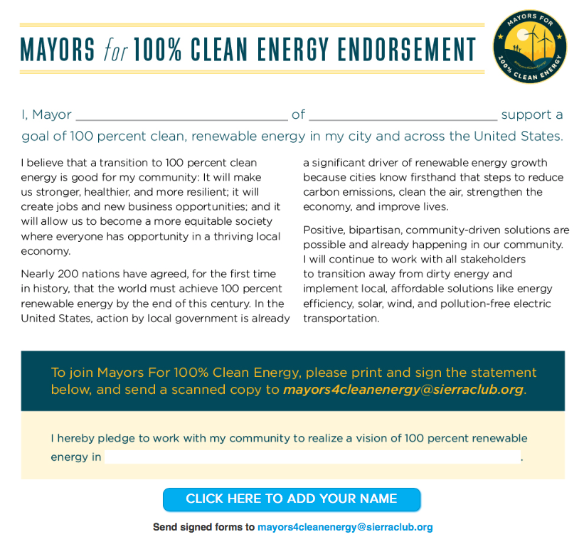
Example: Ready for 100: Endorsement
Suggested text for Mayors/Village President to post public commitment to sustainable practices
Available@: http://www.sierraclub.org/ready-for-100/mayors-for-clean-energy
Once signed, considered member community by Sierra Club
No funds required

Slide 3
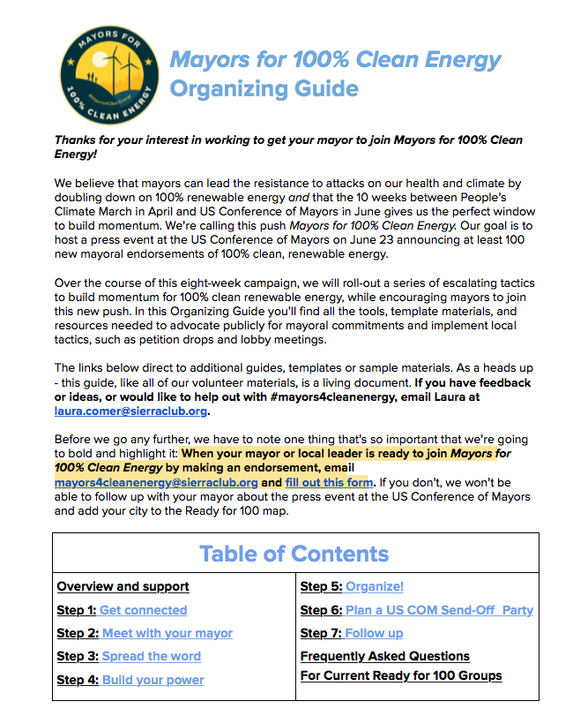
Ready for 100: Guide
18 Page How To Booklet
Available on line as Google Doc @: https://docs.google.com/document/d/1dvxjtK4Ls6vMZ0hs8_YWnYneXNaT2Vy6pgHW0gaCj8g/edit?usp=sharing

