Slide 1
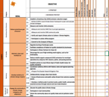
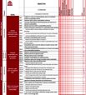
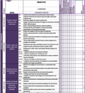
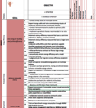
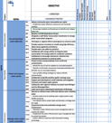
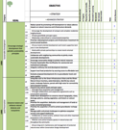
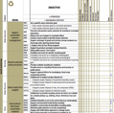
GRC Framework Areas
GRC2 Framework available to be used as customizable sustainability planning tool for municipalities:
http://mayorscaucus.org/wp-content/uploads/2017/04/GRC2-Framework-Booklet_PDF_Final-2017.pdf
These are the 10 subject areas covered in the Framework:
◎ Mobility
◎ Municipal Operations
◎ Sustainable Communities
◎ Water
◎ Waste & Recycling
◎ Climate
◎ Energy
◎ Economic Development
◎ Land Use
◎ Leadership

Slide 2
GRC Member Municipalities in our Area:
Resolution Signatories
100 Municipalities
10 regional Councils of Government (“COGs)

Slide 3
Example use of GRC2: Energy Framework
https://www.comed.com/WaysToSave/ForYourBusiness/Pages/default.aspx

Slide 4
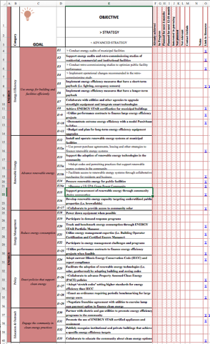
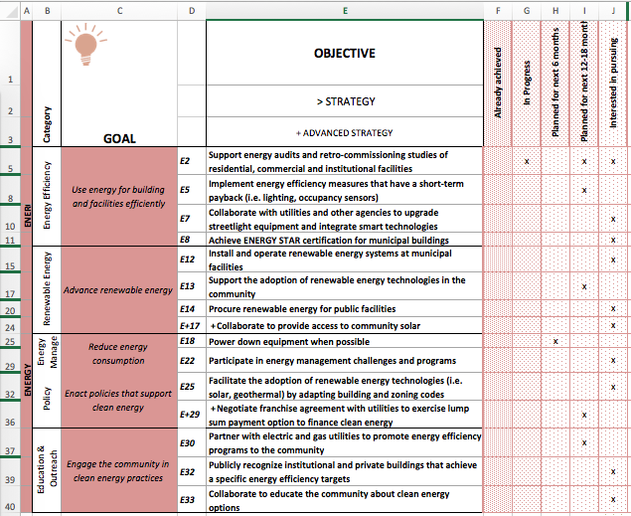
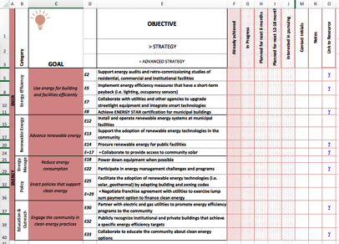
Example use of GRC2: Energy
37 Candidate Actions
Select Subset Areas to Consider (15)
Develop Initial Plan

