Slide 1
Three Planning Platforms
Chicago Metropolitan Agency for Planning (CMAP) – ONTO 2050 Plan
Provides vision for region – broad brush, long term, region wide
Focus: resilience, inclusiveness and prioritized investment for regional plans
Municipal perspective: can leverage planning grants, inform planning related to regional needs
Metropolitan Mayors Caucus (MMC)- Greenest Region Compact (GRC)
Provides municipalities with resolution (commitment) and GRC Framework to address specific municipal issues
Focus: Sustainability Spectrum
Municipal Perspective: For those communities that have signed resolution, GRC Framework provides list of 1100 ideas that can be used to build municipal sustainability plans. Also these members into range of related incentives and free services
Ready for 100 (Sierra Club) – RF100
Provides municipalities with resolution and ideas for reducing greenhouse gases and committing to 100% renewable energy by 2050
Focus: Green Energy
Municipal Perspective: Signing resolution provides good public branding and ideas as to ways to plan and deploy green energy solutions
Notes:
http://www.cmap.illinois.gov/onto2050

Slide 2
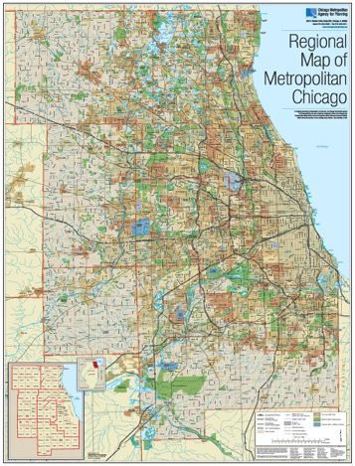
CMAP – ONTO 2050 Vision
ONTO 2050 represents the 7 county* region’s Comprehensive Plan and provides a vision for regional planning for transportation infrastructure, highly trained workforce, natural resources, livable communities and economic vitality
The Principles
Resilience
Inclusive Growth
Prioritized Investment
Categories
Community
Prosperity
Environment
Governance
Mobility
*Cook, DuPage, Kane, Kendall, Lake, McHenry and Will

Slide 3
Category: Community
Strategic and sustainable development
Target infill, infrastructure, and natural area investments
Invest in disinvested areas
Reinvestment for vibrant communities
Support development of compact, walkable communities
Match regional and local housing supply with the types that residents want
Improve natural resources through the redevelopment process
Development that supports local and regional economic strength
Develop tax policies that strengthen communities and the region
Incorporate market and fiscal feasibility into planning and development processes
Align local economic development planning with regional goals

Slide 4
Category: Prosperity
Robust economic growth that reduces inequality
Pursue regional economic development
Support the region’s traded clusters
Prioritize pathways for upward economic mobility
Enhance economic innovation
Responsive, strategic workforce and economic development
Conduct regional planning for human capital
Align local economic development planning with regional goals
Reform incentives for economic development
Expand data-driven approaches in the workforce and education systems

Slide 5
Category: Environment
A region prepared for climate change
Plan for climate resilience
Intensify climate mitigation efforts
Integrated approach to water resources
Protect and enhance the integrity of aquatic systems
Reduce flood risk to protect people and assets
Coordinate and conserve shared water supply resources
Development practices that protect natural resources
Improve natural resources through the redevelopment process
Integrate land preservation into strategic growth efforts

Slide 6
Category: Governance
Collaboration at all levels of government
Use collaborative leadership to address regional challenges
Encourage partnerships and consolidation
Coordinate infrastructure operations and maintenance
Capacity to provide a strong quality of life
Develop tax policies that strengthen communities and the region
Build local government capacity
Data driven and transparent investment decisions
Base investment decisions on data and performance
Improve access to public information through technology and transparency

Slide 7
Category: Mobility
A modern, multimodal system that adapts to changing travel demand
Harness technology to improve travel and anticipate future impacts
Make transit more competitive
Maintain the region’s status as North America’s freight hub
A system that works better for everyone
Leverage the transportation network to promote inclusive growth
Improve travel safety
Improve resilience of the transportation network to weather events and climate change
Making transformative investments
Fully fund the region’s transportation system
Enhance the region’s approach to transportation programming
Build regionally significant projects

Slide 8
CMAP Idea Areas for Environmental
Transportation planning and deployment for region
Climate change mitigation, resilience and adaptation
Clean energy – energy efficiency, energy storage, renewables
Health
Water quality – protect natural resources
Air pollution- reduce air pollution
Flooding, storm water management, green infrastructure, permeable surfaces, rain barrels, bioswales, etc.
Habitat protection and species diversity (pollinators, invasive species, habitat degradation,….)
Recreational and open space preservation
Locally grown food, organics
Waste management – reduce, recycle, reuse, re-purpose

Slide 9
CMAP Ideas: Transportation
Congestion mitigation – fewer vehicles, more/ smarter mass transit vs. wider roads, more roads
Alternative vehicle (cars, trucks, buses, boats, locomotives, …) solutions: alternatives to petroleum fuel (natural gas, propane, ethanol, hydrogen, biodiesel, electrification)
Availability of and access to infrastructure
Push to eliminate diesel – noisy and polluting
Public education / outreach
CAFÉ standards – lobby to keep them in play (CAFÉ = Corporate Average Fuel Economy = policies to continue to improve vehicular fuel efficiency)
Bikeability and walkability – access, dedicated areas, safety issues
New transportation alternatives: Uber, Lyft, Zipcar, bikeshare, etc.
Autonomous vehicles – planning for the inevitable?
Ways of being inclusive – access to all
Policies and practices to facilitate smart transportation solutions
Carbon (GHG) management policies
Incentives for vehicles, fuel and infrastructure.
Tax and user fee programs- to drive behavior change

Slide 10
Greenest Regional Compact = “GRC”
Original GRC in 2009
Restarted in March of 2017 = GRC2, being renamed GRC again
Promotes sustainability in Chicago communities across the region with an emphasis on building strong and vibrant communities.
The foundation of the GRC are 49 high-level goals that have been reached by consensus
Goals aligned with important local, regional, national and global goals,
Have support from 100 communities that have adopted the GRC.
GRC consensus goals guide municipal action, support mayors in their role as environmental leaders, and foster collaboration that will have positive impacts on the region.

Slide 11
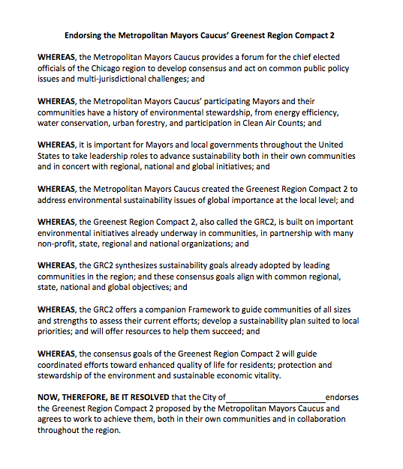
Example: MMC GRC2 Resolution
Suggested text for community to make public commitment to sustainable practices
Once signed, considered member community by Metropolitan Mayors Caucus (MMC)
Resolution available on line @: http://mayorscaucus.org/initiatives/environment/regional-environmental-collaboration/
No funds required from the municipality
MMC Environmental Committee manages certain environmental grants and members are provided access and alerting to existing and new programs
Notes:
USEFUL WEB LINKS
To learn more, please visit the following sites:
Metropolitan Mayor Caucus Site: http://mayorscaucus.org
Green Region Compact webpage: http://mayorscaucus.org/initiatives/environment/regional-environmental-collaboration/)
GRC2 Resolution: http://mayorscaucus.org/wp-content/uploads/2016/03/GRC2-Municipal-Resolution-FINAL.pdf
GRC Summary List: http://mayorscaucus.org/wp-content/uploads/2016/03/The-Greenest-Region-Compact-2-FINAL.pdf
GRC2 Framework: http://mayorscaucus.org/wp-content/uploads/2016/03/GRC2-Framework-COMPLETE-FINAL1.pdf
GRC2 Framework Tool - http://mayorscaucus.org/wp-content/uploads/2017/04/GRC2-Framework-Tool-4-2017-Final-complete.xlsx

Slide 12
