Slide 1
Fiscal and Economic Issues
Discussion Group
July 2018

Slide 2
Organizing for Action (OFA) and NWSOFA
In January 2013, we started as a gathering of friends and neighbors from the NW Suburbs who wanted to continue to have impact on the progressive issues we voted for in 2012
This grassroots, bottom up movement spread across the country and sparked the creation of Organizing for Action, OFA National, which now has Chapters all over the country
This is a non-partisan, volunteer organization that focuses on progressive issues we are committed to taking Action on to make a difference locally, statewide and nationally.
NWSOFA has several issue teams; tonight is a meeting of the Fiscal & Economic team
Presentation will be available at: http://www.nwsofa.org/resources/fiscal/

Slide 4
Future NWSOFA Events
July 11 NWSOFA Cool Cities Team: Age of Consequences film Event 6:30 -8:30 PM at the Platine Library, Meeting Room #1, a film about climate change through the perspective of national and global security
July 19 NWSOFA Gun Violence Prevention Meeting 6:30pm – 8:00pm
See our calendar of events: http://www.nwsofa.org/calendar/

Slide 5
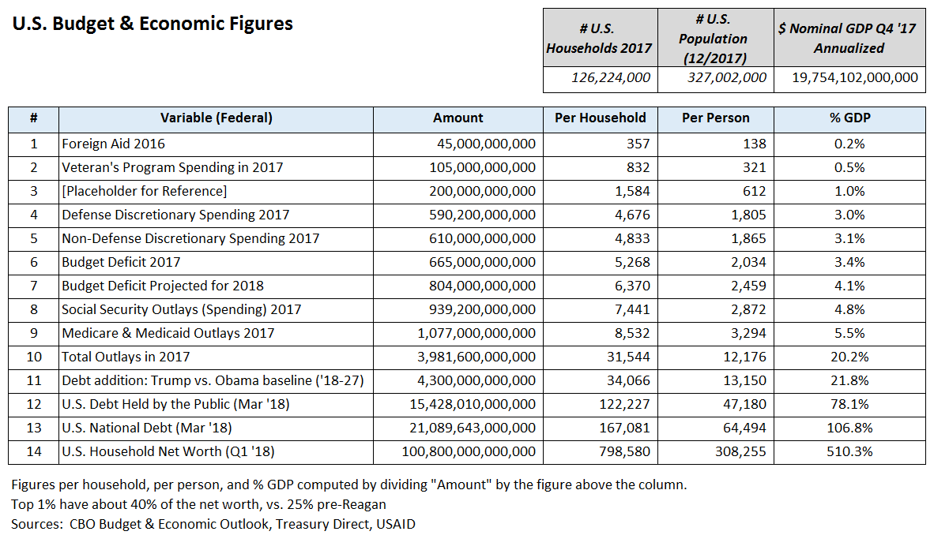
U.S. Federal Budget & Economic “Math”

Slide 6
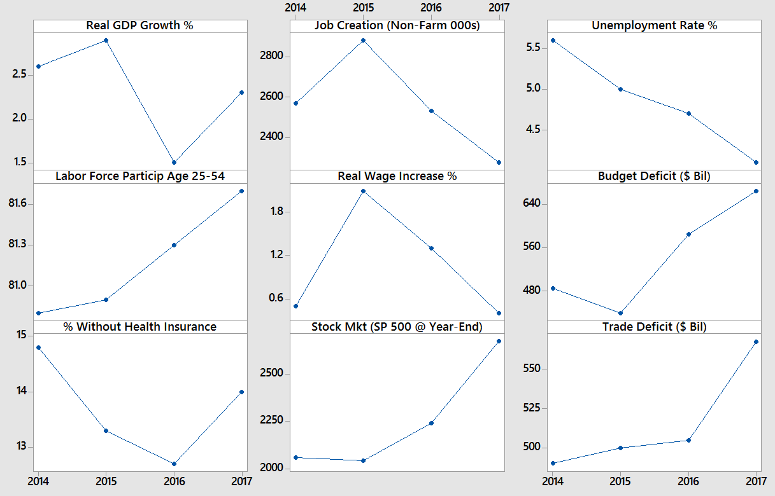
U.S. Economic Trends 2014 - 2017
Summary
The economy has been doing well for a number of years, although several measures were worse in 2017 under Trump than 2014-2016 under Obama
Job creation, real wages, budget deficit, health insurance coverage, and trade deficit trended unfavorably in 2017
The narrative that the economy suddenly boomed under Trump in 2017 is misleading
1
2
3
4
5
6
7
8
9
Sources
1: Bureau of Economic Analysis (BEA)
2,3,4,5,8: Federal Reserve Economic Data (FRED)
6: CBO Historical Data
7: Commonwealth Fund
9: Census Bureau

Slide 7
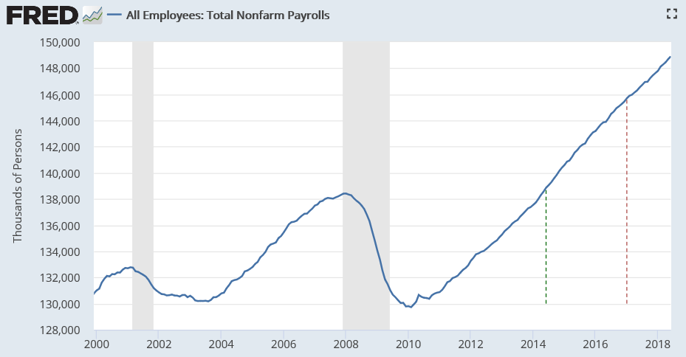
Jobs: Total Non-Farm Payrolls (Private and Govt / FT & PT)
June 2018
148.9 million total
+213,000 vs. May
Recent Trend
3.54 mil jobs last 17 mos. Obama
3.22 mil jobs first 17 mos. Trump
Private is 127m; Govt is 22m
May ‘14
Jan ‘17

Slide 8
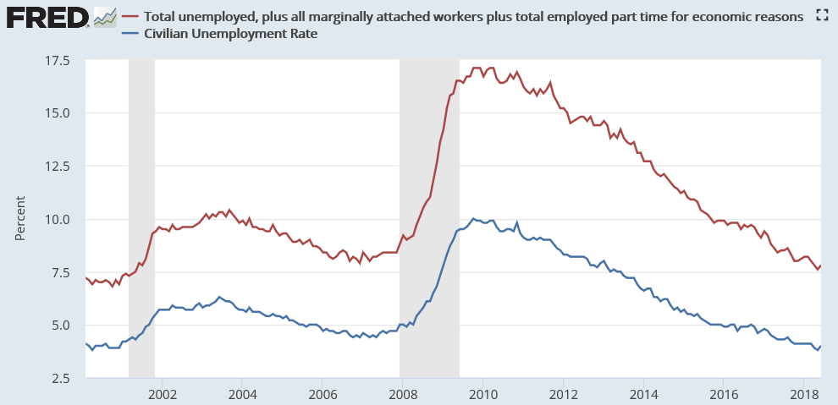
Unemployment Measures Below Pre-Crisis Levels / Are We At Full Employment?
U-6
June ‘18
U-3
7.8% or
13.1m
4.0% or
6.6m
May
2016
Pre-crisis rates (Nov ‘07) were 8.4% (U6) and 4.7% (U3)

Slide 9
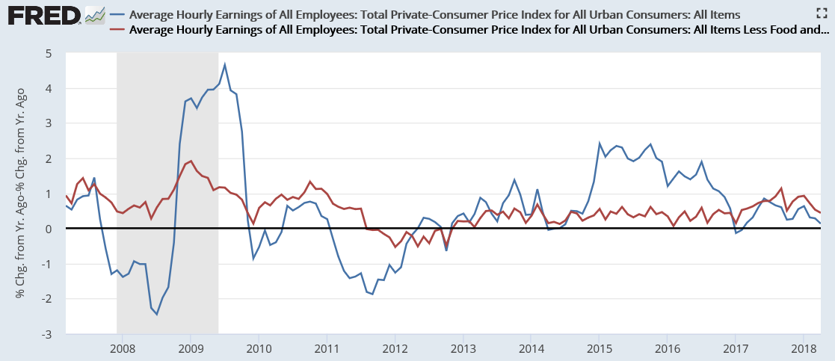
Real Hourly Earnings (Through May 2018)
Despite low unemployment, wages are not yet rising significantly in real (inflation-adjusted) terms
Real Wages (Infl: All Items)
Real Wages (Infl: Less Food & Energy)

Slide 10
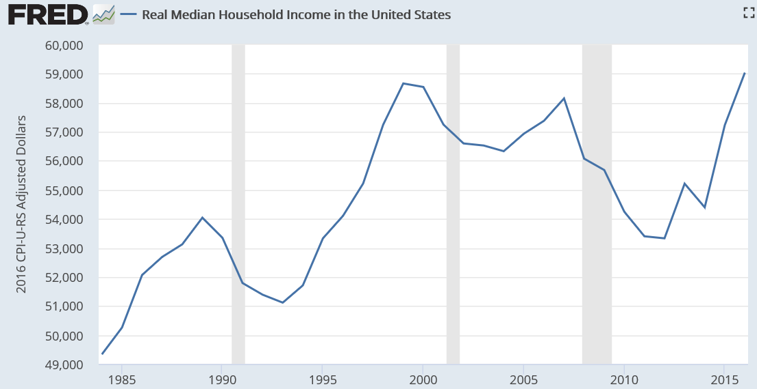
Real (Inflation-Adjusted) Median Household Income
Hit Record Level in 2016
2016
$59,000
More jobs, moderate wage growth drove record level
Median = 50th percentile (half above and half below)
2017 data not available until September ‘18
Census Bureau: “Income and Poverty in the United States: 2016” (September 2017)
VOX: “5 Ways the Census Income Report misleads us about the real state of the economy” (September 2016)

Slide 11
CBO: Debt Trajectory Increasing Under Trump
Debt Additions 2018 - 2027 ($ Trillion)
+2.3 trillion or 24%
+18,200 per family
+4.3 trillion (46%)
+34,000 per family
CBO “Budget & Economic Outlook” reports (January 2017 and April 2018)

Slide 12
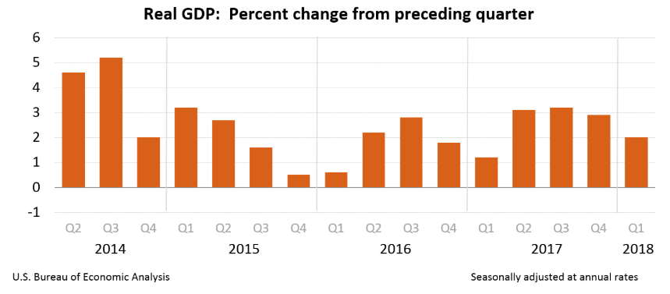
Will the Tax Cut Drive Higher GDP Growth?

Slide 13
CBO: About 7 Million More Uninsured Projected Over 10 Years
Number uninsured fell by ~20 million from 2010-2016, about 40%
In 2018, CBO forecast 35m uninsured in 2026, vs. 28m in 2016 forecast (+7m or 25%)
Change due mainly to ending individual mandate and cost sharing subsidies
47
35
28
27
16%
Percent uninsured fell by 7 percentage points from 2010-2016
In 2018, CBO forecast 13% uninsured rate in 2026, vs. 10% in 2016 forecast
13%
10%
9%
Sources:
Census Bureau / American Community Survey (ACS) Historical Tables
CBO: “Federal Subsidies for Health Insurance Coverage for People Under Age 65” (2016, 2017, and 2018 reports)

Slide 14
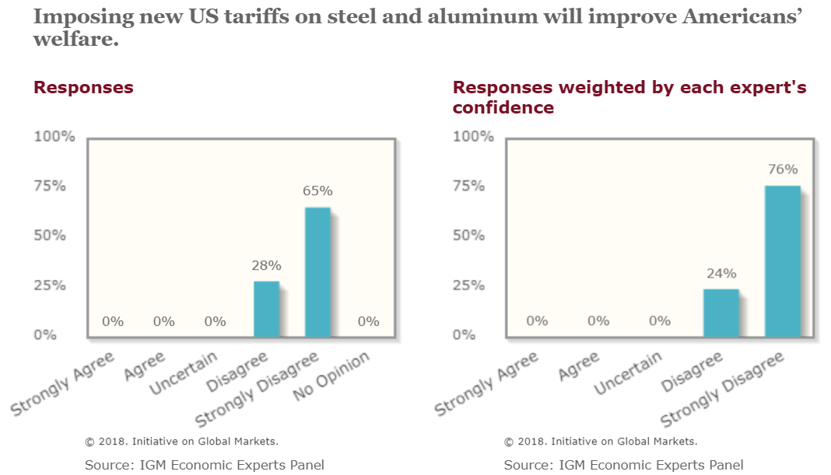
IGM Economic Experts Panel: Tariffs Help Some, Hurt Others, Overall A Bad Idea

