Slide 1
Fiscal and Economic Issues
Discussion Group
May 2018

Slide 2
Mission / Purpose
Mission / Purpose
Improve economic and budgetary literacy, both federal and state
Enable fact-based argumentation regarding economic and budgetary subjects in the news
Identify opportunities to engage with politicians and community leaders
Provide informative graphics for distribution on social media
Approach
Explain linkage between economic and budgetary results
When we review policy issues we ask:
How will this policy issue affect economic growth and jobs?
How will this policy issue affect the budget deficit, both now and in the future?
We use a standard set of slides updated with the latest information, plus special topics
We invite guest speakers and have “field trips”

Slide 3
What We Ask of You
Understand the Facts
Sharpen Your Arguments
Communicate to Your Audience

Slide 4
Topics
Take Action
Key Economic Indicators
Budget Deficits & Debt
Inequality
Healthcare
Special Topics: Tax Expenditures

Slide 5
Letter to Legislators: Fiscal Policy / Budget Sustainability
Dear Legislator:
I’m concerned about the national debt. When the economy is booming, we should be taxing more and spending less, not the reverse. We should target a 3% GDP budget deficit in a strong economy, a sustainable level. Please advocate these fiscal policies:
Remove the cap on the payroll tax to help fund Social Security. This should cover about 70% of the shortfall over the next 75 years. I’m willing to pay a higher payroll tax rate to cover the rest.
Re-brand the payroll “tax” as a “savings contribution” which is what it really is.
Increase the marginal tax rate on income over $500,000 to 40%, and to 50% for income over $1 million.
Eliminate preferential treatment for capital gains and dividends for individuals with incomes over $200,000. CBO estimates the top 1% get $100 billion/year due to this tax break.
The top 20% get about $700 billion in “tax expenditures” per year excluding #4 above. Many of these should be reduced or eliminated over time.
Share buybacks are a major upward redistribution mechanism, mainly enriching the wealthy, while reducing investment in more productive assets. Require corporations to pay a 25% tax on shareholder buybacks; raise that to 50% over time.
Reinstate an estate tax with teeth. Billionaires should have single-digit millionaire heirs.
Freeze defense spending for a decade.
Sincerely,
Name

Slide 6
Letter to Legislators: Universal Healthcare via ACA Expansion
Dear Legislator:
Our people should have quality, affordable healthcare. We are the only developed country that doesn’t cover all its citizens, with over 30 million uninsured and rising. I read recently that 4 million more are uninsured versus 2016, while we just gave tax cuts mainly to the rich. Please advocate these policies:
Expand ACA subsidies to a higher percentage of the poverty line to help more people afford health insurance.
Provide additional incentives (beyond 90% reimbursement by the Federal government) to adopt the ACA Medicaid expansion in those 18 states that have yet to do so. This can cover up to 4 million people, reducing avoidable mortality by 5,000 people per year.
We can fund this expansion by higher marginal tax rates or reduced tax expenditures for high income persons. For example, the top 1% receive an estimated $300 billion/year in tax expenditures; about half of that is the break they receive for capital gains and dividends.
Sincerely,
Name

Slide 7
Letter to Legislators: Universal Healthcare via “Medicare for All”
Dear Legislator:
Our people should have quality, affordable healthcare. We are the only developed country that doesn’t cover all its citizens, with over 30 million uninsured and rising. Please advocate these policies:
Universal healthcare or “Medicare for All”, with the government covering all costs of treatment done per best practice guidelines.
My taxes should replace premiums but be lower than the costs I pay today, as we spend about 5% GDP ($3,000 per person) more on healthcare than the next most expensive countries for comparable quality.
A transitional approach that involves reducing the eligibility age (e.g., initially to 60 or 55, for example) may be effective for overcoming opposition in the employer-based market. This would require an alternative method of funding, such as higher tax rates and reduced tax expenditures for higher income persons.
Sincerely,
Name

Slide 8
Letter to Legislators: Universal Education
Dear Legislator:
For the U.S. to compete successfully, our people should have access to life-long education. Please advocate these policies:
The federal government should pay college and trade school costs directly. For example, a cost-effective method is for students to attend two years at community colleges before transferring to a state school to complete their education. The government should cover tuition for community college while the student lives at home, then tuition, room and board upon transfer. This progression allows students to demonstrate their dedication at relatively low cost initially, before transferring.
A Medicare-like process should be established to keep costs under control. Student financial support would be directed to schools that did not increase their tuition beyond federal guidelines.
Let working people earn tax credits over time for life-long learning financial support.
The $1.5 trillion student loan debt is a travesty and should be forgiven.
We can fund these programs by higher marginal tax rates and reduced tax expenditures for high income persons. For example, the top 1% receive an estimated $300 billion/year in tax expenditures.
Sincerely,
Name

Slide 9
Slide of the Month
Pick your favorite slide and share it!

Slide 10
Topics
Take Action
Key Economic Indicators
Budget Deficits & Debt
Inequality
Healthcare
Special Topics: Tax Expenditures

Slide 11
Job Creation: Total Non-Farm Payrolls--Private & Govt (Thousands)
12 Months Ending in April of Each Year
Apr ‘18
+164,000
3-month avg.
208,000
2014-2016 job creation average was 224k per month

Slide 12
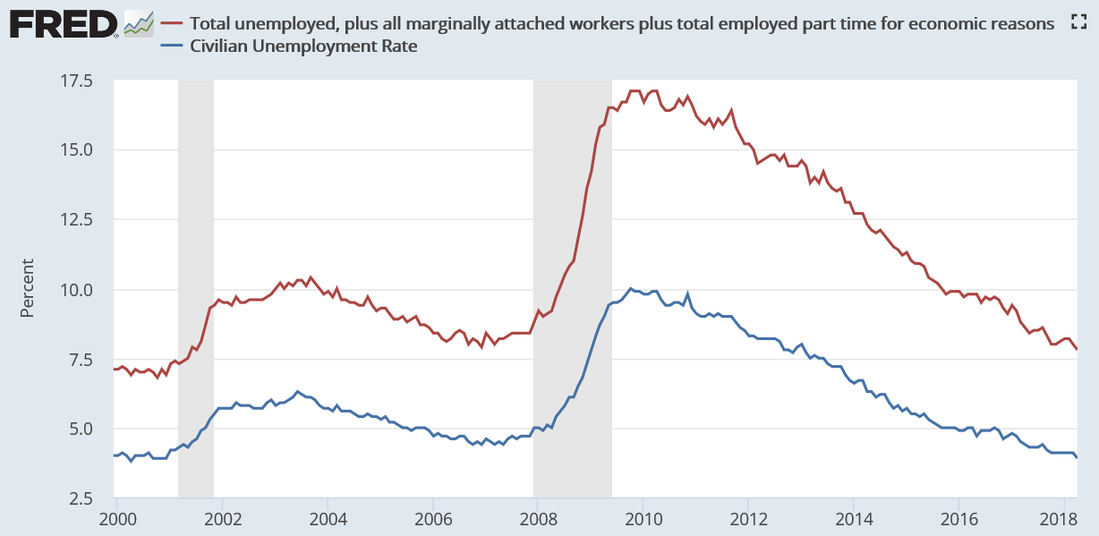
Unemployment Measures
U-6
Apr ‘18
7.8%
3.9%
U-3
Pre-crisis rates (Nov ‘07) were 8.4% (U6) and 4.7% (U3).

Slide 13
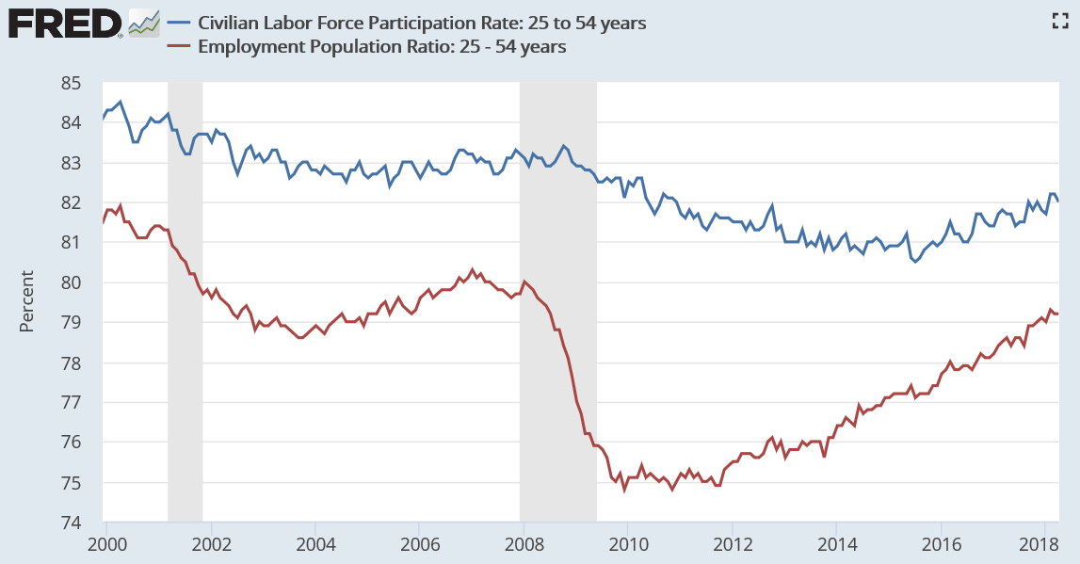
Labor Force Participation (Age 25-54)
%
LFPR= 82.0%
Labor Force
Civilian Population
Empl Rate=79.2%
Employed
Civilian Population
Nov ‘07
83.3%
79.7%
Labor Force = Employed + Unemployed
Civilian Non-Institutional Population = Age 25-54 not in jail or active military
Possible causes for long-term decline: Disability, opioids, dislocation of immobile workers due to globalization

Slide 14
Disabled as % Labor Force (Age 25-54)
2014
5.2%
2017
4.8%
Year | Number (000’s)
2014 | 5,268
2017 | 4,907
Source Data: BLS Data Finder

Slide 15
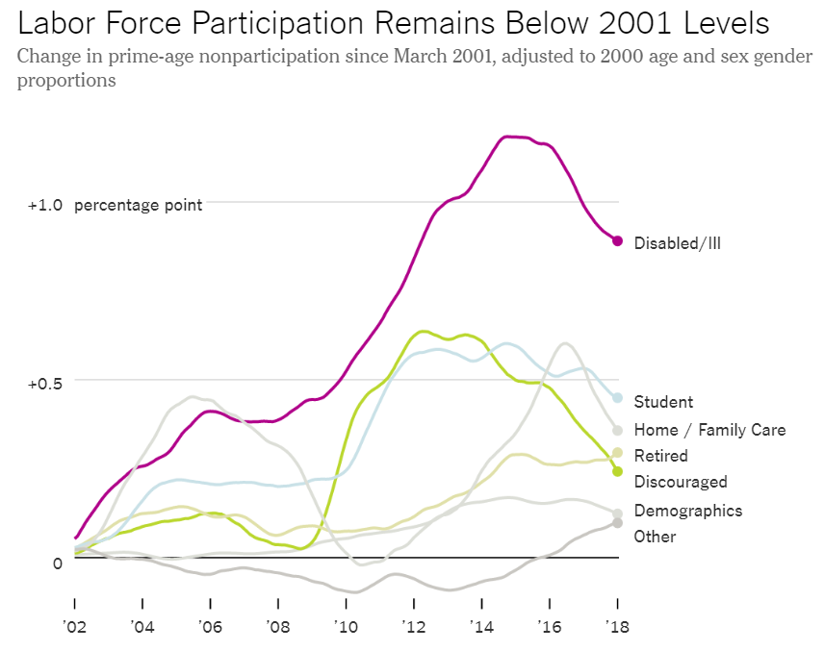
Labor Force Participation (Age 25-54)
“The number of prime-age people who cite disability as their reason for not working has shrunk by 7 percent since mid-2014.”
“The number of disabled nonparticipants without a high school diploma fell by 18 percent, versus 4 percent for those with at least a high school diploma.”
NYT: Will Employment Keep Growing? (March 15, 2018)

Slide 16
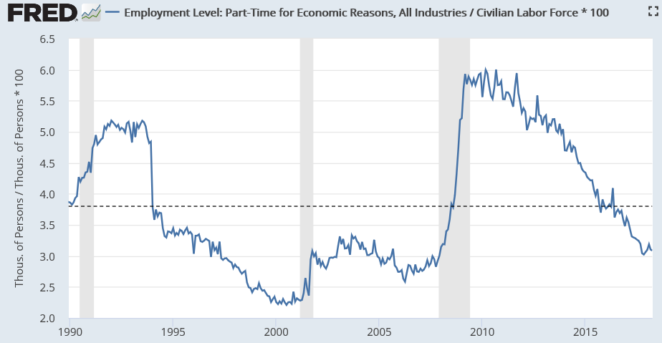
Slack in Labor Market?
Working Part-Time for Economic Reasons as % Labor Force (Age 16+)
Avg. ‘90-’18
3.8%
Apr ’18
3.1%
2.6%
Ratio: 5.0 million PT for ER / 161.5 million in labor force = 3.1%

Slide 17
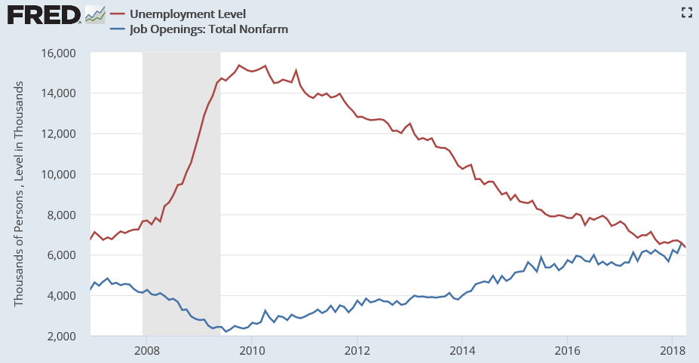
Job Openings vs. Number Unemployed (000’s)
Skills mismatch
Willingness to relocate
Pay mismatch
Willingness to change fields
Unemployed (#)
6.3Mil
Job Openings

Slide 18
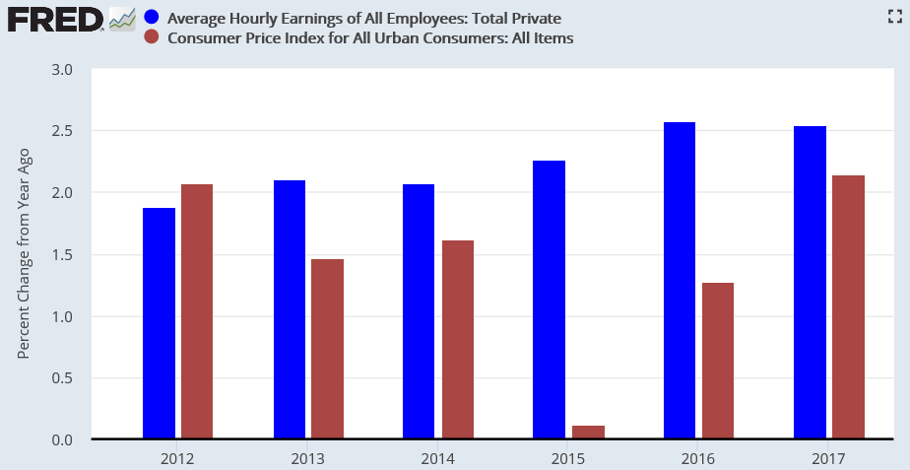
Wages and Inflation
Real Wage
Change
-0.2
0.6
0.5
2.1
1.3
0.4

Slide 19
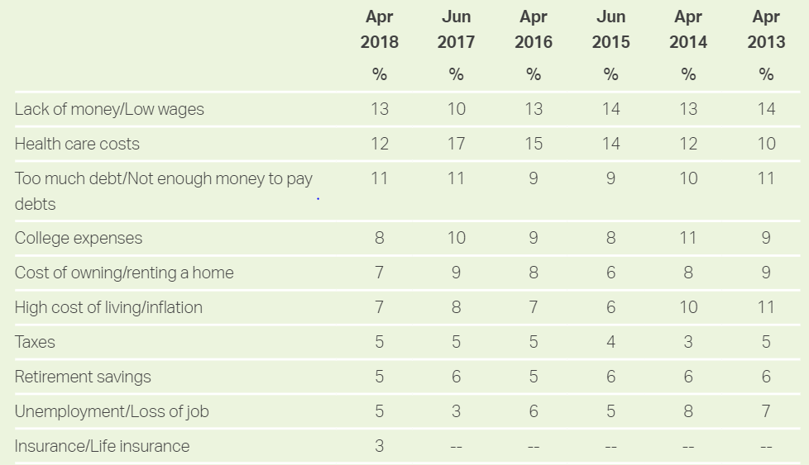
Gallup: “What is the most important financial problem facing your family today?”
Gallup: http://news.gallup.com/poll/1609/consumer-views-economy.aspx

Slide 20
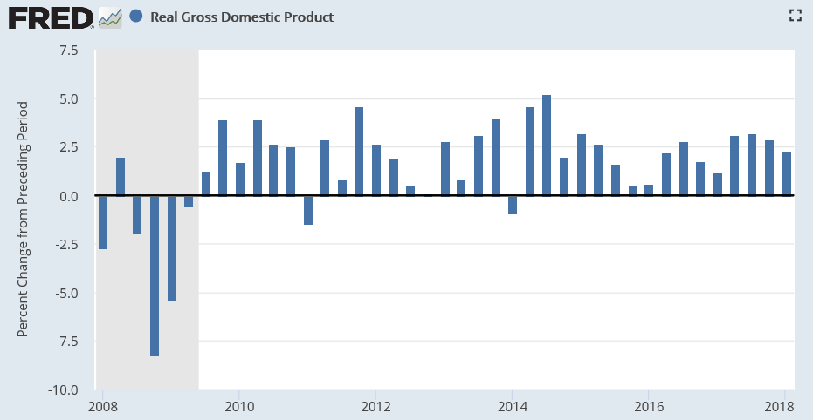
Countering the “Economy is Booming Due to Trump Policies” Narrative
Real GDP Growth: Quarterly (Q1 2008 to Q1 2018)
5.2%
3.2%
2.3%
Best Trump quarter: Q3 ‘17 at 3.2%
Best Obama quarter: Q3 ‘14 at 5.2%
We have not had a 3% growth year since 2005 (3.3%)
Obama 2014, 2015, 2016: 2.6%, 2.9%, 1.5%
Trump 2017: 2.3%

Slide 21
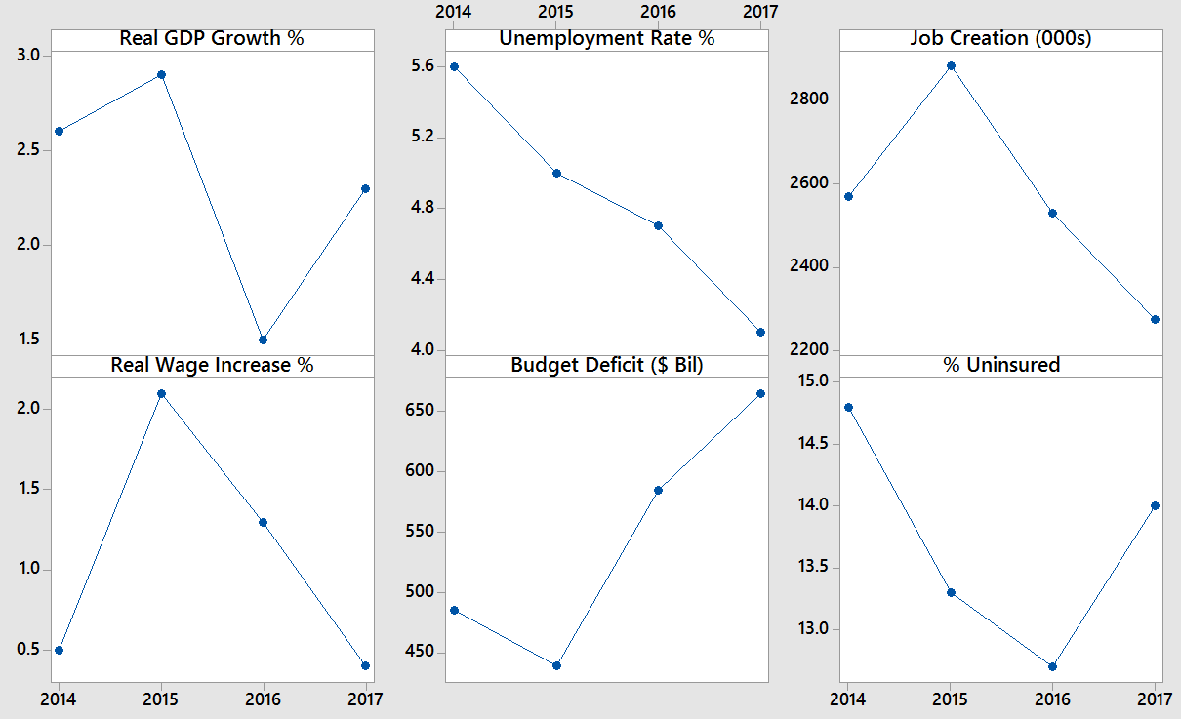
Economic & Budgetary Summary (2014 - 2017)

Slide 22
Countering the Narrative: “The Economy is Booming Because of Trump’s Policies”
GDP and Employment
Trump has yet to have 3% real GDP growth for a full year; Obama’s best quarter was 5.2% vs. Trump’s 3.2%
Job creation was slightly lower in 2017 than 2014-2016
The unemployment rate has been falling consistently since 2009; this isn’t a new trend
Wages and Inflation
Real wage gains were faster under Obama: 2.1% in 2015 and 1.3% in 2016, vs. 0.4% in 2017
Inflation, mortgage rates and gas prices are higher in 2017 vs. 2016
Healthcare Coverage
The number uninsured is up 4 million from 2016, about 14%
This is a combination of ACA sabotage and not addressing known problems with the ACA
Managing the Budget
Budget deficit is up significantly
$585B in 2016, $665B in 2017 and over $800B forecast for 2018
2018-2027 forecast total up from $10.1 trillion (June 2017 baseline, before Trump’s policies) to either $11.7 trillion (CBO current law baseline) or $13.7 trillion (CBO Current policy/alternate baseline)
Deficit should be falling when economy is booming, not rising.

Slide 23
Topics
Take Action
Key Economic Indicators
Budget Deficits & Debt
Inequality
Healthcare
Special Topics: Tax Expenditures

Slide 24
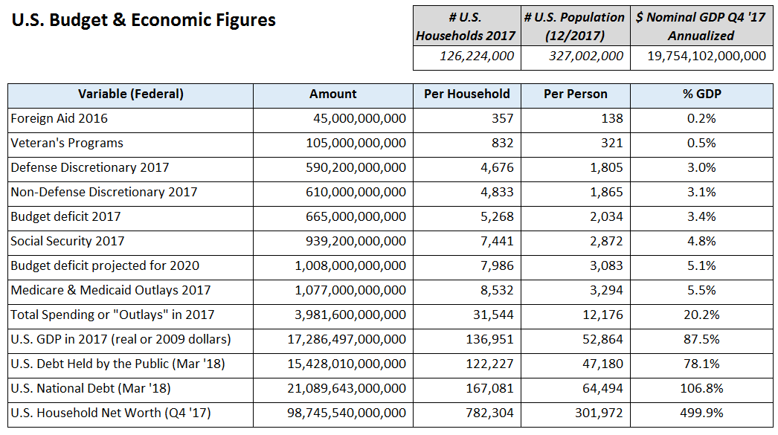
U.S. Federal Budget & Economic “Math”

Slide 25
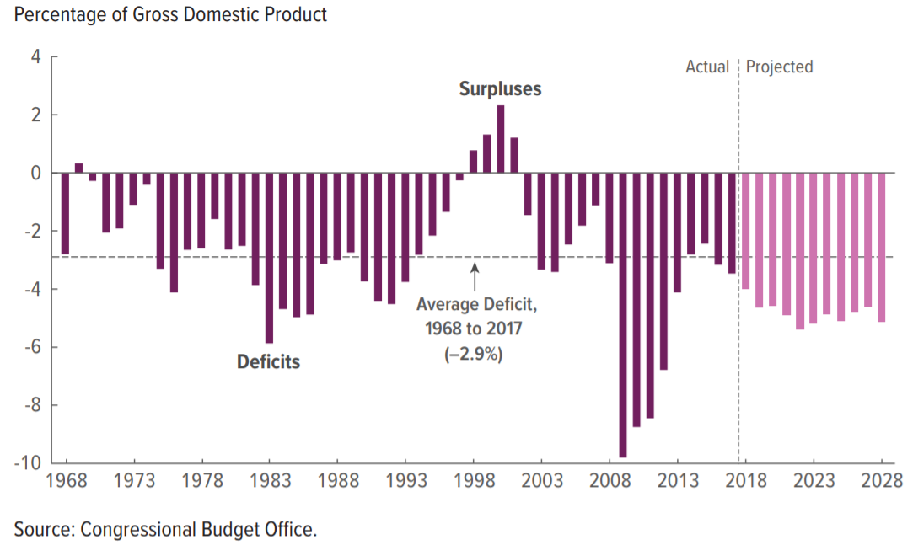
Federal Budget Deficit % GDP (1968-2028)
Deficits average about 5% GDP 2018-2028, or $1.2 trillion per year
Using $20 trillion as a rough estimate of GDP allows a quick conversion of % GDP to dollars.
CBO “Budget & Economic Outlook 2018-2028” (April 2018)

Slide 26
CBO Forecast: Sum of Federal Deficits 2018-2027 (Debt Additions)
Baselines and Cause of Change ($ Billions)
Continuation of Current Policy
Extending Trump Tax Cuts for individuals after 2025
Preventing other tax increases from taking effect
Relaxing spending caps
Changes after June ‘17 Baseline
Tax Cuts and Jobs Act
Two spending laws
Source Data: CBO Budget & Economic Outlook 2018-2028

Slide 27
CBO: Social Security Policy Options (2015)
Social Security
Average Annual Funding Gap (% GDP)
Over 75 Years
Measured over 75-years, Social Security has a 1.4% GDP Annual funding gap on average
$280 billion/year in today’s dollars
Removing cap ($128,700; top 6% of earners) without increasing benefits covers 1.0% GDP of gap, about 70%
Raising payroll tax contribution 1 percentage point today covers 0.3% GDP of gap, about 21% of it
Raising payroll tax contribution 2 percentage points over 10 years covers 0.6% GDP of gap, about 43% of it
This calculation includes the Trust Fund, which is exhausted over the next 15 years or so
Trust Fund has legal right to force the government to borrow to cover shortfall, but to the extent this happens the Trust Fund is diminished
CBO: “Social Security Policy Options” (2015)

Slide 28
Progressive Options for Addressing the Debt Problem
More progressive income taxes
Marginal income tax rates of 40% for income over $500,000 and 50% for income over $1 million
Limit “tax expenditures” for the top 1%, such as treating capital gains and dividends as ordinary income
Stabilizing Social Security
Remove the cap on the Social Security tax, currently capped at $128,400 (with no increase in benefits)
Raise the payroll contribution rate by 1 percentage point (from 12.5% to 13.5%)
Reform Wealth / Estate Tax
An estate tax that only leaves children with a maximum of $10 million each, including the value of real estate. This means a billionaire couple’s estate tax bill will be over $900 million
Reduce / Freeze Defense Spending
Freeze defense spending at current level (i.e., decrease it by rate of inflation)
Reduce Healthcare Prices
Medicare for All, so the government has the power to reduce healthcare spending by one-third, which brings us to the level of Europe
See also: “CBO-Options for Reducing the Deficit: 2017 to 2026” and “Social Security Policy Options, 2015”

Slide 29
Topics
Take Action
Key Economic Indicators
Budget Deficits & Debt
Inequality
Healthcare
Special Topics: Tax Expenditures

Slide 30
Share of After-Tax Income (1962-2014)
Bottom 50%
Top 1%
Source: Piketty, Saez, Zucman. Distributional Tables (2016)

Slide 31
What Does Income Inequality Mean for Families?
Real Median Household Income ($)
Continuation at
1984-1999
Growth Rate
Real Median Household Income Would be about $12,000 higher if it had continued growing at 1984-1999 rate of 1.2%
Pre-Tax Income (Not Shown)
If the United States had the same income distribution in 2012 that it had in 1979:
The bottom 80% of families would have $11,000 more in annual pre-tax income (or)
The bottom 99% would have $7,100 more
Actual
Sources: Alan B. Krueger “The Rise and Consequences of Inequality in the United States” (January 12, 2012)
Washington Post: Larry Summers “Focus on growth for the middle class” (January 2015)
NYT: Eduardo Porter-Rethinking the Rise of Inequality (November 2013)
FRED Database: “Real Median Household Income”

Slide 32
Economic Impacts of Inequality
More income shifts to the wealthy, who tend to spend less of each marginal dollar, causing consumption and therefore economic growth to slow
Top 1% households save 50% of their marginal dollars, vs. about 10% for the remainder
With pre-Reagan inequality, consumption might be 5% higher
GDP would be about 3.5% higher (Consumption = 70% GDP x 5%)
Income mobility falls, meaning the parents' income is more likely to predict their children's income [see the “Great Gatsby Curve” for international comparison]
Middle and lower-income families borrow more money to maintain their consumption, a contributing factor to financial crises; and
The wealthy gain more political power, which results in policies that increase inequality thus further slowing economic growth
Alan B. Krueger “The Rise and Consequences of Inequality in the United States” (January 12, 2012)
Former Chairman, Council of Economic Advisers

Slide 33
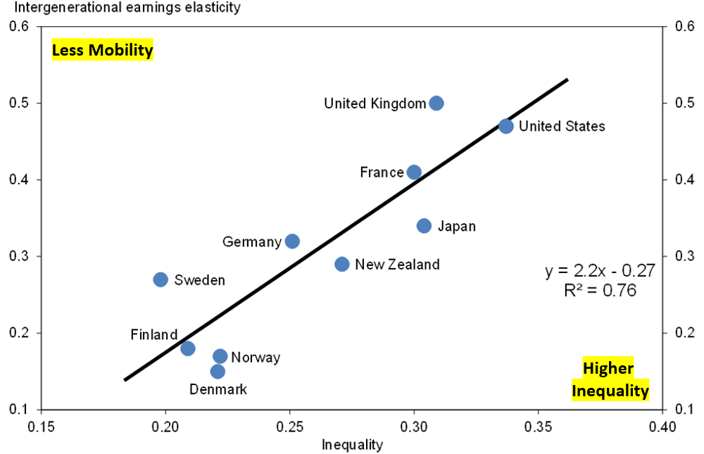
Great Gatsby Curve: Inter-Generational Mobility
Across countries, as inequality gets worse, income brackets get “stickier”
Trend less clear for U.S. over time (conflicting studies)
Source: Alan B. Krueger “The Rise and Consequences of Inequality in the United States” (January 12, 2012)
Former Chairman, Council of Economic Advisers
If parents earn 50% above average, child will earn 20% above average if IGE at 0.4

Slide 34
Solutions to Inequality
Market Income “Pre-Distribution”
Education funding (all ages)
Retraining / Life-long learning
Higher minimum wage
Stronger unions / labor power (service industries not subject to intl. competition)
Higher profit sharing / 401k match
Restrict buybacks and dividends
Cultural shifts and awareness
Breakup oligopolies and monopolies; reduce industry concentration
After-Tax Income “Redistribution”
Raise income tax rates on high incomes
Minimum effective tax rate / “Buffett Rule”
Remove cap on payroll tax
Treat all sources of income similarly
Reduce “tax expenditures” for higher incomes
Minimum effective tax rates
Transfers
Increase earned income tax credit
Expand healthcare subsidies & Medicaid
Medicare for All
For wealth inequality
Raise estate taxes
Sovereign wealth fund

Slide 35
Topics
Take Action
Key Economic Indicators
Budget Deficits & Debt
Inequality
Healthcare
Special Topics: Tax Expenditures

Slide 36
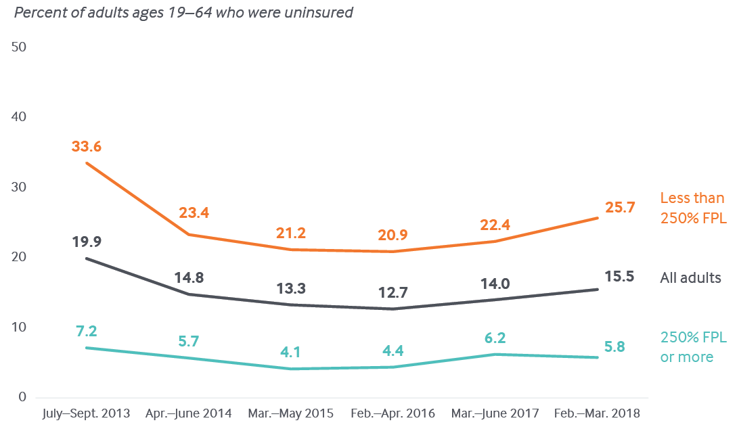
Lower Income Persons Have Higher Uninsured Rates
About 4 million more without health insurance in 2018 vs. 2016
The uninsured rate rose from 12.7% in early ‘16 to 15.5% in early ’18
Premature deaths are around 1/800 without insurance or 5,000/year
$30k Indiv, or
$61k 4-person
Source: The Commonwealth Fund

Slide 37
Regions: South and West Have Higher Uninsured Rates
Percent of Uninsured Adults 19-64
Source: The Commonwealth Fund

Slide 38
The 18 States that Did Not Expand Medicaid under ACA Have Higher Uninsured Rates
Percent of Uninsured Adults 19-64
Source: The Commonwealth Fund

Slide 39
Topics
Take Action
Key Economic Indicators
Budget Deficits & Debt
Inequality
Healthcare
Special Topics: Tax Expenditures

Slide 40
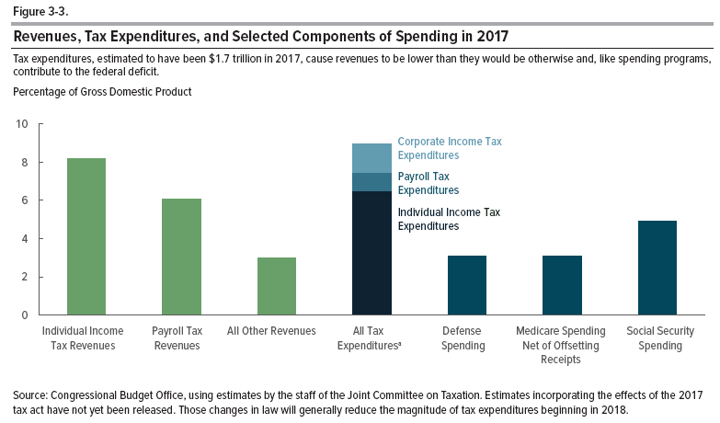
Tax Expenditures / “Loopholes” $1.7 Trillion in 2017 (8.9% GDP)
Income Exclusions, Deductions, Preferential Rates, and Credits
CBO “Budget & Economic Outlook 2018-2028” (April 2018)

Slide 41
Largest Tax Expenditures ($ Billions)
Exclusions, Deductions, Credits, Preferential Rates (2013)
Sum of those listed:
$900 Billion in 2013
CBO: “Distribution of Major Tax Expenditures in the Individual Income Tax System” (May 2013)

Slide 42
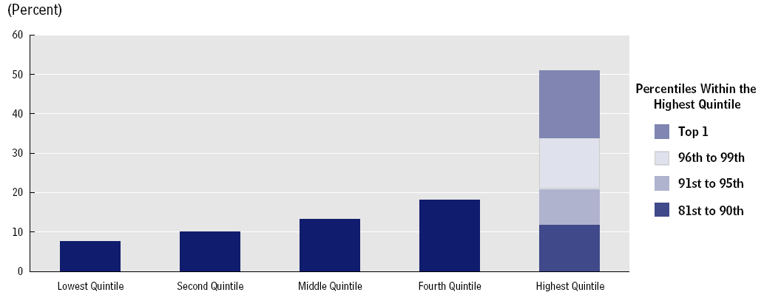
Tax Expenditures: Distribution by Income Level
2014 Threshold
Top 1% = $374,400
Top 5% = $162,000
Top 10% = $117,600
Top 20% = $84,700
Source: CBO
Top 1%: 17% of the benefit X $1.7 trillion = $290 billion
Next 19%: 34% of the benefit X $1.7 trillion = $580 billion
$870 billion
51%
17%
13%
9%
12%
CBO: “Distribution of Major Tax Expenditures in the Individual Income Tax System” (May 2013)

Slide 43
Sources for More Information
Key Reports
CBO “Budget & Economic Outlook 2018-2028”
CBO “Distribution of Household Income, 2014”
BLS “Employment Situation Summary”
Data & Charts
Federal Reserve Economic Data (FRED)
Bureau of Labor Statistics (BLS)
Other Sources
Federal Reserve Board of Governors: Speeches & Testimony
Committee for a Responsible Federal Budget (CRFB)
Wells Fargo Economics
Paul Krugman NYT

