Slide 1
Fiscal and Economic Issues
Discussion Group
April 2018

Slide 2
Mission / Purpose
Mission / Purpose
Improve economic and budgetary literacy, both federal and state
Enable fact-based argumentation regarding economic and budgetary subjects in the news
Identify opportunities to engage with politicians and community leaders
Provide informative graphics for distribution on social media
Approach
Explain linkage between economic and budgetary results
When we review policy issues we ask:
How will this policy issue affect economic growth and jobs?
How will this policy issue affect the budget deficit, both now and in the future?
We use a standard set of slides updated with the latest information, plus special topics
We invite guest speakers and have “field trips”

Slide 3
What We Ask of You
Understand the Facts
Sharpen Your Arguments
Communicate to Your Audience

Slide 4
Topics
Key Economic Indicators
Budget Deficits & Debt
Inequality
Healthcare
Special Topics: Demand, Productivity & Compensation
Take Action

Slide 5
Job Creation: Total Non-Farm Payrolls--Private & Govt (Thousands)
12 Months Ending in March of Each Year
Mar ‘18
+103,000
3-month avg.
202,000
2014-2016 job creation average was 224k per month

Slide 6
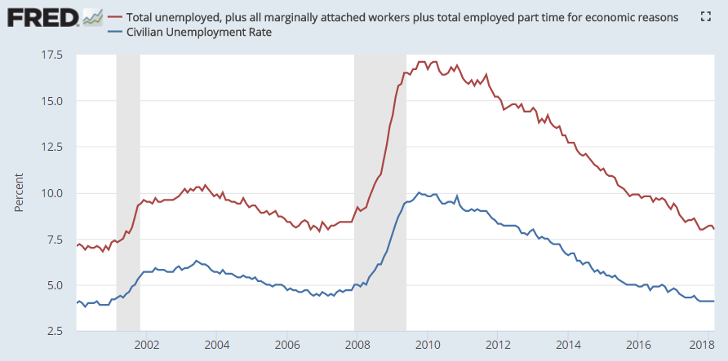
Unemployment Measures
U-6
Mar ‘18
U-3
8.0%
4.1%
Pre-crisis rates (Nov ‘07) were 8.4% (U6) and 4.7% (U3).

Slide 7
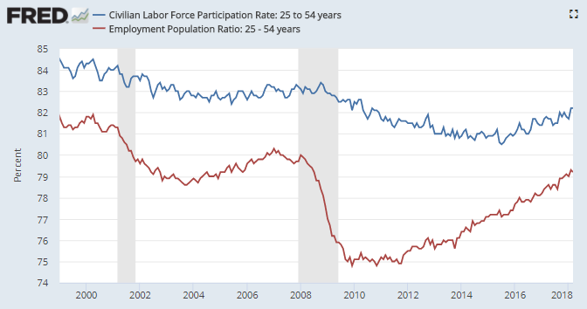
Labor Force Participation (Age 25-54)
LFPR= 82.2%
Labor Force
Civilian Population
Empl Rate=79.2%
Employed
Civilian Population
%
83.3
79.7
Labor Force = Employed + Unemployed
Civilian Non-Institutional Population = Age 16+ not in jail or active military
Possible causes for long-term decline: Disability, opioids, dislocation of immobile workers due to globalization

Slide 8
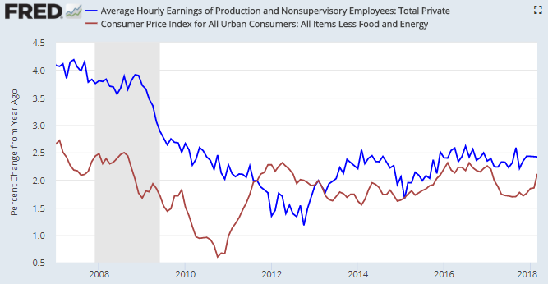
Inflation and Wages
Wages > Inflation means a real wage increase
2017
Wages: +2.3%
Inflation: +1.8%
Wages
Inflation

Slide 9
Real GDP Growth Rate (%) 2017-2027
CBO Baseline Comparison: April ‘18 and June ‘17
%
April ‘18 Baseline: 2.0% average
June ‘17 Baseline: 1.9% average
April ‘18 Baseline
June ‘17 Baseline
CBO Budget & Economic Outlook 2018-2027 (April 2018)

Slide 10
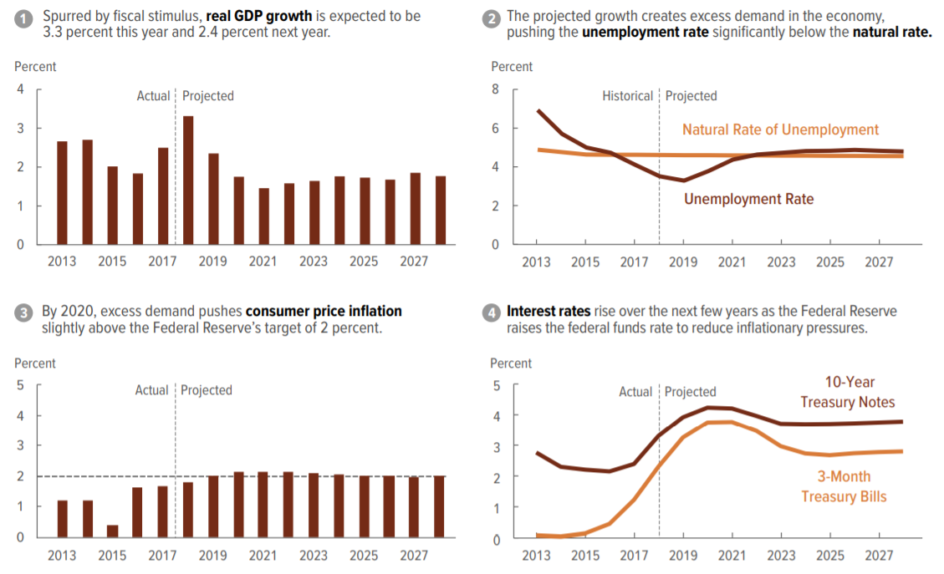
CBO Economic Forecast
CBO “Budget & Economic Outlook 2018-2028” (April 2018)

Slide 11
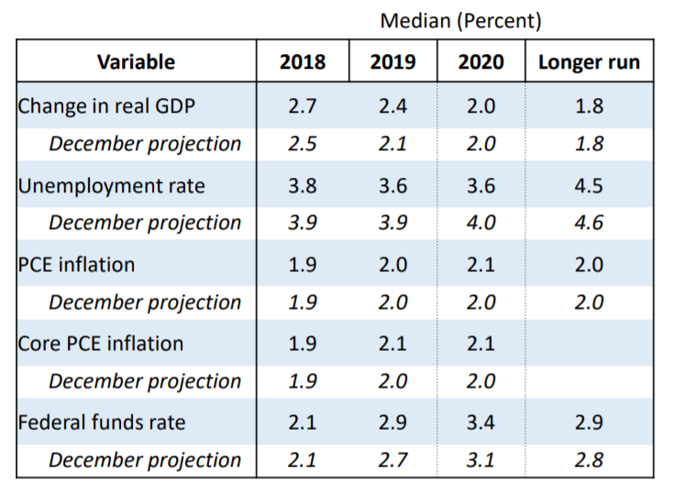
Federal Reserve Forecast as of April 6, 2018
The Fed’s April forecast is more positive than the December forecast
Two or more interest rate increases expected in 2018
Source: Speech by Fed Chair Jerome Powell (April 6, 2018)

Slide 12
Topics
Key Economic Indicators
Budget Deficits & Debt
Inequality
Healthcare
Special Topics: Demand, Productivity & Compensation
Take Action

Slide 13
Federal Budget Process
Fiscal years (FY) run October 1 – September 30; we are in FY2018
President Obama budgeted FY2017; President Trump budgeted FY2018
Budget is a statement of Presidential priorities, but requires Congress to appropriate funds or change laws to pursue these priorities
President’s budget is due first week of February
House and Senate budgets due April 15th
Appropriations passed and signed by President before Sept 30 to avoid need for continuing resolution (CR)
CRFB “Letter to Members of Congress on Statutory Budget Deadline” (April 12, 2018)

Slide 14
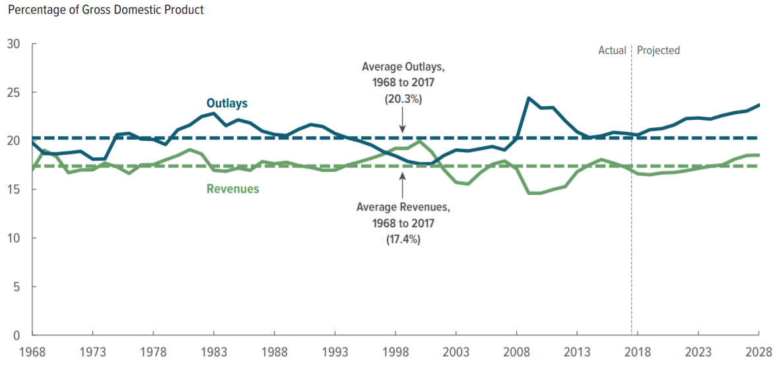
Revenues & Expenses % GDP (1968-2028)
CBO “Budget & Economic Outlook 2018-2028” (April 2018)

Slide 15
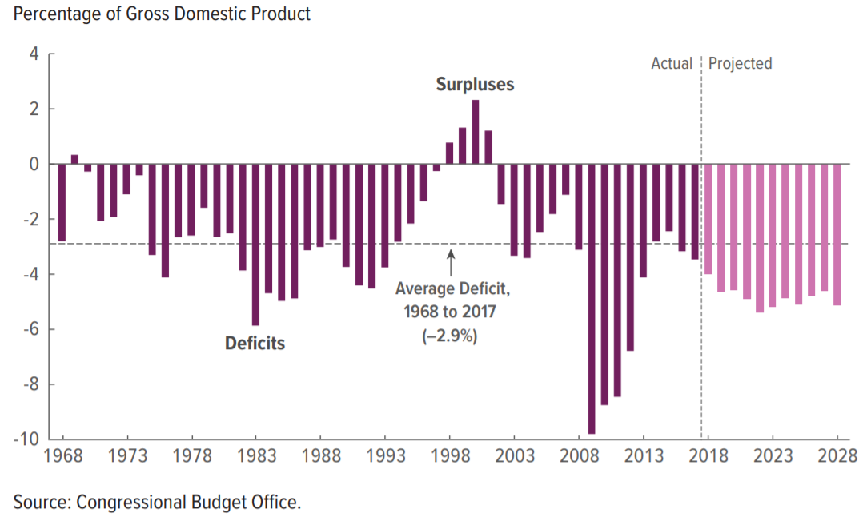
Federal Budget Deficit % GDP (1968-2028)
Deficits average about 5% GDP 2018-2028, or $1.2 trillion per year
Using $20 trillion as a rough estimate of GDP allows a quick conversion of % GDP to dollars.
CBO “Budget & Economic Outlook 2018-2028” (April 2018)

Slide 16
Budget Deficits 2018-2027 ($ Billions)
April 2018 vs. June 2017 Baselines
Sum of Deficits ($ Bil)
$11,696 CBO Apr ‘18
$10,112 CBO June ’17
+$1.6 trillion added, after economic feedback*
($ Bil)
*Deficit Increase:
Legislative Changes $2,656
Less: Economic Feedback $1,015
Net $1.6 trillion added
CBO “Budget & Economic Outlook 2018-2028” (April 2018)

Slide 17
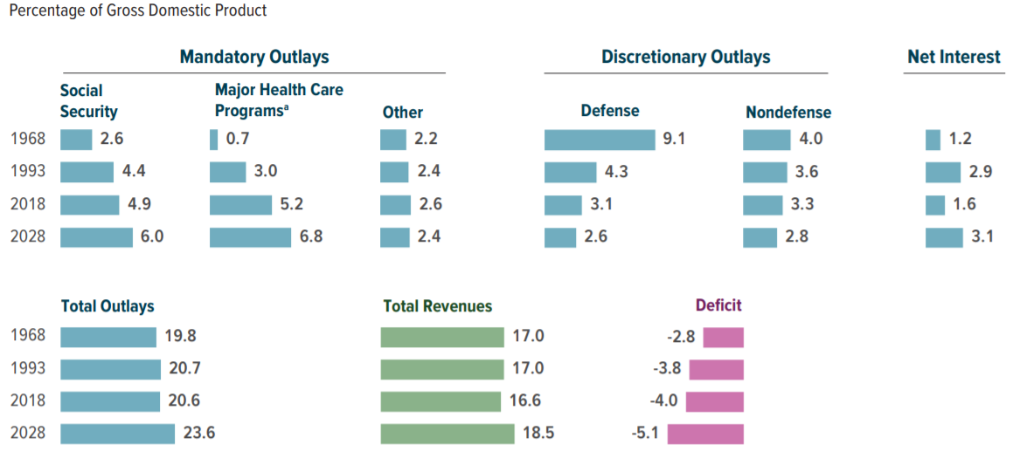
What is Driving Long-Term Debt?
CBO “Budget & Economic Outlook 2018-2028” (April 2018)

Slide 18
Debt Held By the Public to GDP Ratio % (2017-2028)
%
Baseline
CBO “Budget & Economic Outlook 2018-2028” (April 2018)

Slide 19
Risks Posed by Growing Deficits (CBO)
Crowding Out: A growing portion of savings would go towards purchases of government debt, rather than investments in productive capital goods such as factories and leading to lower output and incomes than would otherwise occur.
More interest, fewer benefits: Rising interest costs would force reductions in government programs.
Higher future taxes discourage work: To the extent that additional tax revenues were generated by increasing marginal tax rates, those rates would discourage work and saving, further reducing output and incomes.
Ability to respond to economic crisis: Restrictions to the ability of policymakers to use fiscal policy to respond to economic challenges
Liquidity crisis: An increased risk of a sudden fiscal pressure on the government, in which investors demand higher interest rates
Inflation: Higher inflation allows debtor to pay off debt with cheaper dollars.
CBO: Federal debt and the Risk of a Fiscal Crisis (2010)

Slide 20
Progressive Options for Addressing the Debt Problem
More progressive income taxes
Marginal income tax rates of 40% for income over $500,000 and 50% for income over $1 million
Treat capital gains and dividends as ordinary income for those with over $200,000 in income
Stabilizing Social Security
Remove the cap on the Social Security tax, currently capped at $127,200 (with no increase in benefits)
Raise the payroll tax rate by 1 percentage point (to 13.5% from 12.5%)
Reform Wealth / Estate Tax
An estate tax that only leaves children with a maximum of $10 million each, including the value of real estate So a billionaire couple’s estate tax bill will be over $900 million
Reduce / Freeze Defense Spending
Freezing defense spending at current level (i.e., decreasing it by rate of inflation)
Reduce Healthcare Prices
Medicare for All, so the government has the power to reduce healthcare spending by one-third, which brings us to the level of Europe
See also: “CBO-Options for Reducing the Deficit: 2017 to 2026” and “Social Security Policy Options, 2015”

Slide 21
Topics
Key Economic Indicators
Budget Deficits & Debt
Inequality
Healthcare
Special Topics: Demand, Productivity & Compensation
Take Action

Slide 22
Top 1% Income Share (1979 – 2014)
Pre-Tax and After-Tax
%
Pre-Tax
After-Tax
Variable | 1979 | 2014
Pre-Tax % | 9.0 | 16.7
After-Tax % | 7.4 | 13.3
CBO: Distribution of Household Income, 2014 (March 2018)

Slide 23
Share of After-Tax Income (1962-2014)
Bottom 50%
Top 1%
Source: Piketty, Saez, Zucman. Distributional Tables (2016)

Slide 24
What Does Income Inequality Mean for Families?
If the United States had the same income distribution it had in 1979, the bottom 80% of the population would have $11,000 per family more in annual pre-tax income. [Paraphrased]
-- Larry Summers (2015)
Source: Larry Summers “Focus on growth for the middle class” Washington Post. January 2015
Note: This figure would be $7,105 for bottom 99%, comparing 1979 and 2012. (NYT: Eduardo Porter-Rethinking the Rise of Inequality (Nov 2013)

Slide 25
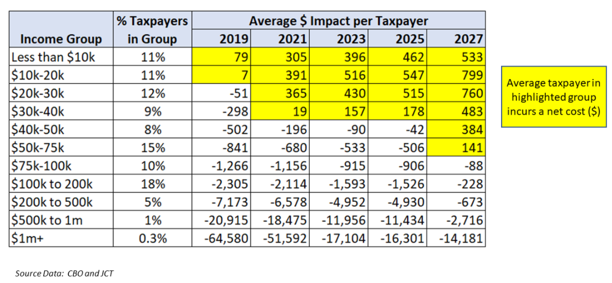
Tax Cuts and Jobs Act
Distribution of Impact by Income Group (Average $ per Taxpayer)
The bottom 60% get about 17% of the benefit of the Tax Act (Source: TPC).
If it is financed by spending cuts, this would adversely impact lower incomes.

Slide 26
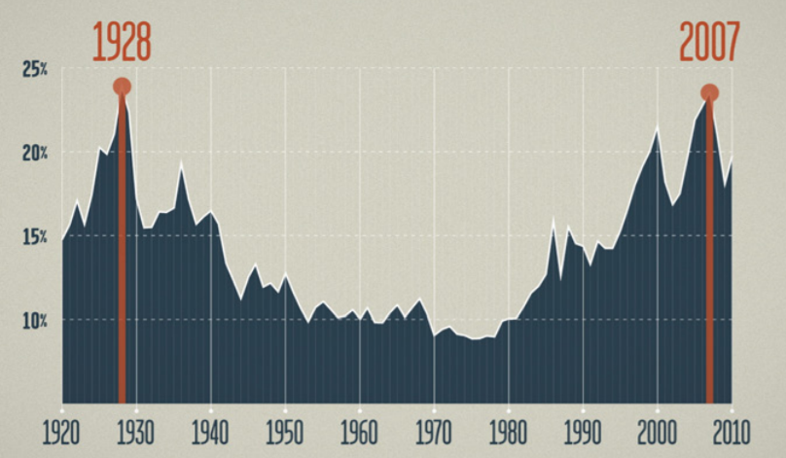
Pre-Tax Income of Top 1% over Long-Run
“Great Moderation” (1945-1980)
Stronger unions
Moderate executive pay norms
Higher real minimum wage
Less international competition & offshoring
Less outsourcing (contracting)
Less concentrated industries
Smaller “college premium”
Few/no stock buybacks < 1982
Higher income taxes
Source: Inequality for All - Graphics Package http://inequalityforall.com/resources/#/

Slide 27
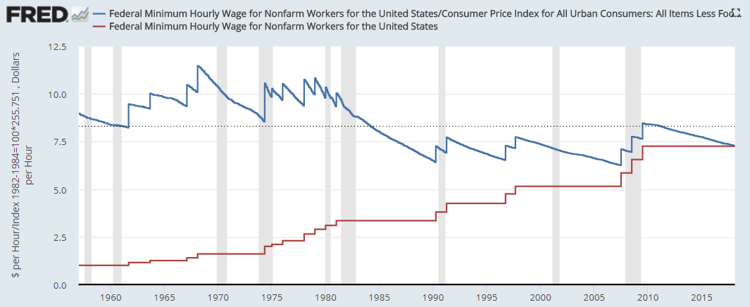
Minimum Wage: Real & Nominal (1957-2018)
Federal minimum wage of $7.25 is below the historical real average of $8.30.
Average = $8.30
$7.25
FRED Blog: “The Real Minimum Wage” (July 2015)

Slide 28
Solutions to Inequality
Market Income “Pre-Distribution”
Education funding (all ages)
Retraining / Life-long learning
Higher minimum wage
Stronger unions / labor power (service industries not subject to intl. competition)
Higher profit sharing / 401k match
Restrict buybacks and dividends
Cultural shifts and awareness
After-Tax Income “Redistribution”
Raise income tax rates on high incomes
Minimum effective tax rate / “Buffett Rule”
Remove cap on payroll tax
Treat all sources of income similarly
Reduce “tax expenditures” for higher incomes
Minimum effective tax rates
Transfers
Increase earned income tax credit
Expand healthcare subsidies & Medicaid
Medicare for All
For wealth inequality
Raise estate taxes
Sovereign wealth fund

Slide 29
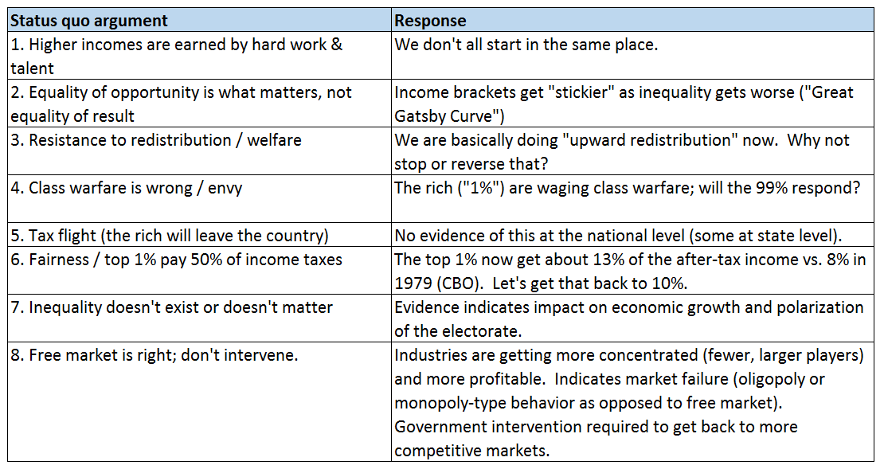
Debating Income Inequality
29

Slide 30
Topics
Key Economic Indicators
Budget Deficits & Debt
Inequality
Healthcare
Special Topics: Demand, Productivity & Compensation
Take Action

Slide 31
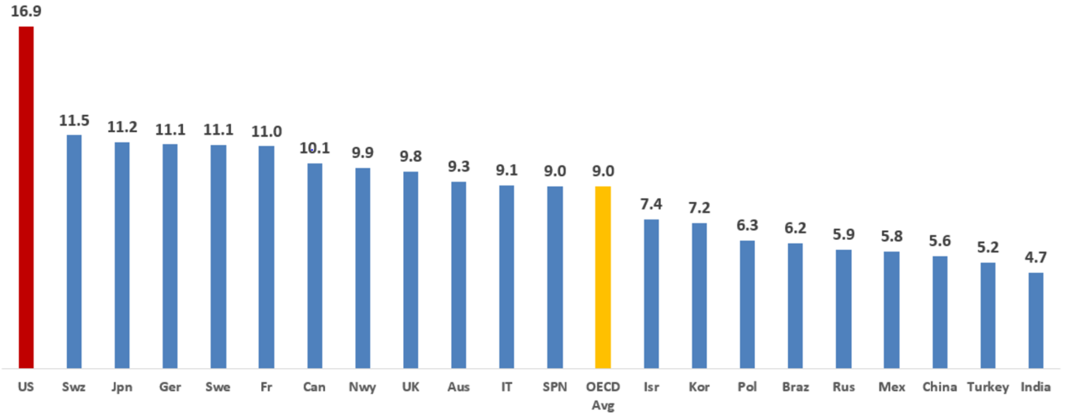
Healthcare Expenses % GDP (2015)
Formula | Variable | Amount
a | Nominal GDP $ | $20,000,000,000,000
b = a * 16.9% | Healthcare Spend at 16.9% GDP | $3,380,000,000,000
c | Population | 325,000,000
d = b / c | Healthcare Spend per Capita $ | $10,400
e = a * 5% | Gap of 5% GDP | 1,000,000,000,000
f = e / c | Gap per Capita $ | 3,077
Source: OECD Health Statistics 2016
http://stats.oecd.org/Index.aspx?DataSetCode=SHA

Slide 32
Tax Cuts and Jobs Act (TCJA)
Number Without Health Insurance Under Age 65 (Millions)
Additional Uninsured
Due to TCJA
CBO Baseline
Uninsured
Source Data: NYT, CBO, Kaiser Family Foundation

Slide 33
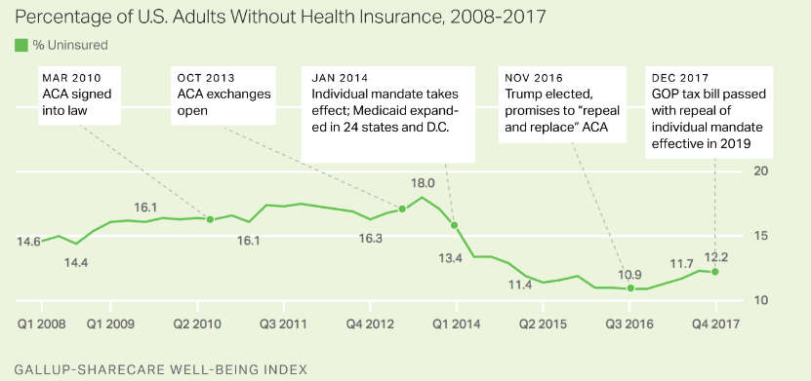
Gallup: Percentage Without Health Insurance
The uninsured rate rose from 10.9% in November 2016 to 12.2% in December 2017
Number uninsured rose from about 28 million in 2016 to 31 million in 2017 (+3.2m or 11%)
http://news.gallup.com/poll/225383/uninsured-rate-steady-fourth-quarter-2017.aspx

Slide 34
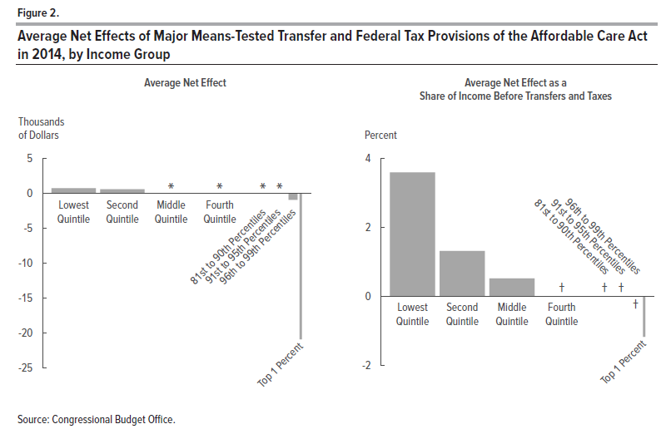
CBO: Distributional Impact of the ACA
$690
$560

Slide 35
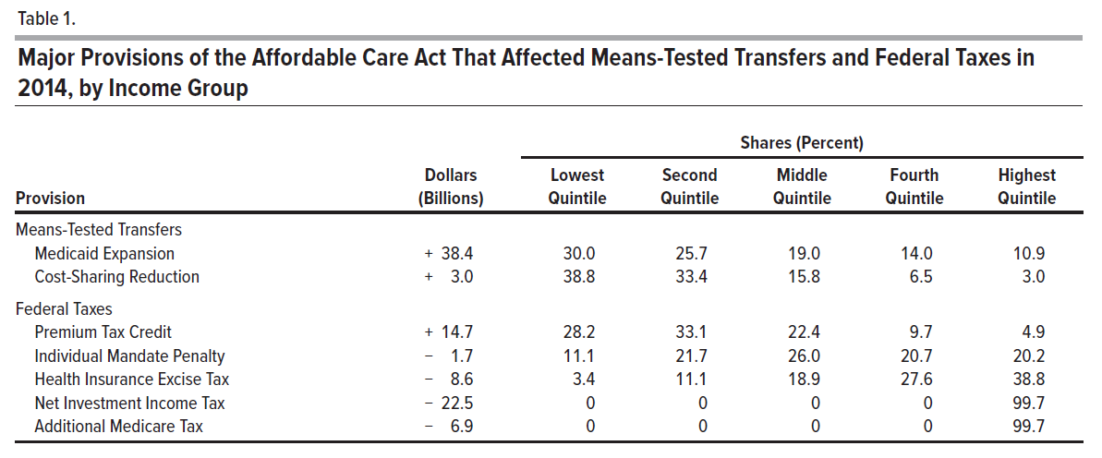
CBO: Distributional Impact of the ACA
CBO: The Distribution of Household Income, 2014 (March 2018)

Slide 36
Topics
Key Economic Indicators
Budget Deficits & Debt
Inequality
Healthcare
Special Topics: Demand, Productivity & Compensation
Take Action

Slide 37
Do We Have a Demand Problem? [Secular Stagnation]
Definitions
Secular = Long-term
Secular stagnation theory: The “new normal” of a slow growth economy over the long-term, rather than responding to a business cycle, which can’t be overcome with near-zero interest rate monetary policy
Possible causes: Lack of consumer demand, lack of business investment, demographics (aging/more retired persons), slower population growth, saving or paying down debt (deleveraging)
Key Measures
GDP = Consumption + Business Investment + Government + Net Exports
GDP = C + I + G + NX
NYT-Paul Krugman: “Secular Stagnation: The Book” (2014)

Slide 38
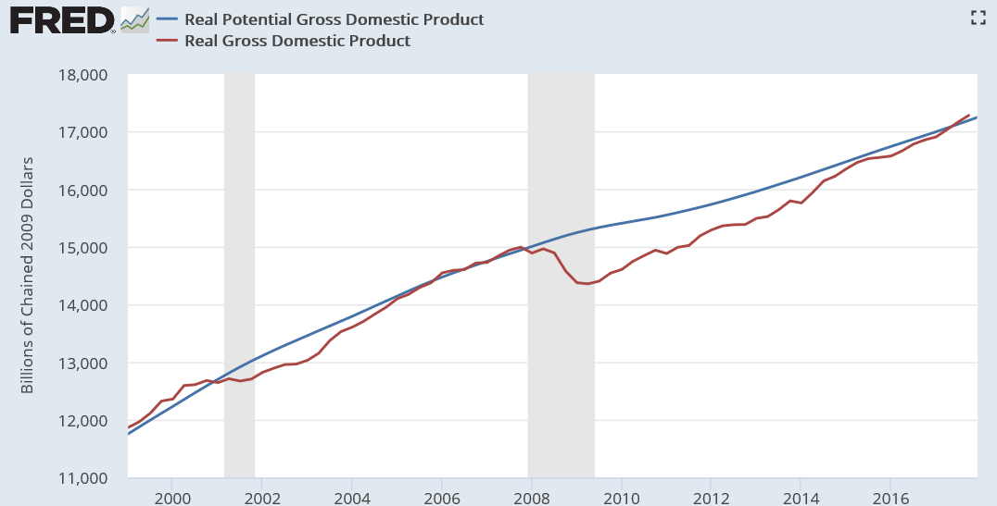
Real vs. Potential GDP
FRED: “Real potential GDP is the CBO’s estimate of the output the economy would produce with a high rate of use of its capital and labor resources.”
The gap was about $1 trillion in 2009
Economists argued government should act to bridge the gap (i.e., more stimulus)
Gap has since closed
NYT-Paul Krugman: “Secular Stagnation: The Book” (2014)

Slide 39
Real Gross Domestic Product (2009 Dollars in Billions; Q4 2017 Annualized)
Real GDP
$17,287
C: Consumption (PCE)
$12,035 (70%)
G: Government
$2,922 (17%)
I: Business Investment
$3,011 (17%)
NX: Net Exports
(-$654) (-4%)
Notes
PCE=Personal Consumption Expenditures
Federal: Government transfers (Social Security, Medicare) are in PCE, so this is mainly federal discretionary spending (defense and non-defense)
Real GDP is in 2009 dollars; the Nominal GDP was $19,754
Imports are greater than exports, so NX is negative (indicates a trade deficit)
Source: BEA, GDP Press Release (Table 3), March 28, 2018

Slide 40
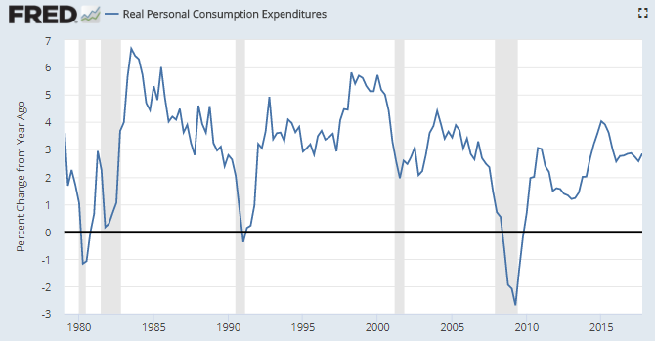
Consumers C: Real Personal Consumption Expenditures (PCE) (70% GDP)
Time Period | Average Growth
1980s | 3.4
1990s | 3.4
2000s | 3.5
2010s | 2.4
‘14-17 | 3.0
Source: Federal Reserve Economic Data

Slide 41
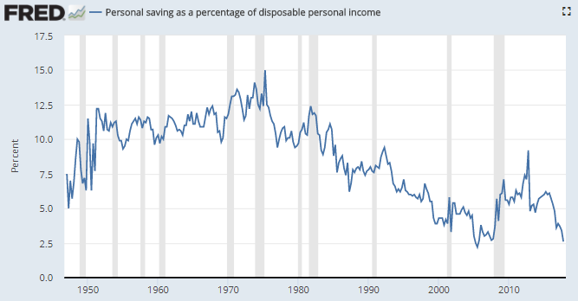
Personal Saving as % Disposable Income
Time Period | Avg.
1947-2017 | 8.5
1980s | 9.3
1990s | 6.7
2000s | 4.3
2010s | 5.5
Source: Federal Reserve Economic Data

Slide 42
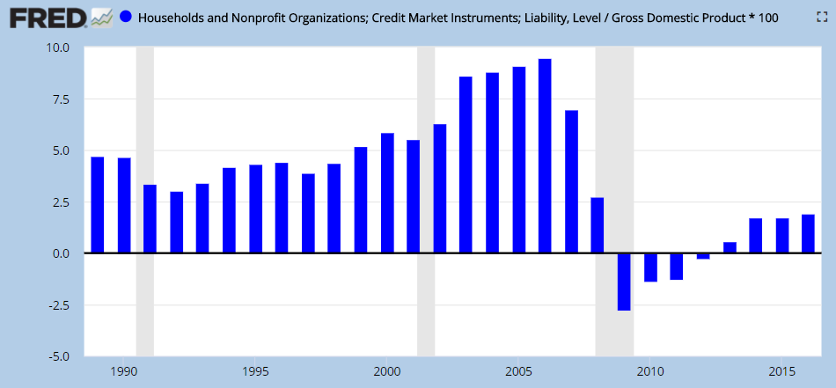
U.S. Change in Household Debt 1989-2016 (% GDP)
GDP
%
Households paid down debt for four years, rather than borrowing and spending
Source: Federal Reserve Economic Data

Slide 43
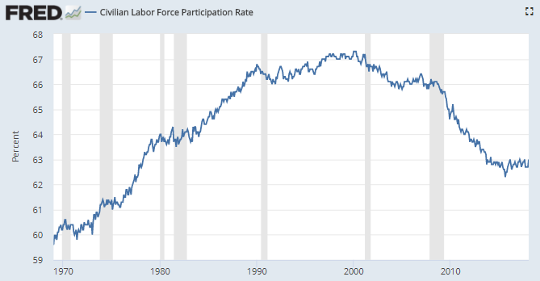
Labor Force Participation (Age 16+)
Labor force participation is significantly impacted by an aging country; retirees are not in the labor force
A lower percentage of age 65+ persons work vs. the 25-54 working age, lowering demand (perhaps slope of potential GDP line?)
LFPR=
Labor Force
Civilian Population Age 16+
Source: Federal Reserve Economic Data

Slide 44
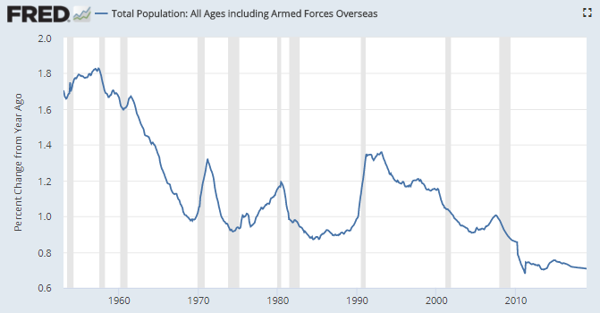
Population Growth (% Change vs. Year Ago)
Slower population growth means fewer new workers, other things equal
Source: Federal Reserve Economic Data

Slide 45
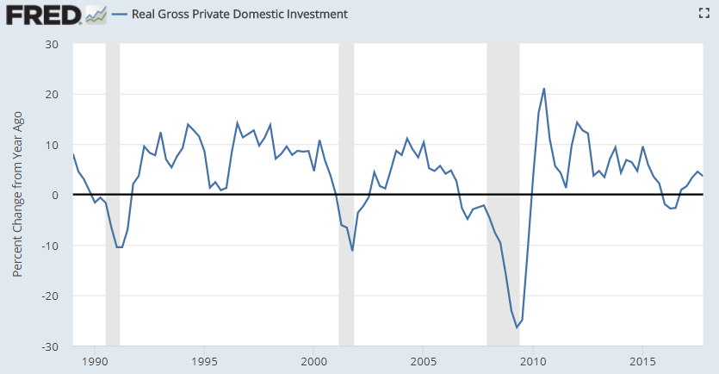
I: Real Gross Private Domestic Investment (Businesses) (17% GDP)
Time Period | Average Growth
1980s | 3.4
1990s | 6.0
2000s | -1.2
2010s | 6.0
14-17 | 3.1
Source: Federal Reserve Economic Data

Slide 46
Output and Productivity
Mathematically: Output = Output/Hour X Hours Worked
In a fair world, workers wages would go up with productivity and inflation
Wage Growth = Productivity Growth + Inflation
Output
(GDP)
Output per Hour (Productivity)
Hours
Worked
Capital
Intensity
Labor Composition
Multifactor Productivity
Productivity Drivers
Capital intensity: Capital per worker (tools & technology)
Labor composition: Worker skill (education, training, experience)
“Multi-factor productivity” – process efficiency, globalized supply chains*
*Multifactor productivity is designed to measure the joint influences of technological change, efficiency improvements, returns to scale, reallocation of resources, and other factors on economic growth, allowing for the effects of capital and labor.
BLS: Multifactor Productivity Trends - 2017

Slide 47
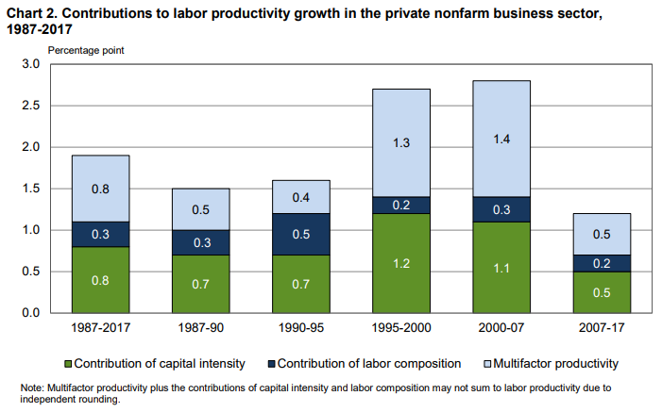
Productivity Components
From 2007-2017, productivity lower across all three components vs. prior periods
Tough to get wage growth with low productivity growth
Wage growth = Productivity growth plus inflation
BLS: Multifactor Productivity Trends - 2017

Slide 48
Theories on Recent Slow Productivity Growth
Capital Intensity
Weak investment after the financial crisis
Businesses weren’t investing while consumers were paying off debt
Stock buybacks vs. investment
Less competitive / more concentrated industries
Oligopoly/Monopoly can profit maximize without as much investment
Labor Composition (Skills & Experience of Work Force)
Loss of skilled Boomer’s from the workforce
Mix of workers shifting to lower productivity industries (?)
It is inconsistent to argue that automation is taking millions of jobs, yet not see sizable productivity impact; is there a measurement problem?
Less worker mobility may mean resources less efficiently deployed
Multifactor Productivity (Technological Changes and Business Process Efficiency)
Productivity gains from globalized supply chains and outsourcing already behind us
Recent innovations (e.g., AI, robotics, social networks, mobile apps) may have less productivity impact or may in the early stages
Reasons for decline in productivity not easy to determine; widely different views among economists
NYT-Neil Irwin-Why is Productivity So Weak? Three Theories (April 2016)
Fed Chair Jerome Powell – Speech “The Outlook for the U.S. Economy” April 6, 2018

Slide 49
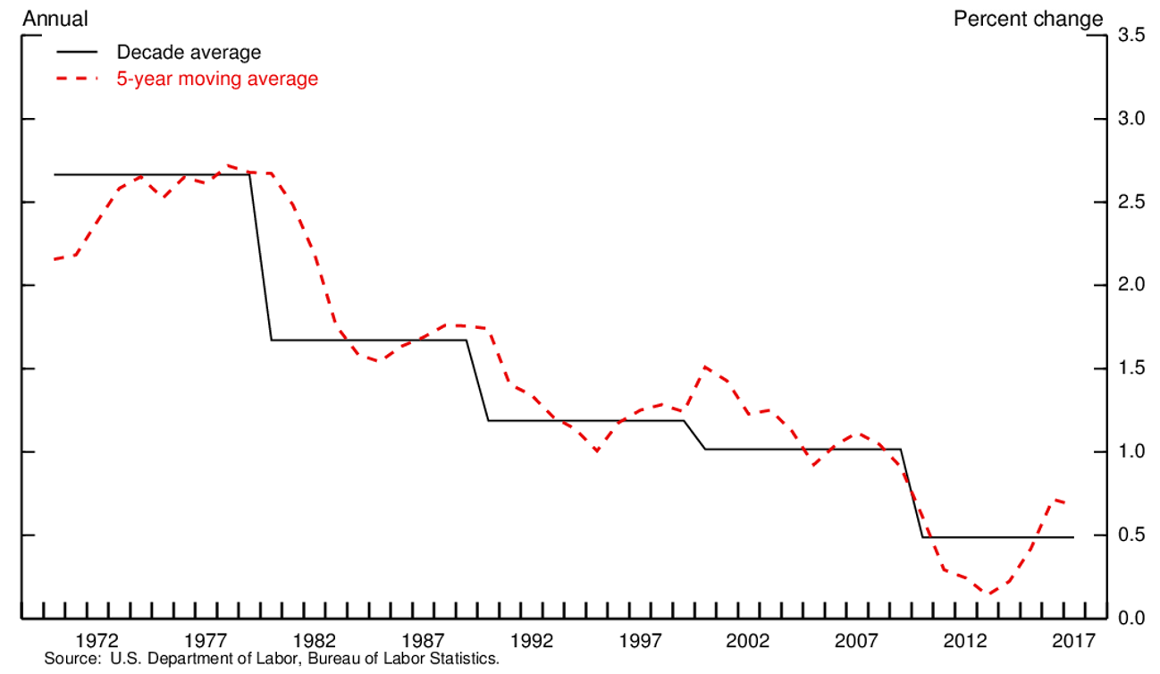
Hours Worked Affected by Slower Labor Force Growth
Labor force growth is a primary driver of hours growth
Labor force growth has slowed, just 0.5% per year average since 2010
Baby boomers are aging and retiring
Prime-age labor force participation declined from 2010 to 2015 and remains low.
Participation rate for prime-age men has been falling for more than 50 years
Participation rate for prime-age women rose through the 1990s but then turned downward, and it has fallen for the past 20 years.
Fed Chair Jerome Powell – Speech “The Outlook for the U.S. Economy” April 6, 2018

Slide 50
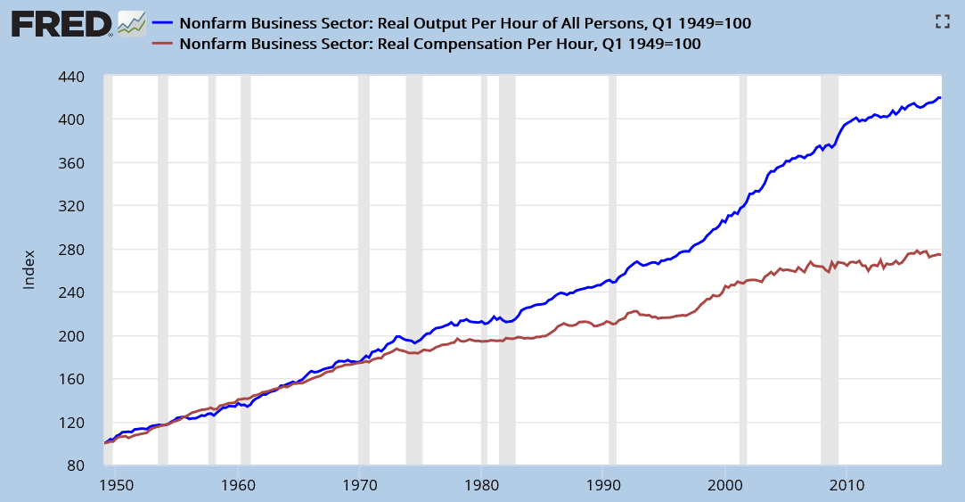
Productivity, Compensation and Inequality
Productivity = Output per labor hour
Worker compensation (pay and benefits) has fallen behind
Labor’s share of total income is falling while capital’s increases
Since capital (owners) tend to have higher incomes, this worsens inequality
Productivity
Growth
Compensation
Growth
(CPI Adjusted)
1949 – 1973 (24 yrs.)
Productivity: +95%
Compensation: +85%
1973 – 2016 (43 yrs.)
Productivity: +218%
Compensation: +97%
BLS: Understanding the labor productivity and compensation gap – June 2017

Slide 51
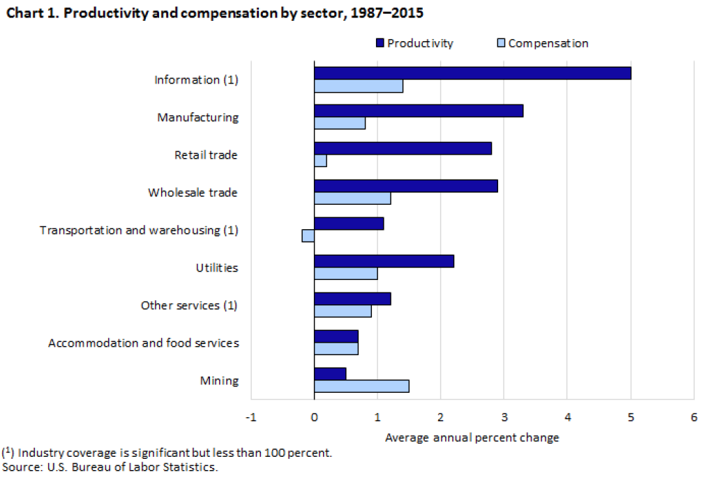
Productivity and Compensation: Annual Growth Rates by Industry (CPI Adjusted)
BLS: Understanding the labor productivity and compensation gap – June 2017

Slide 52
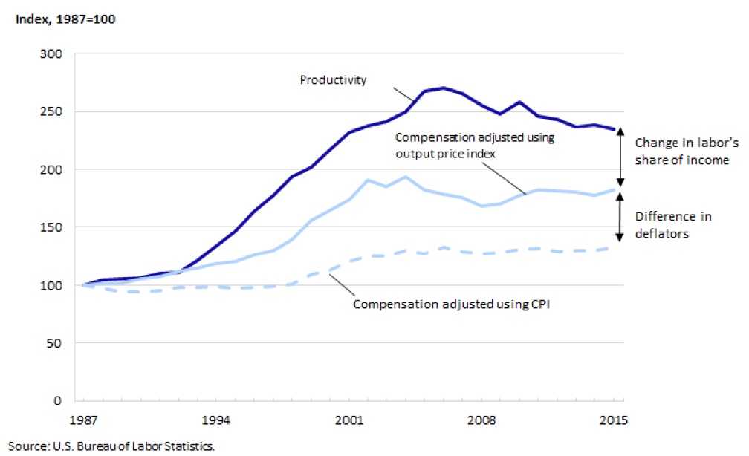
Gap for Power Generation & Supply Industry (1987-2015)
Using Output Deflator Instead of CPI
Using industry-specific output deflators instead of CPI reduces the gap, but does not eliminate it
Deflators less than CPI, so compensation growth relatively faster than CPI
BLS: Understanding the labor productivity and compensation gap – June 2017

Slide 53
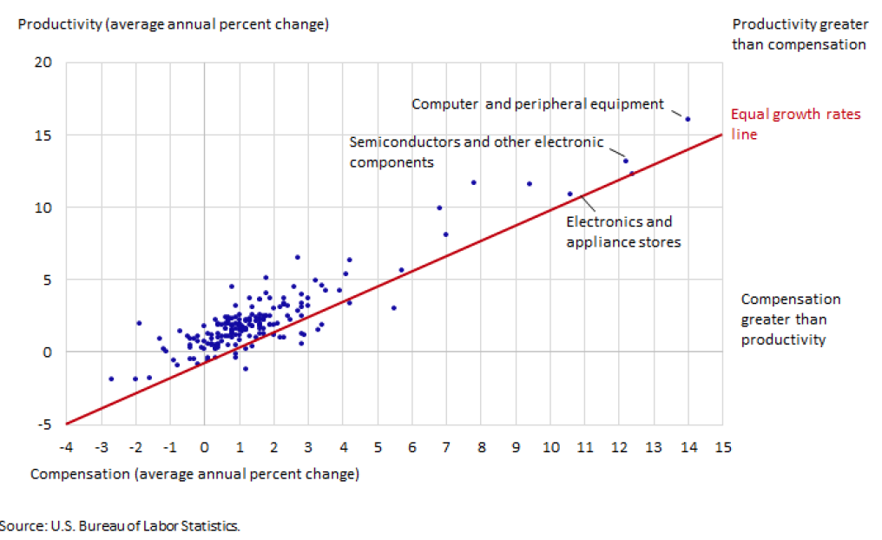
Gap by Industry: Average Annual Percent Change (Industry Deflators)
Each dot is an industry
Industries above the line have productivity growing faster than compensation
The labor share of income declined in 77% of industries studied
This shows the gap after adjusting for inflation using industry-specific deflators rather than CPI.
BLS: Understanding the labor productivity and compensation gap – June 2017

Slide 54
Why the Decline in Labor Share?
Reasons vary by industry. According to BLS:
“Globalization – Some of the income that might have gone to domestic workers is now going to foreign workers due to increased offshoring (i.e. the outsourcing of production and service activities to workers in other countries). This could have caused intermediate purchases to increase and labor compensation to decrease.
Increased automation – It is possible that increased automation has been leading to an overall drop in the need for labor input. This would cause capital share to increase, relative to labor share as machines replace some workers.
Faster capital depreciation – It is possible that the capital used by industries is depreciating at a faster rate in recent years than in the past. These assets include items such as computer hardware and software that are upgraded or replaced more frequently than machinery used in prior decades. This faster depreciation could require a higher capital share to cover upgrade and replacement costs.”
BLS: Understanding the labor productivity and compensation gap – June 2017

Slide 55
Reasons Why Pay Lagging Job Growth
Declining unionization
Restraints on competition (non-compete clauses reduce opportunities for large raises when switching firms)
Minimum wage below peak in real terms
Globalization and automation
Slow productivity growth
Outsourcing (contractor labor; contractor’s paid less)
NYT: “Six Reasons That Pay Has Lagged Behind U.S. Job Growth” (February 2018)

Slide 56
Topics
Key Economic Indicators
Budget Deficits & Debt
Inequality
Healthcare
Special Topics: Demand, Productivity & Compensation
Take Action

Slide 57
Letter to Legislators: Fiscal Policy
Dear Legislator:
I’m concerned about the national debt. When the economy is booming, we should be taxing more and spending less, not the other way around.
I request that you advocate these fiscal policies:
Remove the cap on the payroll tax to help fund Social Security. This should cover about 70% of the shortfall over the next 75 years. I’m willing to pay a higher payroll tax rate to cover the rest.
Re-brand the payroll “tax” as a “savings contribution” which is what it really is.
Increase the marginal tax rate on income over $500,000 to 40%, and to 50% for income over $1 million.
Eliminate favorable treatment for capital gains and dividends for individuals with incomes over $200,000. CBO estimates the top 1% get $100 billion/year due to the current favorable tax break.
Share buybacks are a major upward redistribution mechanism, mainly enriching the wealthy, while reducing investment in more productive assets. Require corporations to pay a 25% tax on shareholder buybacks; raise that to 50% over time.
Reinstate an estate tax with teeth. Billionaires should have single-digit millionaire heirs.
Freeze defense spending for a decade.
Sincerely,
Name

Slide 58
Letter to Legislators: Universal Healthcare & Education
Dear Legislator:
For the U.S. to compete successfully, our people should have quality, affordable healthcare and access to life-long education. I request that you advocate these policies:
Universal healthcare, with the government covering all costs of treatment done per best practice guidelines. My taxes should replace premiums but be lower than the costs I pay today, as we spend about 5% GDP ($3,000 per person) more on healthcare than the next most expensive countries for comparable quality.
Supplemental private insurance can cover other services desired.
Provide incentives to adopt the ACA Medicaid expansion in those 18 states that have yet to do so. This can cover up to 4 million people, reducing avoidable mortality by 5,000 people per year.
Four-year tuition or trade school, paid directly by government to the school. A Medicare-like process should be established to keep costs under control. This should be funded by a combination of tax increases on upper-income persons and cuts to defense spending.
Let working people earn tax credits over time for life-long learning financial support.
The $1.5 trillion student loan debt is a travesty and should be forgiven. Much stronger estate taxes can pay that back to the government over time.
Sincerely,
Name

Slide 59
Sources for More Information
Key Reports
CBO “Budget & Economic Outlook 2018-2028”
CBO “Distribution of Household Income, 2014”
BLS “Employment Situation Summary”
Data & Charts
Federal Reserve Economic Data (FRED)
Bureau of Labor Statistics (BLS)
Other Sources
Federal Reserve Board of Governors: Speeches & Testimony
Committee for a Responsible Federal Budget (CRFB)
Wells Fargo Economics
Paul Krugman NYT

