Slide 1
Sustainability Strategy
PROCESS & TOOLKIT
Tim Milburn
Sierra Club
July 24, 2017

Slide 2
Sustainability Strategy
PROCESS
Tim Milburn
Sierra Club
July 24, 2017

Slide 3
Purpose
Define processes and tools for grassroots groups to define, develop and launch sustainability strategies within and with their communities
  Processes include a range of strategies and tactics
  Tools include a range of sample documents, scripts, agendas and other templates; marketing tools, action lists, references, etc.

Slide 4
Explanation
This presentation is split between into Process and Toolkit sections.
  The Process suggests ideas on best practices for organizations to consider when planning specific strategies and tactics / initiatives; communicating these to and with municipal leadership and other stakeholders, team and message building and deploying actions to achieve the strategies.
  The Toolkit is a repository of examples of documents, ideas and case studies that may be referenced as a team builds its solutions
  The PowerPoint document is structured so that internal links between the Process and corresponding Toolkit examples can be used to toggle back and forth between these sections
This presentation is intended to be used in any way that fits the needs of the team and its goals
  A structured format is provided and team’s are expected to use and/or modify some or all of the slides and customize the process and the tools as needed.
  This resource is incomplete. As new ideas and examples are generated we would like to share these, so this document and its supporting files can be leveraged by a broader, like-minded audience. By intention, this is a living document and will ever be Work In Process.
  Each team should use this as guidelines and tools. By following the steps, the goal is to adapt each program to it’s unique needs.
For questions, ideas, criticisms or contributions to improve the process and toolkit feel free to contact Tim Milburn, logintim@gmail.com .

Slide 5
Definition
  Sustainability* is the ability to continue a defined behavior indefinitely and may be divided into three key areas:
  Environmental sustainability
  Economic sustainability
  Social sustainability
September 3, 2017
Notes:
For more discussions: *Thwink.org Definition http://thwink.org/sustain/glossary/Sustainability.htm

Slide 6
Sustainability
Universe
Sustainability
Air Quality
Pollution
Health
Water Quality
Drinking water quality
Sewage
Stormwater / Flooding
Waste
Health
Waste Management
From power
From transportation
Other sources
Pollution
Climate Change
Energy
Renewable Energy
Wind
Solar PV
Other
Energy Efficiency
Climate Change
Transportation
Mobility
Bike / Walk
Bus
Rail
Alternative Fuels
EVs
CNG, Propane
Biofuels
Land
Pollution
Plants & gardens
Green Infrastructure
Open Spaces
Recycling

Slide 7
Sustainability Universe:
Climate Change Focus
Sustainability
Climate Change
Transportation
Mobility
Bike / Walk
Bus
Rail
Alternative Fuels
EVs
Natural Gas
Biofuels
Energy Efficiency
Solar PV
Wind
Renewable Energy
Climate Change
Energy
Propane

Slide 8
Sustainability Universe
Sustainability
Climate Change Mitigation
Renewable Energy
Energy Efficiency
Air
Air Pollution
Health
Water
Drinking water quality
Sewage
Stormwater / Flooding
Land
Waste
Transportation
Health
Plants & gardens
Green Infra
Waste Mgmt
Recycling
Open Spaces
Mobility
Alternative Fuels
From power
From transportation
Other sources
Wind
Solar PV
Other
Water Pollution
Land Pollution
Bus
Rail
EVs
CNG, Propane
Biofuels
Bike / Walk
Notes:
Alternative format

Slide 9
Sustainability Strategy Process Flow
Define Mission & Preliminary Strategy & Plan
Build Teams
Start Planning, Preparation & Define Asks
Meet with Municipal Leadership
Refine Strategy
Get the Word Out
Build Your Power
Plan & Organize Events/Actions
Convene Events
Implement Actions
Follow up on Outcomes

Slide 10
Step 1: Define Preliminary Strategy/Plan
Define Mission
Define initial strategy and supporting goals
  Strategic plan description
  Initial goals and achievable, measureable targets
  Consider creating a logo or a meme
  Define preliminary sequence of events
  Set expectations for team (roles, actions)
  Develop initial ideas for municipality, community and other stakeholders
Select initial core team members and define roles
Set clear concise recruiting message for prospective team members
Start Community Mapping process

Slide 11
Typical Organizational Structure
Grass Roots Group Organization
- Steering Team
- Members
Supporting Members
Contributors
Recruiters
Policies
Ordinances
Regulations
Mission
Strategy
Actions
Core Team
-Leadership
-Members
Muncipality
- Leadership
- Staff
Experts
- Asks
- Recommendations
Sustainability Plan
Strategy
Actions
Other Community Stakeholders
Collaborators

Slide 12
Municipality: Potential Sustainability Roles
  Develop Municipal Sustainability Plan / Strategy
  Define and deploy actions to support strategy
  Provide leadership within the community to demonstrate sustainability objectives – set the example
  Work with local organizations (businesses, schools, volunteers, etc.) to capture ideas, define programs and initiate actions
September 3, 2017

Slide 13
Community Mapping
  Community Mapping is a process of gathering important and relevant information about the community in which we live and/or work, and then applying it to a project to increase the likelihood of successful outcomes. This information:
    Provides a deeper understanding of our community(ies), allowing us to develop strategies and tactics in a thoughtful manner
    Helps define roles and responsibilities for participants
    Defines current connections and identifies with whom else we may want to build relationships
  Communities may be defined as
    Public entities: municipalities, schools, park districts and combined
    Grass roots organizations
    Other stakeholders
September 3, 2017

Slide 14
Step 2: Build Teams
Recruit people in and around your community
  Be inclusive and diverse (age, culture, language)
  Leverage collaborative resources
  Reach out to like-minded groups
    National
    Local groups – interfaith, health issues, labor, Meetup, Youth Groups, Colleges, etc.
Maintain good recruiting habits
  When possible, meet one-on-one with new people to educate them on your goals, learn about them. Listen and inform at a good pace, so both parties are comfortable with the outcomes.
  Invite to small and large group meetings to discuss issues and understand their best place on the team
  Record and track information for current and future actions
Communicate effectively with emails, Google Groups, Social Media and the like

Slide 15
Step 3: Start Planning, Prep, Define Asks
Set up introductory Group Team planning meeting(s)
  Meet (as often as needed) with your team to define mission, goals, needs and asks
  Select Core Team members and identify leader(s) and other roles
  Prepare actions – create background homework assignments for individuals/groups
  Define need for subject matter expert participation
  Define asks and develop plan to meet with community leaders
Establish municipality’s historical baseline: know their perspective
Target meeting with Mayor/Village President level (“Top Down” approach).
  Don’t be put off by “the Mayor is very busy”. You are a constituent and have every right to ask for and get a meeting.
  If not the top person, try to identify champion with influence with top leadership that you can develop into voice for communicating your goals.
  Know the process: attend council/board meetings well in advance of making the first “ask,” or watch on cable TV, to get the “lay of the land” for how meetings run and to learn different elected officials’ positions on issues
Contact elected official and arrange meeting

Slide 16
Consider Asks from your Elected Official’s Point of View
Your Elected Official cares a lot about: | Your Elected Official doesn’t care much about:
People who can vote for them and/or provide campaign contributions | People who can’t vote for them
Local press and editorials | A 20+ page review or analysis of anything
Advocacy from real people - calls, personal emails, handwritten letters, especially people that show up in person | Form letters, a tweet, or a Facebook comment (unless there are dozens)
A clear, concrete ask that they know how to solve - sign this letter, make a public statement, attend this meeting, etc. | General ideas or a laundry list of concerns

Slide 17
Step 4: Meet with Community Leaders
Be organized and do your homework
  Know your audience
  Present agenda, reference documents, technical support, etc.
Shoot for less than 30 minutes for first meeting and limit number of Group /Core team members
Provide in writing and state clear, concrete ask(s) (sign a letter, make a public statement, attend this meeting, etc.)
Listen and ask thoughtful questions. Be thinking about advancing the Community Map.
These are very important and busy people. The more prepared you are the more likely the conversation will be effective and you will be welcome in the future
Document key results. Set achievable and measurable expectations (targets).

Slide 18
Step 5: Refine Strategies
Meeting participants (e.g. Core Team) - conduct Lessons Learned exercise
  What worked well?
  What aspects would be better with enhancements?
  What are the next steps for the Team? For the Municipality? For others?
  What was agreed upon?
Take Lessons Learned and apply to strategy going forward
Document refined message, strategies, actions and asks
Communicate results to extended team participants / collaborators

Slide 19
Step 6: Get the Word Out
Communicate meeting outcomes
  With Municipality
    Document what was discussed and agreed to
    Send thank you notes
  With grass roots Group
    Group members
    Supporting members
    Collaborators
  With local media - newspaper, TV, radio
    Be certain that municipal leaders are comfortable with messages
    Consider having municipality communicate directly with media
  With residents
    Via media outlets (pitching stories, letters to the editor) and social media
Celebrate resolutions that get signed and actions that are initiated

Slide 20
Step 7: Build Your Power to Achieve Goals
Build your volunteer base
  Capture and communicate educational materials and messages
    Provides consistent, clear background, asks, actions and messages for participants
    Strengthens understanding and commitment
  Increase number of supporters of these asks, actions, mission
    Targeted meetings
    Outings
    Public presentations
    Informal meetings
    Outreach – phone, social media, email, etc.
Build support of stakeholder communities
  Municipal Leadership
  Other Community Leadership
  Community activists
  Other stakeholders
Demonstrate public support for asks and actions
  Online and papers petition gathering
  Letters to Editor
  Press releases

Slide 21
Step 8: Plan and Organize Events and Actions
Event/action planning
  Assign event managers, recruiters and other participants
  Define audience goals and interests
  Capture agenda topics
  Identify and commit qualified and effective presenters
Recruitment
  Recruit using phones, personal meetings, outings, mass email, social media, etc.
  Parse needs, responsibilities and delegate responsibilities
  Document sign ups everyone – keep track for future activities
  Alert members of where and when there will be public meetings by city/village boards so people can attend, show their support, learn by observing, and bring their learnings back to their respective teams in their respective home towns
Follow-up
  Shortly before event/action, make sure everyone who said yes gets reminder call and/or email

Slide 22
Step 9: Convene /Host/ Co-sponsor Event/Action
Preparation
  Schedule event – timing, venue reservations
  Define resource needs (projectors, monitors, screens, handouts, food and drinks, etc.)
  Press packets
  Other handouts
  Banners, placards
Invitations
  Define who to invite, including community leadership, media, grass roots groups, collaborators, other stakeholders
Deliver invitations
Prepare agenda
Convene meeting

Slide 23
Step 10: Follow-up on Event Outcomes
Communicate results (actions, timing, next steps, recommendations, etc.) to broader audience
Thank participants
Reinforce message and outcomes
  Capture talking points
  Issue press release
  Hold press conference
  Launch social media content
  Celebrate!
Recognize individual and group successes
  Municipality
  Grass Roots Group and Core Group
  Collaborators
  Etc.
Track results
Consider continuous improvement actions to advance next steps and continue to accomplish mission
  Analyze measures
  Reassess activities
  Modify actions as required

Slide 24
Sustainability Strategy
TOOLKIT
Tim Milburn
Sierra Club
July 24, 2017

Slide 25
Step 1 Tools: Define Preliminary Strategy/Plan
Sample Mission statement, w/ icon/meme
Sample Strategic Plan
  Sample recruiting message
  Examples of roles - for participants and municipality
  Examples of targets
  Discussion on Community Mapping
  Sample sequence of events

Slide 26
Climate Change Strategy:
Example Mission & Icon/Meme
Our group is committed to affecting positive change NOW to protect the Earth - by reversing the impacts of human influence on climate through smart energy actions by the Citizens and Leadership of our community.
September 3, 2017

Slide 27
Climate Change Strategy:
Example Recruiting Message
  The <group name> is looking to work with <Municipality> to try to effect positive change in policies and practices.
  We need your help and are looking for volunteers to help us identify topics, messages and then organize and communicate with <Municipality>
  We are having a kickoff meeting on <Date> and invite you to attend.

Slide 28
Municipality Sustainability Plan
  Develop Municipal Sustainability Plan / Strategy
    Start with simple Mission Statement
    Consider leveraging developed programs
      Sierra Club’s Ready for 100 (% Clean Energy) (133 national mayor signatories)
      Greenest Region Compact 2 set up by Chicagoland Metropolitan Mayors Caucus (50 Illinois signatories)
    Review policies & ordinances and adjust for sustainable practices
    Establish sustainable purchasing policies
    Establish sustainable practices by department
    Deploy sustainable solutions
    Define measures of success & track programs accordingly to establish accountability
    Document plan, actions and results (e.g. GRC2)
September 3, 2017

Slide 29
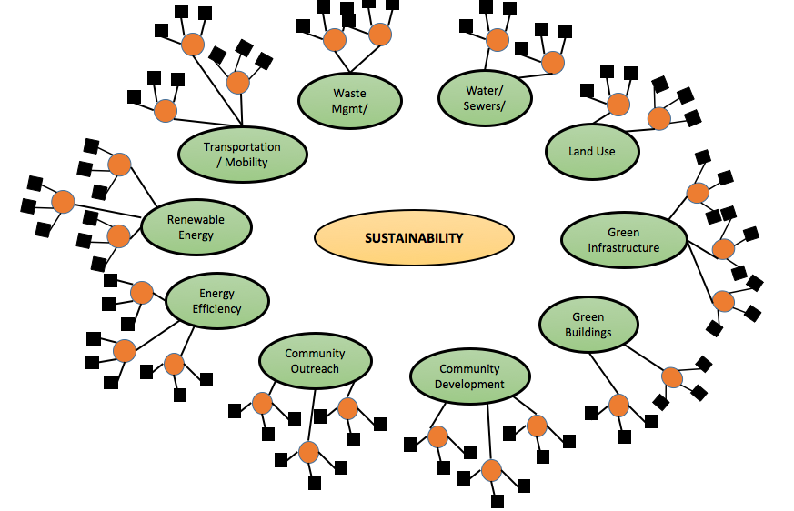
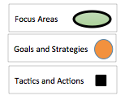
Process Concept
Define overall strategies and set overall goals
Prioritize strategies, define resource requirements – define what can be done realistically
Define and prioritize tactics / actions to support strategies
Capture related history and define opportunities for improvement
Define measures of success
Deploy tactics /actions
Assess and adjust programs as needed (continuous improvement)
September 3, 2017

Slide 30
Example of Strategy/Tactics: Solar Electric
Strategy: Increase the adoption of Solar Photovoltaic (PV) system within municipality in order to reduce greenhouse gases, pollution and reduce energy bills
Tactics:
Form solar energy team: City Council, City Staff, interested and informed volunteer citizens
Review current policies, ordinances and inspection processes and compare to Best Practices in other communities. Find ways to adjust to facilitate PV adoption.
Define suitable projects to install solar PV systems in municipality – residential, municipal, business, not-for-profit, park and school districts, community-based projects, group purchasing.
Leverage support programs:
  New Renewable Portfolio Standard incentives, net metering, Investment Tax Credit (ITC),
  Grow Solar and Sol Smart: Local government Toolkit (Sol Smart) and Technical Assistance Programs
Define Measures of Success: Return on Investment, pollution/ GHG reduction and tons of coal /natural gas /nuclear reduced
Develop and deliver outreach program
Establish recognition program
September 3, 2017

Slide 31
Example of Strategy/Tactics: Energy Usage Reduction
Strategy: Decrease the consumption of electricity and natural gas through energy conservation and efficiency program and reduce energy bills
Tactics:
Form energy conservation energy team: Elected Leaders, Municipal Leaders/Staff, interested and informed volunteer citizens
Review current policies, ordinances and inspection processes. Find ways to adjust to facilitate PV in your community
Define suitable projects to modify existing homes, businesses, not-for-profits, park and school districts, etc..
Leverage support programs:
  New Energy Efficiency incentives which encourage use of energy efficient appliances
  Leverage ComEd, Nicor and CUB programs for assessments and technical assistance
Define Measures of Success: Return on Investment, pollution/ GHG reduction and tons of coal /natural gas /nuclear reduced
Develop and deliver outreach program
Establish recognition program
September 3, 2017

Slide 32
Team Homework
Back
Internal: Map Your Team’s Community
External: Map Your Municipality
  Learn about your municipal government
    Type of government (Village Board/Trustee, City/Alderman)?
    Who is on the City Council/ Village Board? Tenures/ Election cycles
    Who are key members of municipal staff, their titles and responsibilities?
    Any other stakeholders of import?
    History on environmental issues
      Any known political stances (pro-green, anti-green)?
      Organized sustainability program, ad hoc sustainability strategy or little to no sustainability strategy?
      If possible, develop baseline list of historical and current sustainability initiatives and successes?
  Identify and pre-existing relationships with team members?
  Define who to contact and best path(s) for starting dialogue, if not top elected officials
September 3, 2017

Slide 33
Why Community Mapping?
Be strategic and thoughtful in communities we’re working in
Identify resources & community assets
Understand outlooks and leanings of community leadership
Identify champions and leaders for sustainability
Identify relationships you’d like to develop, strengthen
Identify which team members will take on the responsibility for developing relationships with key stakeholders within the community
Develop lists of key contacts/social networks
Develop the right organizing strategy to bring together a base of supporters based on shared community interests and needs
Notes:
Community Mapping helps us to…

Slide 34
Types of Community Relationships
The communication process often starts with transactional interactions. A goal is to migrate toward transformational interactions, where relationships are strong enough to effect positive changes
Transactional | Transformational
Communication is urgent, driven by desire to “get to yes”; see person or constituency as “useful” or “strategic” to reaching goals; based on specific actions taken | Communication is respectful, open, humble, curious, patient; Goal is to gather and share information & opinions; listen and seek guidance
Flow: 1-way flow (we “educate” the stakeholder); Issue specific | Flow: 2-way; both parties gathering and sharing information
Short-term, based on policy or issue cycle | Long-term, based on building trust, respect, and mutual understanding
Action-oriented | Relationship-oriented
Takes action in support of grass roots activities | Jointly plans, implements campaign plans
Grants money to grass roots organizations | Raises revenue together
September 3, 2017
Notes:
Plan sufficient time to develop relationships which can move at the speed of trust and the three stages of partnership
Ask a participants to read aloud the descriptions (one person reads a transactional and a transformational so 4 people total)
Ask the room - how do you relate to this? Have you experienced these types of relationships with partners or allies? Is anyone willing to share?

Slide 35
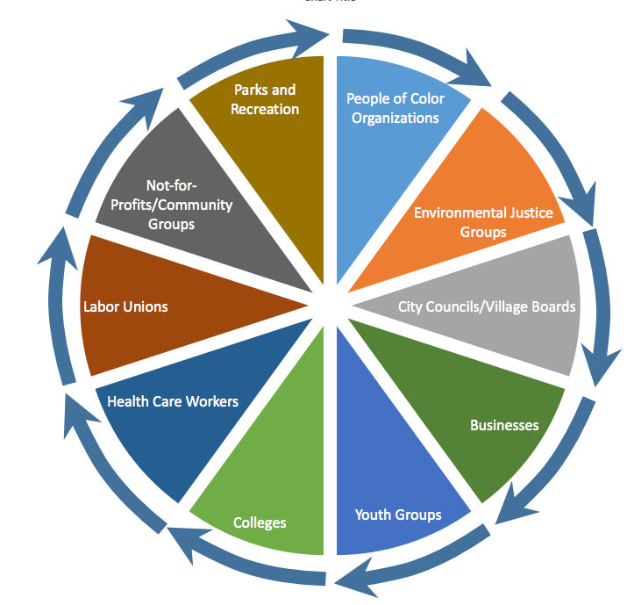
Relationships
What types of groups in your community do you have relationships with?
Is there a type of group/institution where you’d like to build more relationships?
Who are stakeholders in issues you’re working on/considering working on?
Sample Tracking Document
September 3, 2017
Notes:
Link needs approval from Google Docs

Slide 36
Community Mapping: Know Thyself
Know your own capabilities, limits, opportunities and weaknesses
How many members do you have? How many are and could be truly active and engaged?
What groups are represented in your membership?
What relationships or partnerships do you have with other groups? With elected officials? With municipal staff?
What comprises these partnerships? What are the strengths and weaknesses of each partnership?
What expertise do your members offer for a specific initiative?
What motivates your group? What excites it?
What are your group’s greatest strengths? How are you hoping to grow?
Be ready to convince muni that you are the group to work with
September 3, 2017

Slide 37
Community Mapping:
Assess Current and Potential Relationships
Back
What other groups/institutions/communities do you currently have relationships with?
What type/level of relationships do you have with different groups?
    0 – Prospective participant
    1 – Regular Communication - In the same networks, communicate occasionally
    2 -- Mutual Support - Take some actions for each others' issues, take action jointly around common issues
    3 -- Joint Planning - Actively work together on a campaign or set of common issues"
September 3, 2017

Slide 38
Types of Asks
Back
Resolutions
  Gain commitment of municipal leaders on specific action(s) or broad range of sustainability issues and/or strategies
  Start a transformational relationship
Actions – define specific requests for action by municipality and/or other communities
  Measureable goals – financial, social and environmental
  Investment evaluation
  Time tables

Slide 39
Sample Measures of Success
Examples of Measures of Success
Quantitative | Measure
Greenhouse Gas and pollution reduction – through emissions reduction and capture: tree/plant green infra, heat, electricity, vehicles | Pollution / greenhouse gas (GHG) reduction: Tons per year reduction of Carbon Dioxide (CO₂), particulate, Carbon Monoxide, Hydrocarbons, NOx
Building and Water Heating Natural Gas Energy Use/Savings | Return on Investment, pollution/ GHG reduction, Therms Natural Gas, kWhr electricity saved, appliance efficiencies and quantities, etc.
Electricity Consumption/Savings - all devices | Return on Investment, pollution/ GHG reduction and kW-hour saved- daylighting space area, appliance efficiencies and quantities, etc.
Solar Photovoltaic | Return on Investment, pollution/ GHG reduction and tons of coal /natural gas /nuclear reduced
Vehicles | Return on Investment, pollution/ GHG reduction and Gallon Diesel and Gasoline reduced
Green Infrastructure: Planting of trees, plants and (rain) gardens to absorb storm water. Addition of rain barrels and other green infrastructure | Return on Investment, pollution reduction/ GHG capture, Trees Planted. Gallons of rain water detained/retained from sewers
Green Buildings | Return on Investment, pollution reduction/ GHG capture and number of LEED buildings
Mobility | Miles of bike paths added. Number/miles of walk routes added
Water use reduction | Return on Investment, gallons saved using smart water devices, better usage practices
Runoff chemicals | Tons not entering aquifers through usage changes, technology
Waste reduction / recycling | Tons of waste recycled, reused, repurposed, saved- by waste category
Recognition Awards received | Quantity and type of and reason for award
Green education/outreach activities | Quantity and effectiveness
Public Policies Affected | Number of green policies enabled, number of green ordinances revised/written

Slide 40
Step 2 Tools: Team Building
Digital communications
Educational materials
September 3, 2017

Slide 41
How to recruit team members
Type of Contact | How Effective | Necessity | How to Use
Calling | Very Effective | Important | Invite, reminder
Texting | Effective | Important | Reminder
Personal Email | Good | Basic, but necessary | Invite, reminder
Facebook: Messenger | Good | Basic, but necessary | Invite, reminder
Facebook: Groups & Pages | Fair | Basic, but necessary | Expand invitation to new people
Public event posting: MeetUp or Nextdoor | Fair | Helpful, not necessary | Expand invitation to new people
Flyers | Poor | Helpful, not necessary | Reminder
September 3, 2017

Slide 42
Step 3 Tools: Preparing for Meeting Developing Asks
Digital communications
Educational materials
September 3, 2017

Slide 43
Start Planning, Prep and Define Asks
Set up introductory team meeting(s)
  Tie in core team and supporting participants with emails, Google Groups, Social Media and the like
  Meet (as often as needed) with your team
    Refine mission, goals
    Define paths of communication
    Educate team on target issues (e.g. Climate Change, Solar Power, Energy Efficiency)
    Define technical support and resources needed (if any)
    Select specific asks of municipal leadership
  Prepare
    Know national, state and local policies and incentives for initiatives of import
    Identify urgency and timing of actions and results
  Establish baseline – assess historical and current related sustainability initiatives
  Define asks and plan to meet with community leaders
    Know specifically what you want to ask
    Who should participate – initial meetings should have limited numbers
    Define team leader and other roles
    Target and develop green champions
September 3, 2017

Slide 44
Sustainability
Universe
Sustainability
Climate Change
Transportation
Mobility
Bike / Walk
Bus
Rail
Alternative Fuels
EVs
Natural Gas
Biofuels
Energy Efficiency
Residential Solar
Wind
Renewable Energy
Climate Change
Energy
Propane
Example:
  Drill down to 2-3 manageable targets
  based on Team’s research and recommendations
Define clear strategy and tactics
Identify incentives
Set measures of success
September 3, 2017

Slide 45
Targeting the
Sustainability Universe
Climate
Change Mitigation
Renewable Energy
Energy Efficiency
Transportation
Mobility
Alternative Fuels
Wind
Solar PV
Other
Bus
Rail
EVs
CNG, Propane
Biofuels
Bike / Walk
Residential Solar
Residential efficiency
Business efficiency
Example:
  Drill down to 2-3 manageable targets
  based on Team’s research and recommendations
Define clear strategy and tactics
Identify incentives
Set measures of success
Notes:
Alternative format

Slide 46
How to prepare 1st Meeting Agenda
Introductions
Problem – relate to municipality, etc. For climate change: what are obstacles to 100% clean energy, what are related health concerns
Solutions – commit to transition to more sustainable future. Identify real, near and mid-term achievable initiatives
Urgency – change is happening now (cite related examples)
Asks
  Clearly define asks.
  Shoot for endorsement, resolution and /or specific actions
  Find out who else should be involved and ask to open dialogue with them (sponsored by leadership)
  Get OK about communicating outcomes with press, if appropriate
Personal Stories – relate something personal, germane, local or other perspectives that make the ask important , relevant and current
Always follow-up
  Define who follows-up
  Thank you letter plus supply of follow-up resources, if any
  Be thinking about long term development of relationships
  Be persistent, yet polite
  Establish process of ongoing communication

Slide 47
Types of Asks
Resolutions
  Gain commitment of municipal leaders on specific action(s) or broad range of sustainability issues
Actions – define specific requests for action by municipality
Define and prioritize asks/issues for each community
  Examples:
    Implement Climate Change plan
      Solar PV Actions
      Energy efficiency actions by community
      Alternative Fuel Vehicles Actions
    Flood control with green infrastructure
    Community garden
    Adjust community policies to facilitate positive change
  Gain commitment/sponsorship to support education of communities’ residents and local employers/workforce

Slide 48
Sample email for Resolution Request
Dear XXX,
I’m reaching out to let you know about a 10-week campaign we are launching in April after the People’s Climate March. This campaign would be much stronger with [ORG NAME]’s involvement and wanted to ask you to consider joining us in this push.
Will you join us in asking our Mayors to pledge their support for 100% clean and renewable energy. #Mayors4CleanEnergy aims to build local momentum for a just and equitable transition to 100% renewable energy and demonstrate ambitious local leadership on clean energy and climate in contrast to the steps the Trump Administration has begun to take slashing vital climate and pollution protections.
Between April 29th and June 23rd, we will support local organizers to push their mayors to commit to 100%. For the #Readyfor100 campaign, this short-term campaign will build momentum for our longer term goals of securing community-wide commitments to 100%. For {ORG} this local mayoral push could help build momentum for a longer term goal you have - we’d love to discuss how this could help your work too.
Working with our partners, we will develop template materials, support and coordination across networks and conduct outreach to mayors. We want to work with you to plan, recruit, promote, track progress and build momentum through the duration of the initiative. And we will work with you to ensure that the effort meets or exceeds both our respective and collective goals.
I’ve attached a one-pager that outlines our campaign in more detail and would love to set up a time to talk.

Slide 49
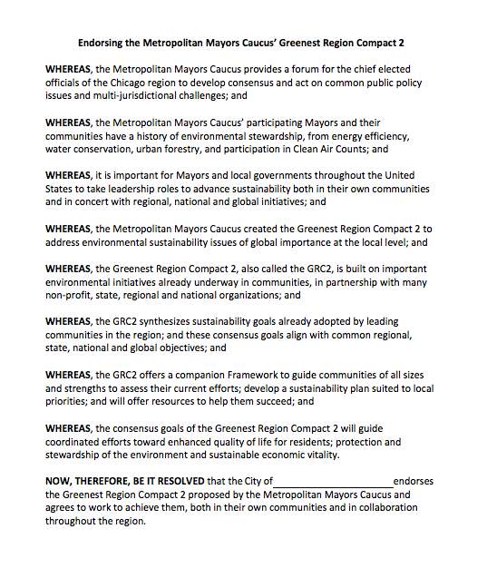
Example: MMC GRC2 Resolution
Suggested text for community to make public commitment to sustainable practices
Once signed, considered member community by Metropolitan Mayors Caucus (MMC)
Resolution available on line @: http://mayorscaucus.org/initiatives/environment/regional-environmental-collaboration/
No funds required from the municipality
MMC Environmental Committee manages certain environmental grants and members are provided access and alerting to existing and new programs
Notes:
USEFUL WEB LINKS
To learn more, please visit the following sites:
Metropolitan Mayor Caucus Site: http://mayorscaucus.org
Green Region Compact webpage: http://mayorscaucus.org/initiatives/environment/regional-environmental-collaboration/)
GRC2 Resolution: http://mayorscaucus.org/wp-content/uploads/2016/03/GRC2-Municipal-Resolution-FINAL.pdf
GRC Summary List: http://mayorscaucus.org/wp-content/uploads/2016/03/The-Greenest-Region-Compact-2-FINAL.pdf
GRC2 Framework: http://mayorscaucus.org/wp-content/uploads/2016/03/GRC2-Framework-COMPLETE-FINAL1.pdf
GRC2 Framework Tool - http://mayorscaucus.org/wp-content/uploads/2017/04/GRC2-Framework-Tool-4-2017-Final-complete.xlsx

Slide 50
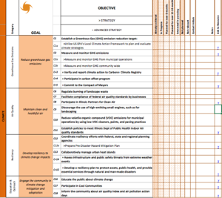
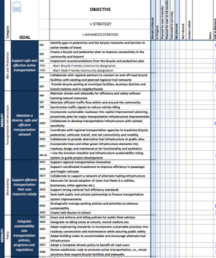
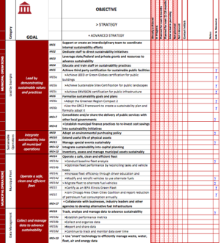
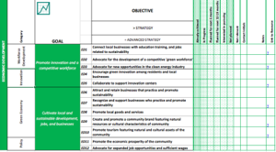
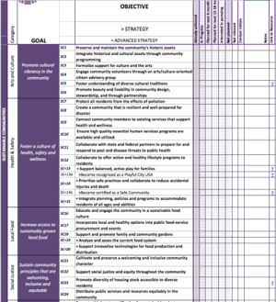
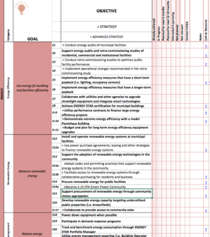
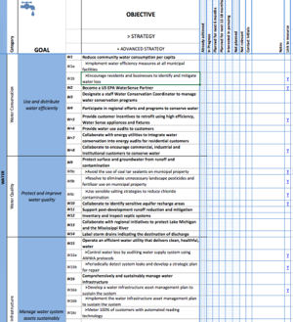
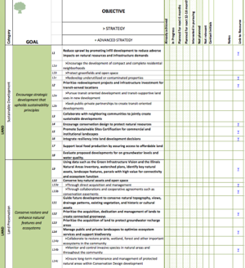
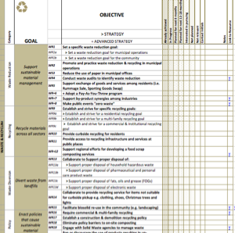
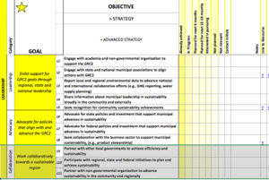
GRC2 Framework Areas
GRC2 Framework available to be used as customizable sustainability planning tool for municipalities:
http://mayorscaucus.org/wp-content/uploads/2017/04/GRC2-Framework-Booklet_PDF_Final-2017.pdf
These are the subject areas covered in the Framework:
        ◎ Mobility
        ◎ Municipal Operations
        ◎ Sustainable Communities
        ◎ Water
        ◎ Waste & Recycling
        ◎ Climate
        ◎ Energy
        ◎ Economic Development
        ◎ Land Use
        ◎ Leadership

Slide 51
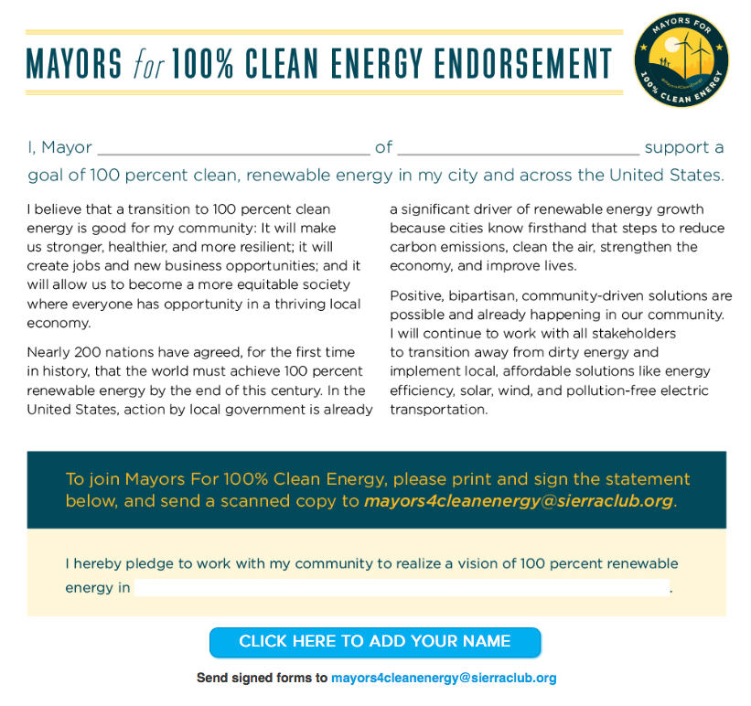
Example:
Ready for 100: Endorsement
Suggested text for Mayors/Village President to post public commitment to sustainable practices
Available@: http://www.sierraclub.org/ready-for-100/mayors-for-clean-energy
Once signed, considered member community by Sierra Club
No funds required

Slide 52
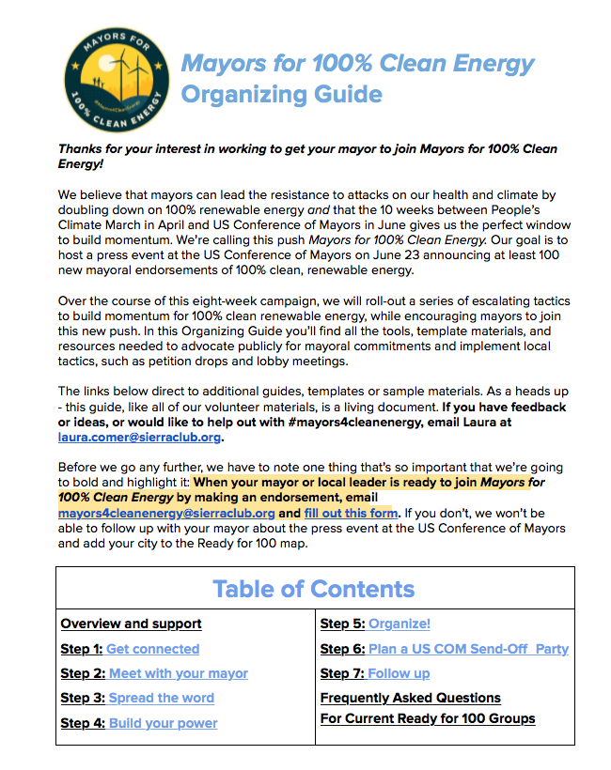
Ready for 100: Guide
18 Page How To Booklet
Available on line as Google Doc @: https://docs.google.com/document/d/1dvxjtK4Ls6vMZ0hs8_YWnYneXNaT2Vy6pgHW0gaCj8g/edit?usp=sharing

Slide 53
Example Asks: Tactics/Actions for Municipality
Create interdisciplinary team to coordinate internal sustainability efforts
Review ordinances to consider sustainability - remove outdated requirements and impediments
Provide dedicated staff to manage sustainability initiatives
Leverage incentives that support sustainability plan
Adopt an environmental purchasing policy
Integrate sustainability into capital planning
Improve energy efficiency in public buildings
Convert municipal fleet to alternative fuel vehicles
Sponsor green events
Notes:
Can we point to examples of municipalities that have adopted these actions, both as motivation for our peers and eventually as Talking Points for use with their local communities [and local media]? Actually, just saw next slide. Do you have additional examples?)

Slide 54
Step 4 Tools: Meet with Community Leaders
Sample Agenda
Resource documents

Slide 55
Step 5 Tools: Refine Strategies
Resource documents

Slide 56
Step 6 Tools: Getting the Word Out
Samples
  Facebook, Instagram, Twitter, etc.
  Standard letters to Editors
  Case studies, stories

Slide 57
Methods of Contact
Type of Contact | How Effective | Necessity | How to Use
Calling | Very Effective | Important | Invite, reminder
Texting | Effective | Important | Reminder
Personal Email | Good | Basic, but necessary | Invite, reminder
Facebook: Messenger | Good | Basic, but necessary | Invite, reminder
Facebook: Groups & Pages | Fair | Basic, but necessary | Expand invitation to new people
Public event posting: MeetUp or Nextdoor | Fair | Helpful, not necessary | Expand invitation to new people
Flyers | Poor | Helpful, not necessary | Reminder

Slide 58
Media Types
Media, Type | Description, Use | Example
Newspaper - Letter to the editor | A 200-300 word letter by a reader about a single issue addressing the readers of the paper and asking them to do something. | “Join me in asking Mayor Jackson to transition the city to 100% clean renewable energy to put Clevelanders in the local high-paying jobs they deserve.” Sample for M4CE.
Newspaper - Op-Ed (opinion editorial) | A 500-800 word opinion piece written by someone who has an important perspective to the issue. | Former mayor writes article supporting transition to renewable energy to demonstrate city leadership. Sample for M4CE.
Newspaper, radio or television story | Reporter covers your campaign or a newsworthy event or case study. | “50 moms marched to city hall with strollers demanding local leadership on renewable energy for healthy clean air.” Template press release.
Media advisory | Send notice of event to multiple media outlets in advance of event
Social media - Blog post | A 200-300 word story about a single issue or event, ideally asking the readers to do something. | Local pastor writes blog post about the benefits of adding solar to the chapel roof.
Social media - Tweet | A 140-character public message on Twitter sharing a link to an article or a petition. | “.@[MAYOR] will you support a goal of 100% clean, renewable energy in [CITY]?! #Mayors4CleanEnergy #ReadyFor100 sc.org/mayors” More sample tweets.
Social media – Facebook, Instagram, Twitter, LinkedIn, Google +, etc. | A public message on a page with an image or info graphic, ideally 80-characters or fewer. Links to article, video or petition. | “Ask Mayor ____ to support 100% clean, renewable energy and join Mayors For 100% Clean Energy! #ReadyFor100 Learn more and take action: sc.org/mayors” More sample posts.
Public Outreach | Petitions, post cards, posters | NEED to DEVELOP and Link

Slide 59
Step 7 Tools: Build Your Power
Sample petitions
Sample presentations

Slide 60
Sustainable Communities and Stakeholders:
Elements of Sustainable Communities
Elected Leadership
Muncipal Staff
Grass roots groups
Commissions & Task Forces
Experts
Muncipal Councils/Boards
School Boards
Park Boards
Libraries
Management
Departments
Stakeholders
Leadership
Shared values
Access to sustainability resources
Education
Public Programs
Best practices
Regulations, laws &, policies
Regional /national resources
COGs
Health
Pollution
Energy/
Utilities
Home grown
Sierra Club
Metro Mayors Caucus
Local business & NFPs
Etc.
Sustainability
Health
Etc.
Etc.
Culture and values
Set Values and Vision
Facilitate results
US /state gov't agencies
MPOs
Ordinances and best practices
Strategic planning
School programs
Higher level education
Chamber of Commerce
Places of Worship
Charities
Public interest group
Where do you already have allies, champions?
Which groups relate to your strategy now and in the future?
Are the groups that you can collaborate with to access other stakeholders?
NFP = Not-for Proftis
COG= Council Of Government
MPO = Metropolitan Planning Organization

Slide 61
Sustainable Communities and Stakeholders:
Strategic Focus Example
Elements of Sustainable Communities
Elected Leadership
Muncipal Staff
Grass roots groups
Commissions & Task Forces
Experts
Muncipal Councils/Boards
Management
Stakeholders
Leadership
Shared values
Education
Public Programs
Best practices
Regulations, laws &, policies
Regional /national resources
Energy/
Utilities
Home grown
Metro Mayors Caucus
Sustainability
Culture and values
Facilitate results
Ordinances and best practices
School programs
Pollution
Where do you already have allies, champions?
Which groups relate to your strategy now and in the future?
Are the groups that you can collaborate with to access other stakeholders?
NFP = Not-for Proftis
COG= Council Of Government
MPO = Metropolitan Planning Organization

Slide 62
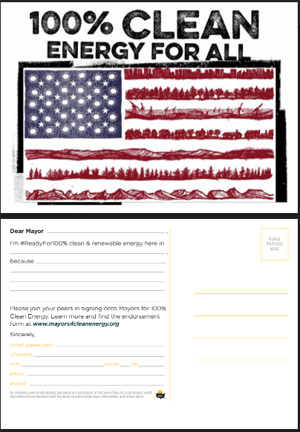
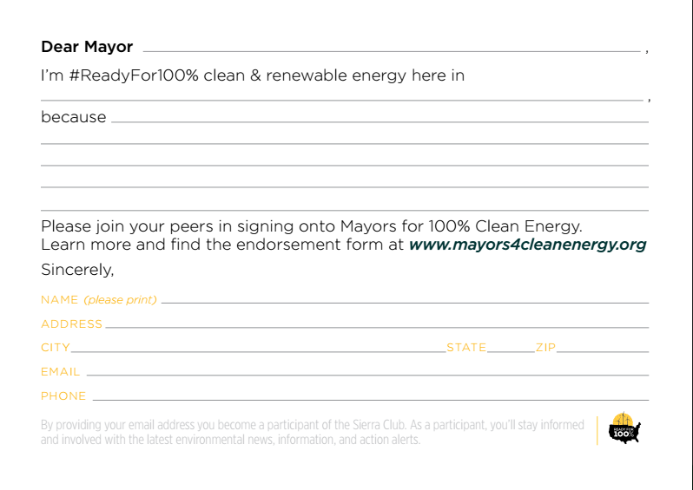
Petition Card Sample

Slide 63
Rally Invite
CLIMATE CHANGE RALLY
WHERE? Offices of Rep. Peter Roskam
2700 International Drive
West Chicago, IL 60185
WHEN? Monday, January 23, 2017
3:30 to 5:00 PM
WHY? Act with common voice with others
Ask Representative Roskam to
          Continue to support the Paris Agreement
          Move forward with the Clean Power Plan
Questions Tim Milburn
logintim@gmail.com

Slide 64
Call Script
Sierra Club script for phone calls to members
Hi, is __________ there?
If constituent
This is ___________. I’m a local Sierra Club member, phoning to tell you about a rally we’re organizing at the office of [your/our] Congressman, Peter Roskam, to demand action on climate change. Is this something you might be interested in?
If new member
This is ___________. I’m a local Sierra Club member. Thanks so much for joining the Club! I’m phoning to tell you about a rally we’re organizing at the office of Congressman Peter Roskam to demand action on climate change. Is this something you might be interested in?
If yes or maybe
Peter Roskam has one of the worst environmental records in Congress. The League of Conservation Voters gave him a score of just 6% in 2015, and his lifetime score is 9%. He has called the scientific consensus on global warming “junk science.” He voted to bar the EPA from regulating carbon and consistently votes against renewable energy and energy efficiency.
Here’s your chance to stand up against this nonsense and to tell Roskam and Trump that the people know climate change is real and that we have to reduce greenhouse gas emissions, the sooner the better.
The People’s Climate Movement has called for 100 hours of resistance after Trump’s inauguration. So we are going to Roskam’s office in West Chicago on Monday, January 23, at 3:30 in the afternoon. Will you join us?
If yes or maybe
Great! Can I send you email with the details? [Monday, Jan. 23, 3:30–5:00 p.m., 2700 International Dr., West Chicago, west side of the DuPage County Airport]. Let me check that I have your email address right. Read address, or obtain.
I really look forward to seeing you there. If you can bring a friend and/or make a sign to wave around, that would be great. Thanks for your time and your commitment! See you soon!
If no (to either initial question or pitch)
No problem. We really appreciate just having you as a member.
If constituent
Will you phone Roskam’s office to tell him that you want him to acknowledge that climate change is real and you want him to start doing something about it? Here’s the phone number: (630) 232-0006. The main things to ask for right now are:
Support the Paris Agreement
Support the Clean Power Plan
Whether or not constituent
Thanks for your time!
Message (leave after 2nd or, better yet, 3rd unsuccessful attempt to phone)
Hi, this message is for __________. This is ____________. I’m a local Sierra Club member, phoning to tell you about a rally we’re organizing at the office Congressman Peter Roskam to demand action on climate change. This is part of 100 hours of resistance that the People’s Climate Movement has called for around Trump’s inauguration. We are going to Roskam’s office on Monday, January 23, at 3:30 in the afternoon. It’s at 2700 International Dr., West Chicago, on the west side of the DuPage County Airport. We hope you’ll come! If you have any questions, please phone Barbara Hill at (847) 991-3204.

Slide 65
Call Script
Hi! How are you?
Listen, respond
Choose one:
Do you have a minute for clean air? We’re not fundraising.
Do you have a minute for clean energy? We’re not fundraising.
We’re working to fight climate change. Can you stop? We’re not fundraising.
Once they stop:
Thanks so much for stopping! I’m _____. What’s your name?
Listen, respond.
Nice to meet you.
I’m a volunteer with the Sierra Club. We’re collecting voter pledges saying that you’re a voter and you support clean energy.
As you know—a lot is on the line this election season—from climate change to the economy.
One thing that I know is clear for me—we all win when we move to clean energy. By switching to renewable energy and energy conservation, we can create good jobs, save on utility bills, and give our kids clean air and a brighter future by cutting the carbon pollution that threatens our planet.
We need leaders who are 100% committed to clean energy.
That’s why we’re collecting voter pledges! By signing this pledge, you’ll be telling our elected officials that you’re 100% committed to clean energy, and that you support working towards a goal of 100% clean energy.
Politicians don’t lead unless we do. Can you take a minute to pledge your support for clean energy?

Slide 66
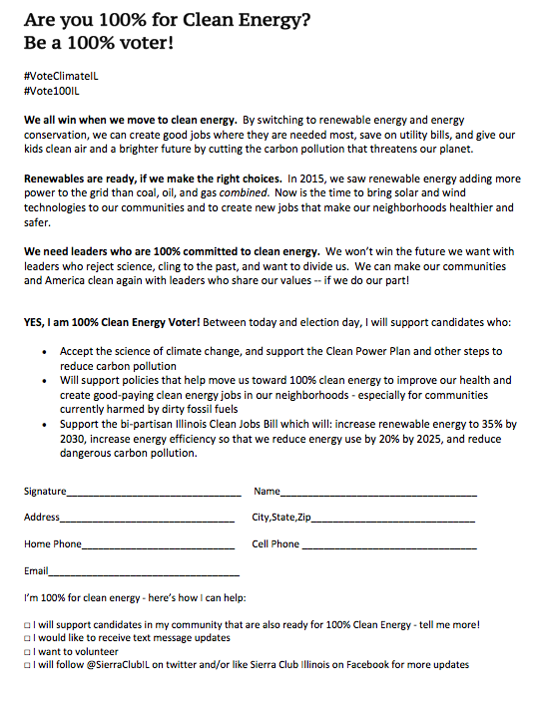
Petition Sample

Slide 67
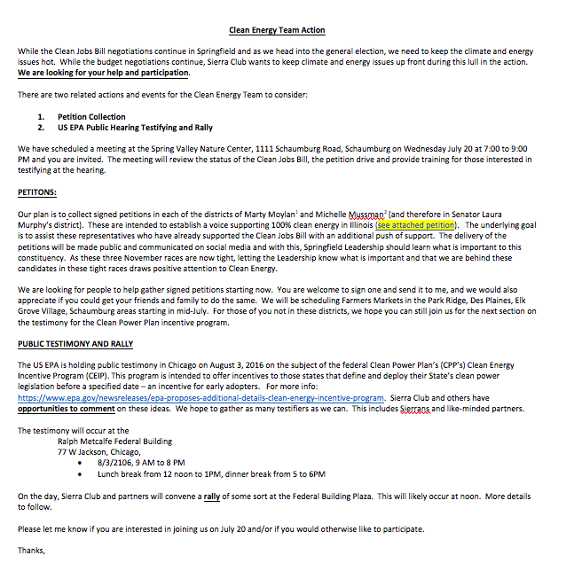
Action Letter

Slide 68
Step 8 Tools: Plan and Organize Events and Actions
Sample agenda
Sample sign-in sheets
Sample Follow-up letter

Slide 69
Step 9 Tools: Convene/Host Event or Action
Sample agenda
Sample invitation
Sample petition
Sample press package

Slide 70
Clean Energy Event Agenda
 | Set up: Send someone to the mayor’s office to let them know you’re on our way. Have everyone meet you at another location near the mayor’s office. Introduce yourself, give an overview of importance of issue and purpose of today, thank (name the groups present/involved) for attending, give an overview of event agenda. Make sure everyone knows who is speaking, what other roles are, and pass out signs for people to hold. | 15 Minutes | Joe B.
 | Constituencies speak. Thank the mayor or staff for meeting with you, give an overview of the issue and introduce the first speaker. Speakers explain who they are, why this matters to them, and what they’d like the mayor to do (2-3 min each). | 10-15 Minutes | Group
 | Present the petition cards and make the final ask. Restate your core key messages and why your mayor should endorse M4CE. Hand them the blank endorsement form for them to complete. | 5 Minutes | Connie W
 | Mayor or staff receives the petitions and responds. | 10 Minutes | Mayor
 | Thank the mayor or staff for the opportunity to have voices heard on this critical issue… and follow up with either saying a) “thanks for saying yes” and take celebratory photo or b) “we look forward to talking with you about this issue more.” Strong exit as a group. | 5 Minutes | Joe B.
 | Outside thank everyone for coming, explain the impact the meeting had invites group to attend next event or meeting. Take more photos! | 5 Minutes | Joe B.
 | Debrief! Ask the best volunteers (even if they are first-timers) if they’d like to stick around for a quick debrief. A debrief (even just a quick go-around with what went well and what could improve) can be an effective way to spend more time with volunteers, get to know them, thank them, and get them plugged into more activities. | 5-10 Minutes | Core Team

Slide 71
Step 10Tools: Follow-up
Sample letters
Sample follow-up action plan
Recognition

Slide 72
Sustainability Recognition
Sierra Club National Awards
Municipal Awards
  Governor's Sustainability Awards (Illinois) – Awarded to municipalities
  Green Government Awards (may be defunct)
  ICMA Local Governance (sustainability) Awards (International City/County Management Association)
Educational Institution Awards
  Green Ribbon Schools – awarded to schools
  Illinois Green Economy Network (Community Colleges)
  STARS program - Sustainability Tracking, Assessment & Rating System™ for colleges and universities
Business Awards
  Governor's Sustainability Awards (Illinois) – Awarded to businesses
  Illinois Green Business Association
  US EPA Listings
  Center for Corporate Climate Leadership
  WasteWise
  SmartWay Transport Partnership
  Downers Grove Green Business Recognition Program – for corporations
  Chicago Area Clean Cities (USDOE) – recognition program for green fleets

Slide 73
Sustainability Recognition
Facility Awards
  US Green Building Council Emerald Awards Program
  University of Illinois Energy Conservation Recognition Program
Other Programs
  Illinois Environmental Council – legislative rating system for sustainability
Other green IEC certification programs include:
  USDA Organic – For farms or handling facilities that comply with USDA organic regulations;
  USDA Biopreferred – For commercial or industrial products (other than food or feed) that are composed in whole, or in significant part, of biological products, renewable agricultural materials, or forestry materials;
  Energy Star – For products that meet certain energy efficiency requirements;
  Design for the Environment – For products that contain only ingredients meeting stringent criteria developed by EPA scientists;
  WaterSense – For products and programs that save water without sacrificing performance or quality;
  EPEAT – Specifically for computers and displays that meet comprehensive criteria for design, production, energy use, and recycling

Slide 74
THANK YOU
Tim Milburn
logintim@gmail.com
847-826-3314
Notes:
Feedback
What was good, missing, do this again?
Rating?

Slide 75
EXTRA Materials: Frequently Asked About Subjects
Municipal Aggregation
Solar Photovoltaic
Energy Conservation
Etc.
Concept: create educational resources for each of these subjects and make available (Aggregation example)

Slide 76
Municipal Aggregation
Municipal aggregation applies for electricity and natural gas, but has been much more commonly applied to electricity
Municipal aggregation active in some communities – to see the status of your community: https://www.pluginillinois.org/MunicipalAggregationList.aspx
  Communities that sign up for aggregation benefit from volume purchasing and can negotiate a better rate than an individual consumer. Typically, a municipality will apply the “Opt-out” process, which means everyone in the town is included and people can choose to opt out of the town’s commitment. There is also an Opt-In process, which few communities have used, which means the town asks people to join and otherwise they are not included. This typically results in fewer participants and less purchasing leverage.
  Many communities that signed up in the first wave (e.g. 2012-ish) have chosen to not re-up. At this time, ComEd was tied into some long-term contracts that forced their rates to a certain level. Alternative Retail Electricity Suppliers (ARES) were then able to broker power contracts from other power sources and beat ComEd’s prices. In June of 2013, the ComEd contracts ended and they were able to negotiate (much) better rates and thus become very competitive with the ARES. This change led to many communities not re-upping their aggregation contracts
  Data for electricity is manage on the Plug-in Illinois site.

Slide 77
Municipal Aggregation
If your community does not offer aggregation, you are on your own to select your electricity supplier. Note, ComEd will still provide the billing services in all cases (in Northern Illinois).
  If you want to learn about your supplier choices, the data are available at https://www.pluginillinois.org/Suppliers.aspx . This site lists 57 ARES.
  I spoke to CUB and they used to maintain a fact sheet on the ARES. There are so many choices and changes now they have discontinued this. What they do provide is a Consumer’s Guide for ComEd Customers: https://citizensutilityboard.org/electriccompetitioncomed/ This helps people avoid some pitfalls. Nonetheless, it is up to the consumer to do the shopping.
  One recommendation before you shop is to check ComEd’s rates. https://www.pluginillinois.org/FixedRateBreakdownComEd.aspx
  From here, apply the CUB Consumers Guide and pick some ARES and find their rates or call. Be sure to understand their terms and conditions in addition to rates. Can the rates change at their discretion? What happens if you want to change suppliers?

Slide 78
Municipal Aggregation
If you want to “buy” renewable energy, understand that this is not how it actually works. What is available is to fund the Renewable Energy Credit (REC) market through a billing option. Electrons cannot be bought and sold from power source to consumer, per se – they flow onto the grid and flow randomly to many places. This means you cannot buy power from a particular wind turbine or wind farm – because the electricity is mixed up. So, what is done is RECs are paid to the power companies who generate renewable energy (mainly wind power). These RECs are funded by “green energy” contracts, either through aggregation or through individual sales. Typically, this means if you are buying “green power” you are paying a little more than “brown power” (coal, natural gas and nuclear) to support the REC market. Some of the ARES offer green power programs and you need to shop around to see.
This is a clunky system at best, and puts the burden on the consumer to pick their energy supplier from 57 alternatives. I would guess many people have gone back to ComEd or stuck with the ARES they used when aggregation was available (for those towns that have stopped aggregation). If this applies to you, as a minimum, I would suggest you check your rate against ComEd’s. if your town does not aggregate, you may want to call and see if this is under consideration. Volume purchase should still carry some value and you might get your town to do the shopping.
My CUB contact said she would speak to her communication person to see if they might offer more specific advice, but I would not wait on this. They cannot pick and choose ARES for the consumers. Similarly, municipalities cannot pick and choose suppliers outside of the aggregation process.

