Slide 1
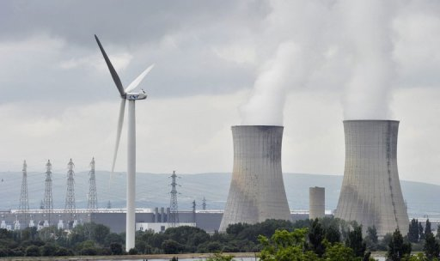
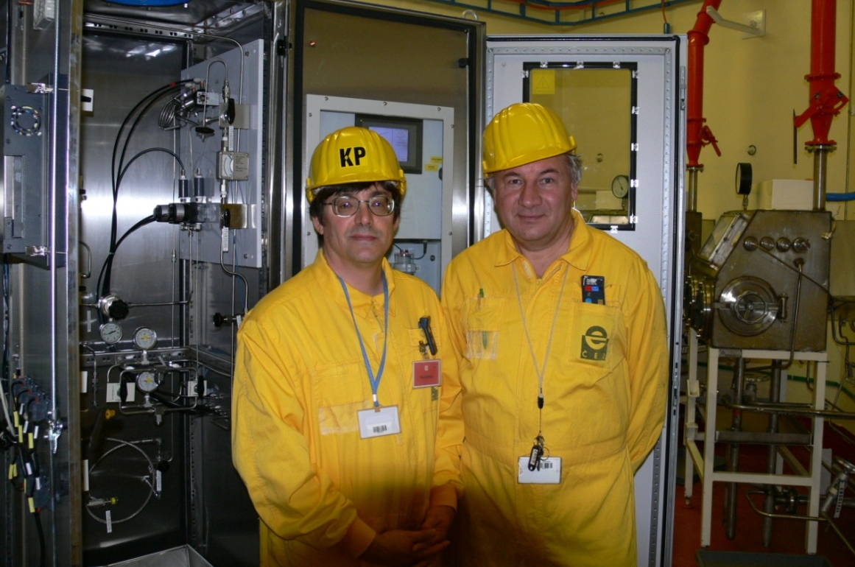
Thorium, Molten Salt Reactors, and Green Energy
Tim Pearson – Vice President NEXTChem Process Analyzers
Bachelor of Science – Chemistry; University of Toledo
Master of Science – Analytical Chemistry; Miami (OH) University
Work Experience :
Saudi Aramco
CEZ / Westinghouse
Canadian Natural Resources
American Electric Power (AEP)
Philips (LED)

Slide 2
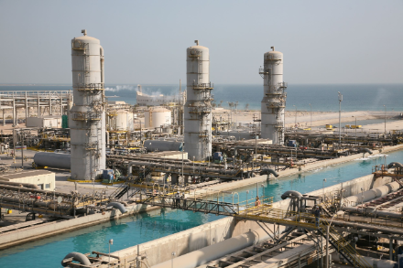
Thorium, Molten Salt Reactors, and Green Energy
Working with Saudi Aramco I became an Environmentalist!
I learned that Saudi Arabia is
running out of oil; and is planning
to covert to a chemical
production economy.

Slide 3
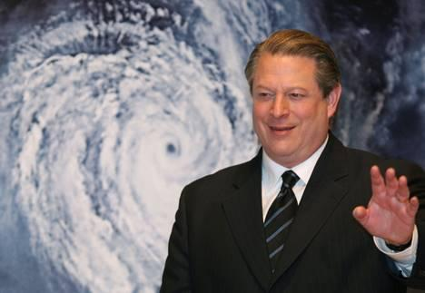
Thorium, Molten Salt Reactors, and Green Energy
About the same time I was shocked by the reality of Saudi Oil I also became aware of the issue of Global Warming!
What do we do?
What do I do?

Slide 4
Thorium, Molten Salt Reactors, and Green Energy
I began to ask questions:
What is the safest power source
What power source produces no carbon dioxide
What power source is scalable to size of our problem
What power source can we actually afford

Slide 5
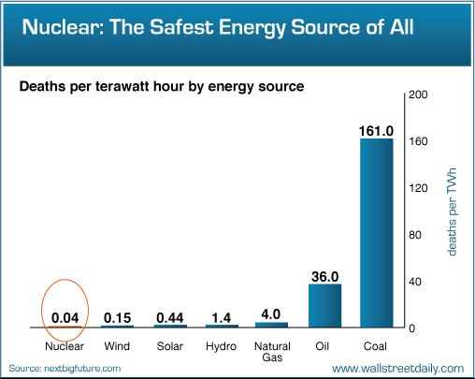
Thorium, Molten Salt Reactors, and Green Energy
What is the safest
power source?

Slide 6
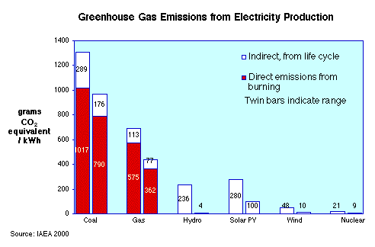
Thorium, Molten Salt Reactors, and Green Energy
What Energy Source produces the least amount of Carbon Dioxide?

Slide 7
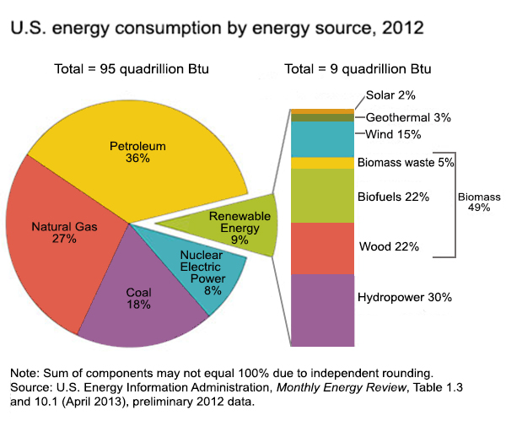
Thorium, Molten Salt Reactors, and Green Energy
What power source is
Scalable to our problem?

Slide 8
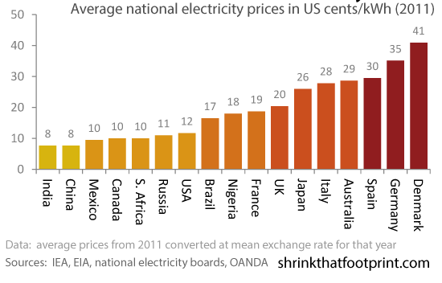
Thorium, Molten Salt Reactors, and Green Energy
What power source can
we actually afford?

Slide 9
Thorium, Molten Salt Reactors, and Green Energy
Based on these facts the choice is clear.
Nuclear Energy will save the World!

Slide 10
Thorium, Molten Salt Reactors, and Green Energy
Why didn’t it happen?

Slide 11
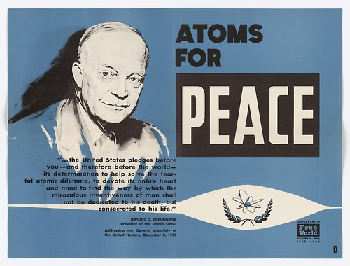
Thorium, Molten Salt Reactors, and Green Energy
Why don’t we have a Nuclear Economy ?
Why do we have Uranium
fueled Light Water Reactors
(LWR) if there are
better reactor designs?

Slide 12
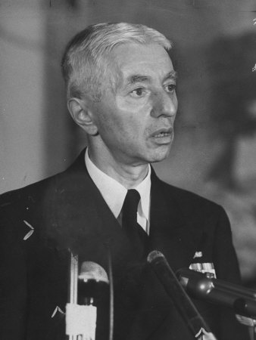
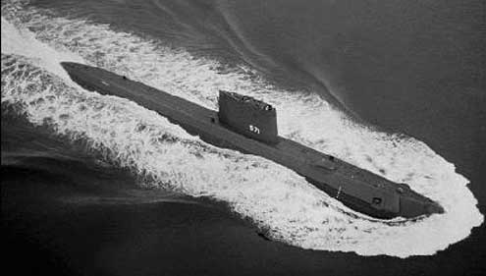
Thorium, Molten Salt Reactors, and Green Energy
Admiral Rickover was determined to have a Nuclear Navy
In 1954 the US launched the USS Nautilus its first operational Nuclear Submarine; and it used a Uranium LWR Reactor

Slide 13
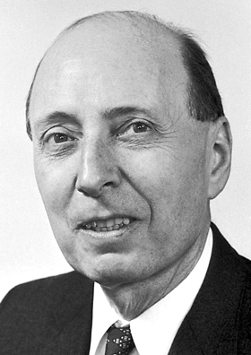
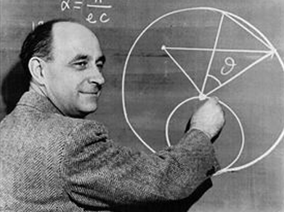
Thorium, Molten Salt Reactors, and Green Energy
Two Visions at the Dawn of the Nuclear Age
Eugene Wigner
Use Slow (Thermal) Neutrons using the
Thorium – Uranium Fuel Cycle
Oak Ridge National Labs (Molten Salt)
Enrico Fermi
Use Fast Neutrons using the
Uranium – Plutonium Fuel Cycle
Argonne National Labs (Fast Breeder)

Slide 14
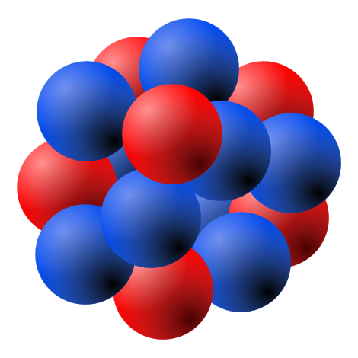
Thorium, Molten Salt Reactors, and Green Energy
Both Visions were for “Breeder” Reactors
To understand a “Breeder” Reactor some
Nuclear Nomenclature is needed.
Fertile Material (A material that must absorb a neutron and converts to a Fissile Material).
Fissile Material ( A material that is capable of sustaining a nuclear fission chain reaction).

Slide 15
Thorium, Molten Salt Reactors, and Green Energy
What is the Distribution of Natural
Fertile and Fissile Materials
Thorium 232 – Fertile Material
Uranium 238 – Fertile Material
Uranium 235 – Fissile Material

Slide 16
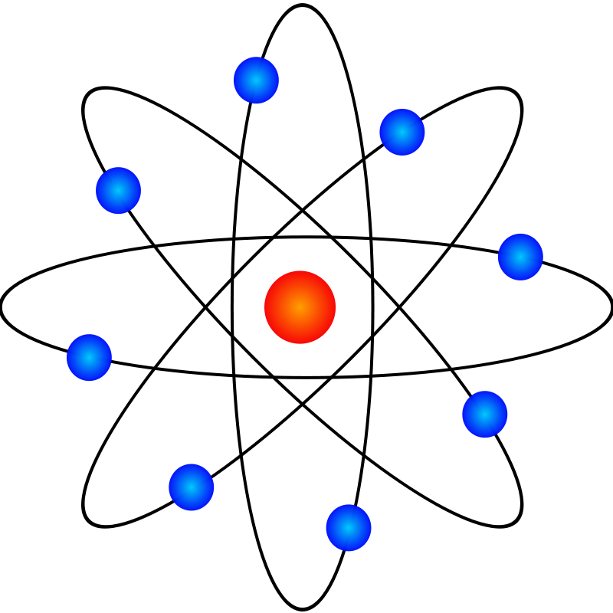
Thorium, Molten Salt Reactors, and Green Energy
Thorium 232 and Uranium 238 Conversions
Th 232 + neutron = U233
Uranium 233 (Fissile Material)
U238 + neutron = Pu239
Plutonium 239 (Fissile Material)

Slide 17
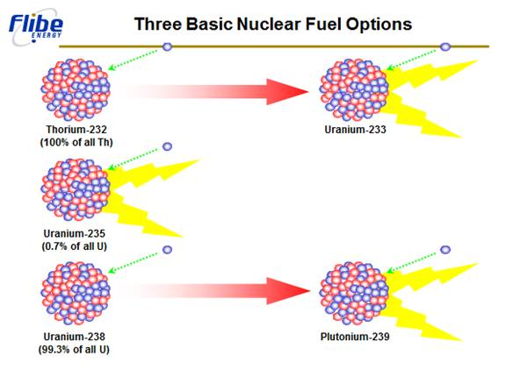
Thorium, Molten Salt Reactors, and Green Energy
Three Possible Nuclear Fuels
Thorium 232
Uranium 235
Uranium 238

Slide 18
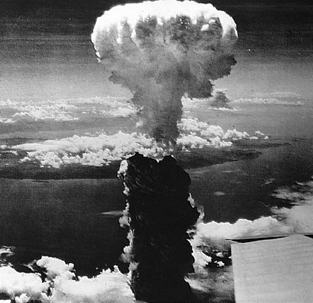
Thorium, Molten Salt Reactors, and Green Energy
Unfortunately Nuclear Fuel can have Dual Use
Uranium 235 (Little Boy Bomb)
Uranium 238 (Fat Man Bomb)
Thorium 232 (Bad Bomb Material)
In the future I would like to give a talk
about proliferation

Slide 19
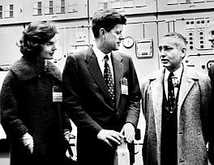
Thorium, Molten Salt Reactors, and Green Energy
Molten Salt Reactor Experiment
Oak Ridge National Labs
(1964 – 1969)
Radical new design using
molten salts not solid fuel
Greatly improved safety features
over existing LWR Reactors

Slide 20
Thorium, Molten Salt Reactors, and Green Energy
Molten Salt Reactor (MSR) Experiment
Dr. Weinberg’s concerns about
LWR Reactors Safety caused problems
with the Nixon Administration
Dr. Weinberg was fired as Director
ORNL 1973
All MSR Reactor work ends in 1975

Slide 21
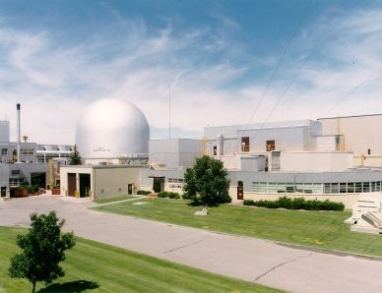
Thorium, Molten Salt Reactors, and Green Energy
Integral Fast Reactor (IFR)
Argonne National Labs
(1984 – 1986)
The reactor used U238 as metallic fuel
and Liquid Sodium as the coolant
The (IFR) Reactors has many safety
advantages over LWR Reactors

Slide 22
Thorium, Molten Salt Reactors, and Green Energy
Integral Fast Reactor (IFR)
April 1986 the IFR Reactor Successfully
Passed a Loss of Coolant Test
April 1986 Chernobyl Reactor #4 Failed a
Safety Test resulting in Disaster
In 1994 the IFR Reactor program was
cancelled due to budget cuts

Slide 23
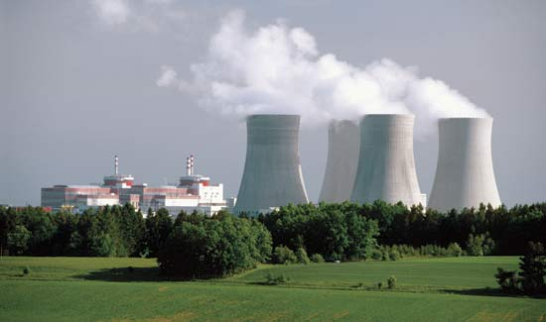
Thorium, Molten Salt Reactors, and Green Energy
The Civilian Nuclear Reactors we use today are not significantly different from those developed for Admiral Rickover in the 1950s!

Slide 24
Thorium, Molten Salt Reactors, and Green Energy
However, even these Cold War
Dinosaurs (LWR Reactors) are the Safest form
of Energy we have Today!
What would happen if we had
even Safer and more Efficient
Reactors?

Slide 25
Thorium, Molten Salt Reactors, and Green Energy
WHAT ABOUT NUCLEAR WASTE!

Slide 26
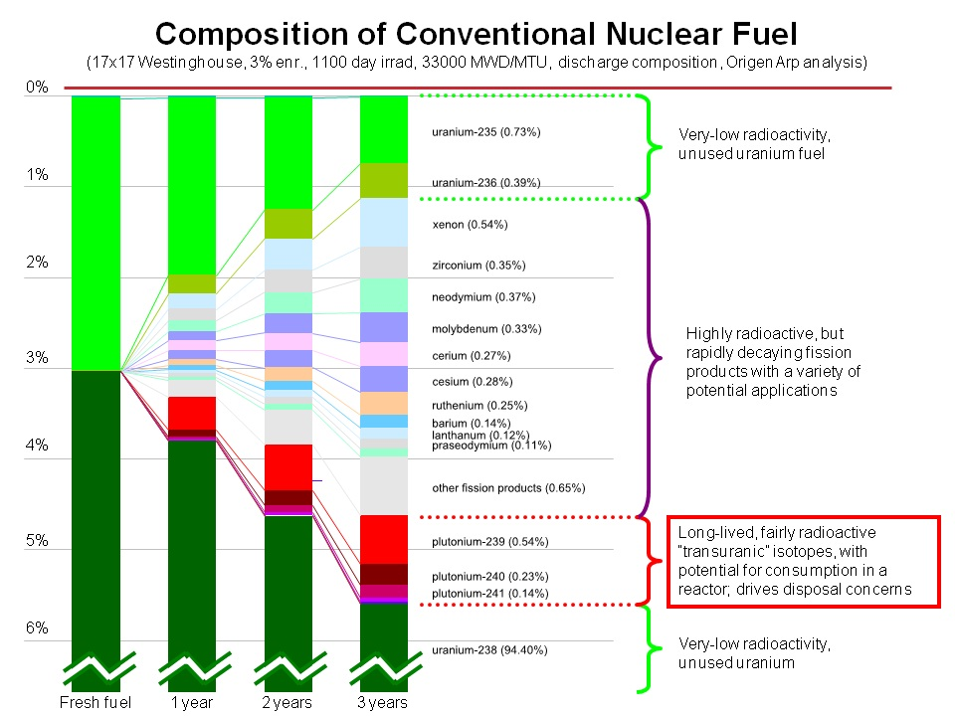
Thorium, Molten Salt Reactors, and Green Energy
What is Nuclear Waste
or Spent Nuclear Fuel?
94.5% U238 (fertile)
1% U235/236 (fissile)
1% Actinides
3.5% Fission Products
Only 5% of the Uranium
is consumed after 3 yrs

Slide 27
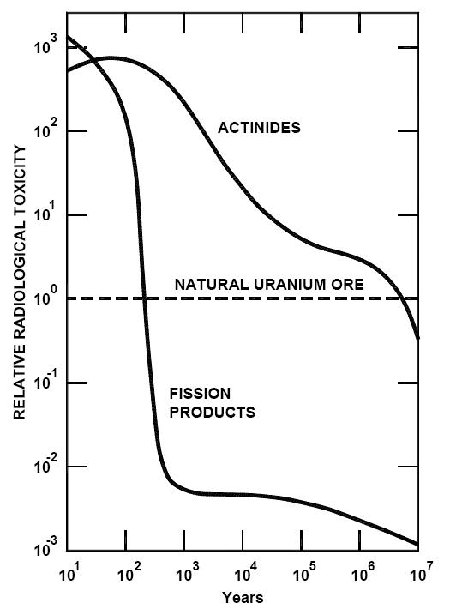
Thorium, Molten Salt Reactors, and Green Energy
Is there a way to make
Nuclear Waste Safer?
If we can remove and destroy
the actinides (transuranics)
we greatly reduce the storage
time and radiological
toxicity

Slide 28
Thorium, Molten Salt Reactors, and Green Energy
WHAT ABOUT THE PLUTONIUM IN
SPENT FUEL!
CAN’T IT BE USED TO MAKE WEAPONS?

Slide 29
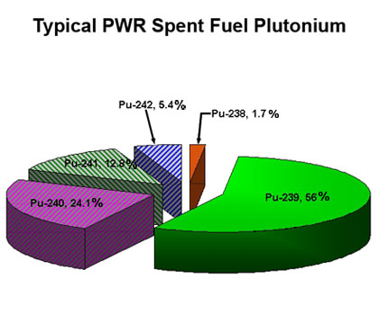
Thorium, Molten Salt Reactors, and Green Energy
Weapon Grade Plutonium has a
very specific recipe.
< 90% Pu 239
>7% Pu 240
Spent Fuel does not meet this
Specification
Plutonium can not be Isotopically Separated

Slide 30
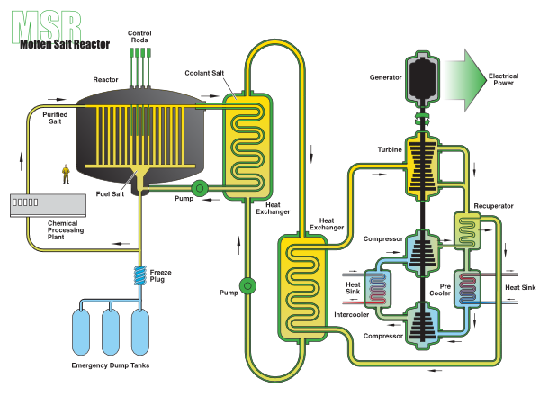
Thorium, Molten Salt Reactors, and Green Energy
Turn the Waste into Energy!
Using MSR Reactors or
IFR Reactors we can
Consume the World’s Nuclear
Waste and Generate huge
amounts of Electric Power

Slide 31
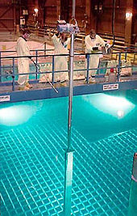
Thorium, Molten Salt Reactors, and Green Energy
Turn the Waste into Energy!
Total Worldwide Electric
Demand can be meet for
a minimum of 70 years
using the world’s stockpile of
Spent Nuclear Fuel

Slide 32
Thorium, Molten Salt Reactors, and Green Energy
“It may be that one day after all the
power reactors have been shut down
and folks have been weaned themselves
off of nuclear energy, some type of
molten salt reactor may be useful for
waste management. But not now! To
do it now would just be unleashing
the dogs of nuclear expansionism” Dr. Gordon Edwards
President - Canadian Coalition for Nuclear Responsibility

Slide 33
Thorium, Molten Salt Reactors, and Green Energy
WHAT ABOUT THE SAFETY OF
MSR REACTORS!
LWR REACTORS HAVE HAD THREE
MAJOR ACCIDENTS AND ONE WAS
CATASTROPHIC!

Slide 34
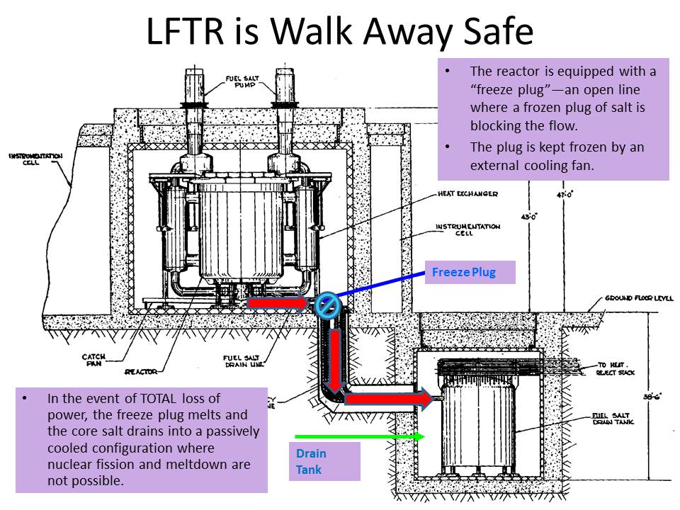
Thorium, Molten Salt Reactors, and Green Energy
MSR Reactors are fundamental
different from LWR Reactors
There cannot be a meltdown
the fuel is already melted
They operate at low pressure;
just above atmospheric pressure.
They can be shut off with no power

Slide 35
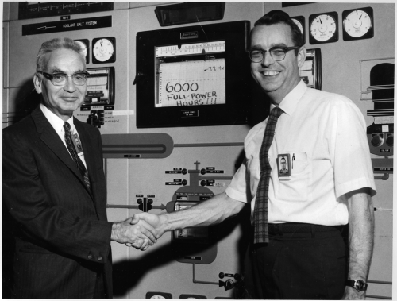
Thorium, Molten Salt Reactors, and Green Energy
There are some additional
important safety features
in the MSR Reactor design
Automatic Containment
of fuel and fission products
when cooled to solid salt
Xenon Gas is easily removed this
was one of factors leading to Chernobyl

Slide 36
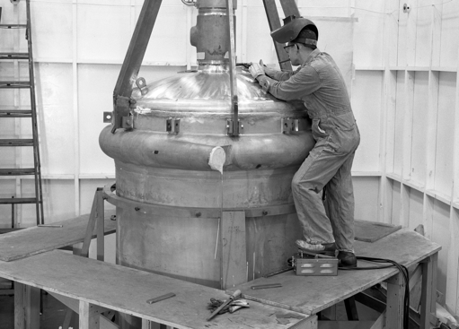
Thorium, Molten Salt Reactors, and Green Energy
The most important feature
of this reactor is that it is
“Self Controlling”
When the salt is too hot
it expands and reduces
“activity” and when it is
too cold it shrinks
and “activity” increases.

Slide 37
Thorium, Molten Salt Reactors, and Green Energy
I WILL NEVER TRUST AN ENERGY SOURCE
THAT INVOLVES RADIOACTIVITY!

Slide 38
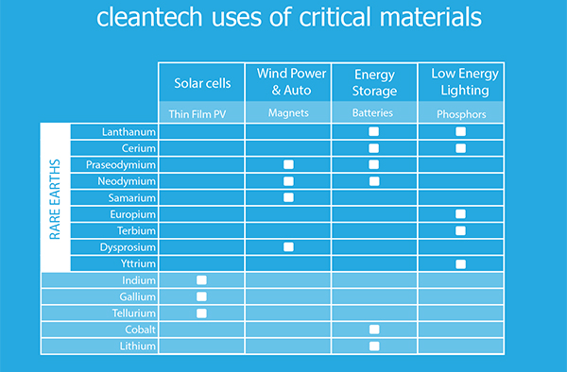
Thorium, Molten Salt Reactors, and Green Energy
Almost all types of Green Energy require Rare Earth Elements

Slide 39
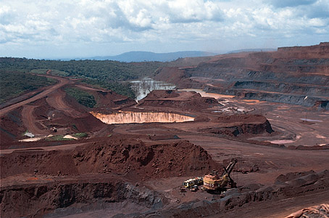
Thorium, Molten Salt Reactors, and Green Energy
Almost all known ways to mine
Rare Earth Elements produce
Radioactive Thorium
Each ton of Rare Earth Elements
produces approximately one
ton of Thorium

Slide 40
Thorium, Molten Salt Reactors, and Green Energy
GREEN ENERGY MANUFACTURING HAS A NUCLEAR WASTE PROBLEM!

Slide 41
Thorium, Molten Salt Reactors, and Green Energy
Until the Thorium-Rare Earth Issue is resolved US Green Energy Manufacturing will never grow into a major industry.
Until the US has a policy to deal
with the Thorium-Rare Earth Issue
there will not be a large increase
in US Green Jobs
Senate Bill S2006 and House Bill
HR 4883; deal with this issue

Slide 42
Thorium, Molten Salt Reactors, and Green Energy
What will these bills achieve?
Setup the “Thorium Bank” to receive Thorium from Rare Earth Mines allowing US mines to begin producing again and allowed the “Bank” to find uses for this Thorium including Energy
S. 2006 / HR 4883 National Rare Earth Cooperative Act of 2014
Prognosis 1-2% chance of being enacted

Slide 43
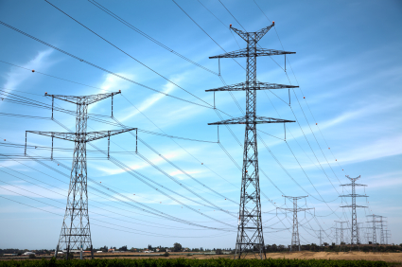
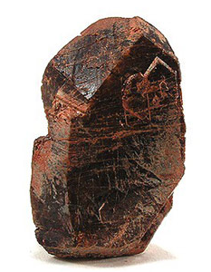
Thorium, Molten Salt Reactors, and Green Energy
How do we convert Thorium to Energy?
=

Slide 44
Thorium, Molten Salt Reactors, and Green Energy
Thorium as a Molten Salt
is the Key!
Using Thorium in a
Molten Salt takes
Advantage of the MSR
Reactor safety features
Being a liquid allows
continuous reprocessing

Slide 45
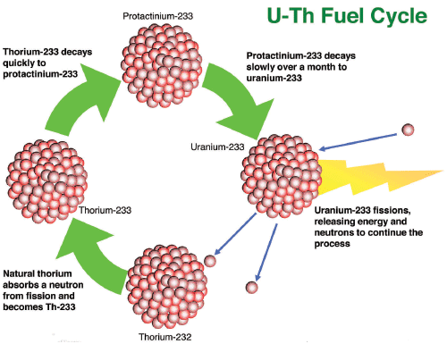
Thorium, Molten Salt Reactors, and Green Energy
Another key advantage
Of using the Th232 – U233
Fuel Cycle is the minimization
of Actinides (Transuranics)
Finally Thorium MSR
Reactors can be used
to dispose of Thorium
Mine Waste and making
Huge Amounts of Energy!

Slide 46
Thorium, Molten Salt Reactors, and Green Energy
NUCLEAR REACTORS WILL ALWAYS BE TOO EXPENSIVE,
WE CANNOT AFFORD TO BUILD NEW ONES!

Slide 47
Thorium, Molten Salt Reactors, and Green Energy
Modular Construction has
greatly reduced the construction
Cost of Modern
LWR Reactors
Westinghouse AP1000
has demonstrated
this principal

Slide 48
Thorium, Molten Salt Reactors, and Green Energy
EVEN IF NUCLEAR POWER IS NEEDED FOR
A CARBON-FREE FUTURE IT WILL NEVER GET
PUBLIC SUPPORT!

Slide 49
Thorium, Molten Salt Reactors, and Green Energy
Political Alliances are possible if all the Low Carbon Industries work together.
In the UK; Wind Companies,
Carbon Capture Association, and
Nuclear Industry all worked
together to help pass an aggressive
Low Carbon Target
Even Greenpeace-UK Agreed!

Slide 50
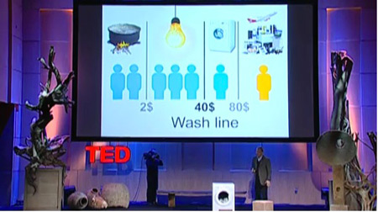
Thorium, Molten Salt Reactors, and Green Energy
We will need to work fast because Poorer Nations want Electric Power to help raise their People out of Poverty

Slide 51
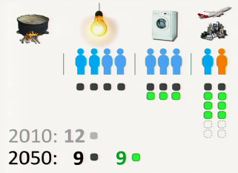
Thorium, Molten Salt Reactors, and Green Energy
The conclusions from Hans Rosling’s TED Talk
We need all Humans to be at
a minimum “Bulb People”
“Air People” need to do the most
to reduce Carbon Dioxide
By 2050 at least 50% of Energy
must be Carbon Free

Slide 52
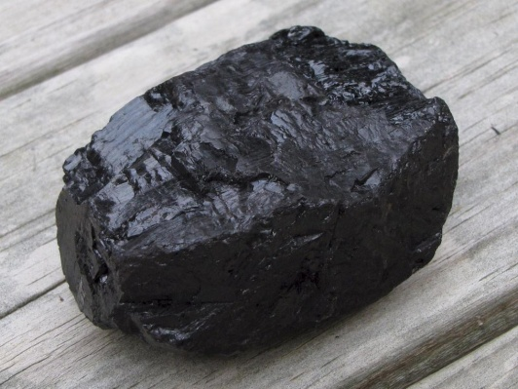
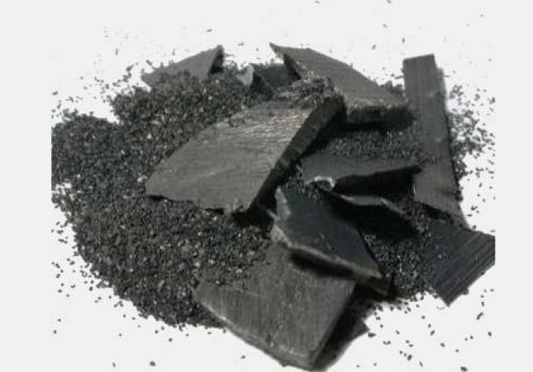
Thorium, Molten Salt Reactors, and Green Energy
More Energy Usage is not Bad!
Because it is the only way to
Stop Overpopulation. Coal
India has the 1/5 of World
Thorium Reserves and the Thorium
Fifth Largest Coal Reserves!
What will they use???

Slide 53
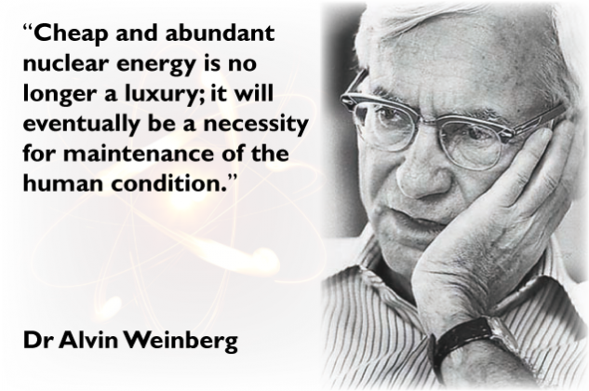
Thorium, Molten Salt Reactors, and Green Energy

